Slide 1
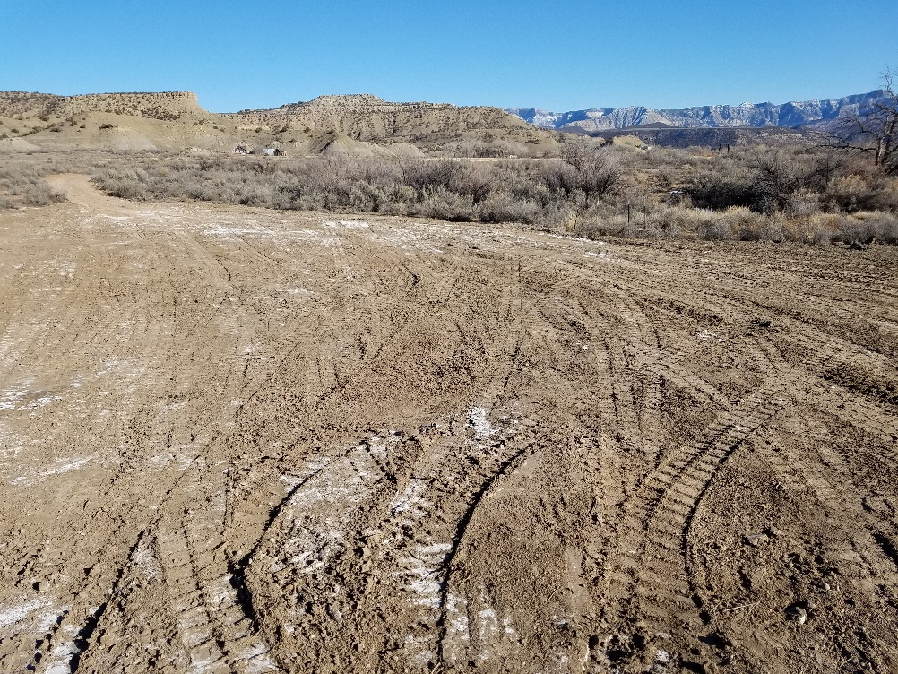
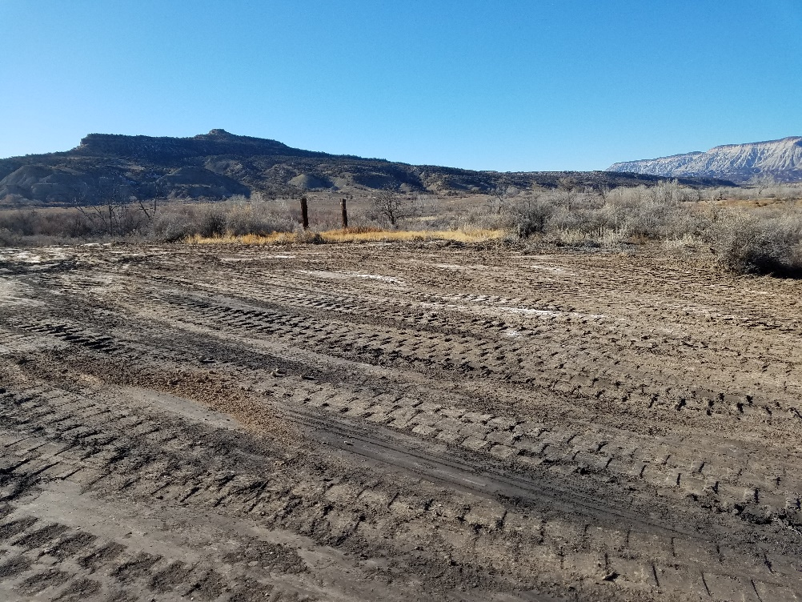
Inspection Photos
Location Name: De Beque
Access and laydown area for Govt-Baker 1-A
API 077-05145
Access and laydown area for Debeque
API 077-05148

Slide 2
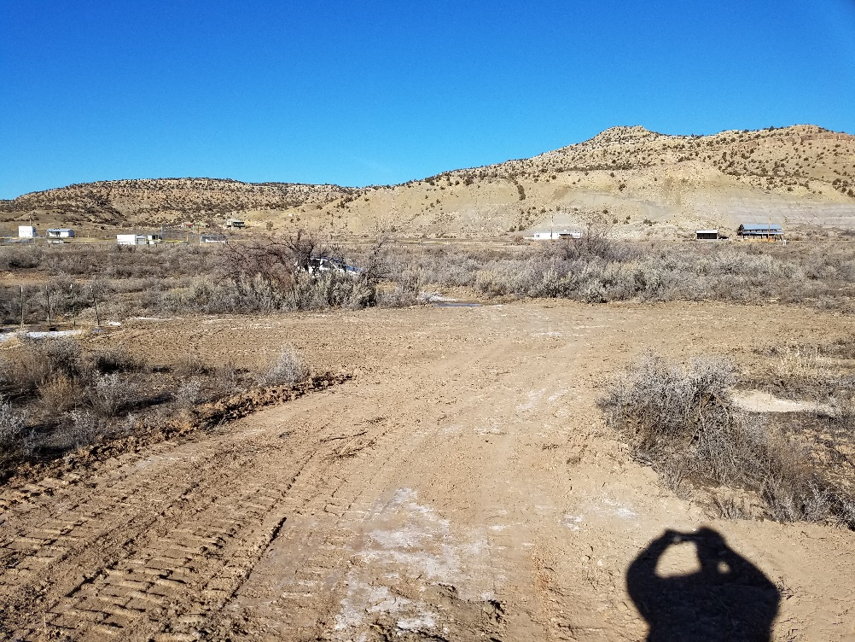
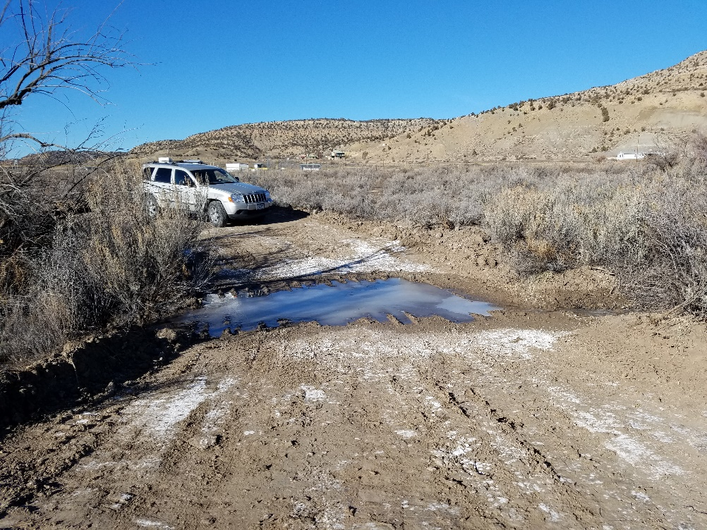
Inspection Photos
Location Name: De Beque
Access and laydown area for Flushwell 1
API 077-10327
Low water crossing to access Geowell 1, Flushwell 1 and Debeque 1.

