Slide 1
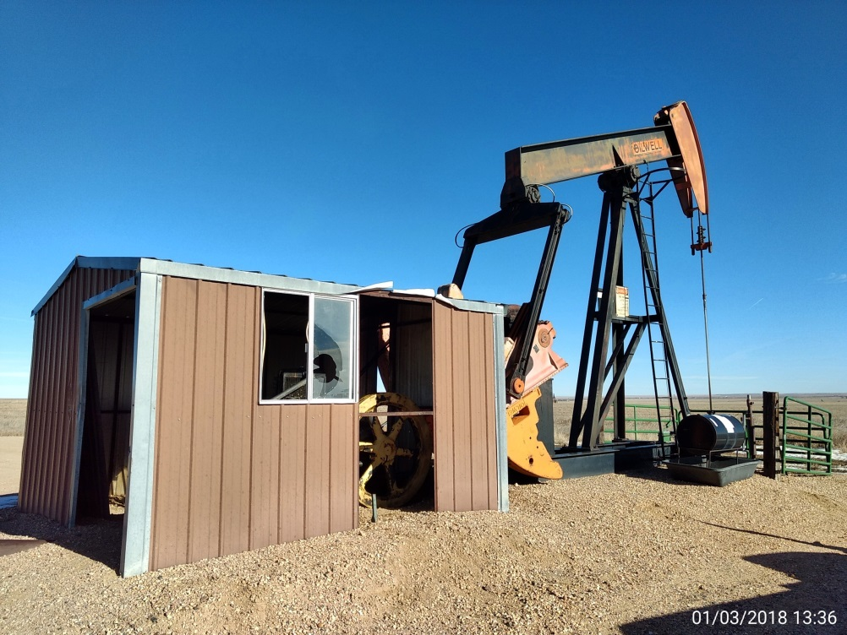
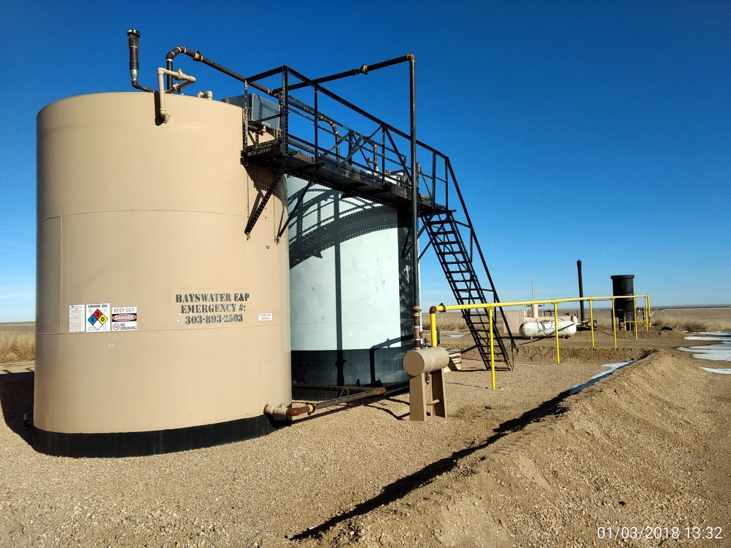
Inspection Photos
Location Name: Zarlengo 21-4
API: 05-001-09468
Wellhead
Battery

