Slide 1
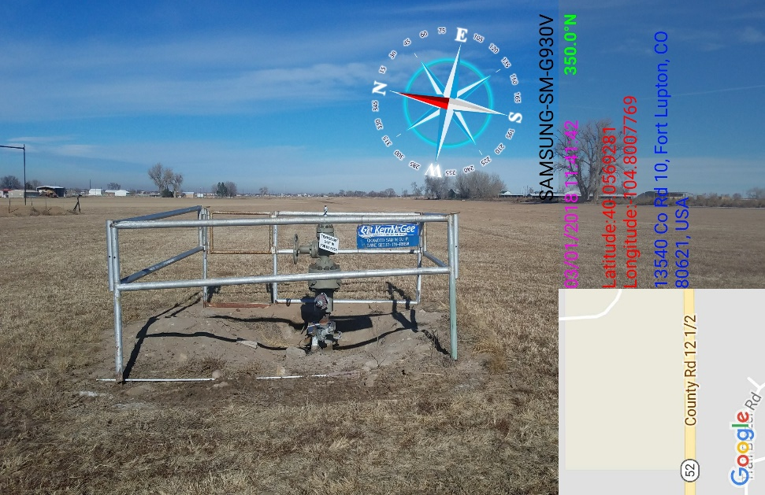
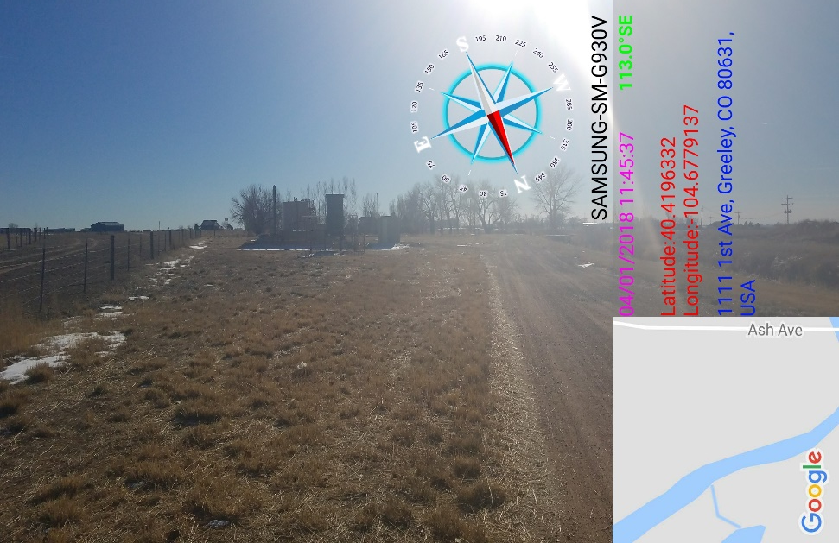
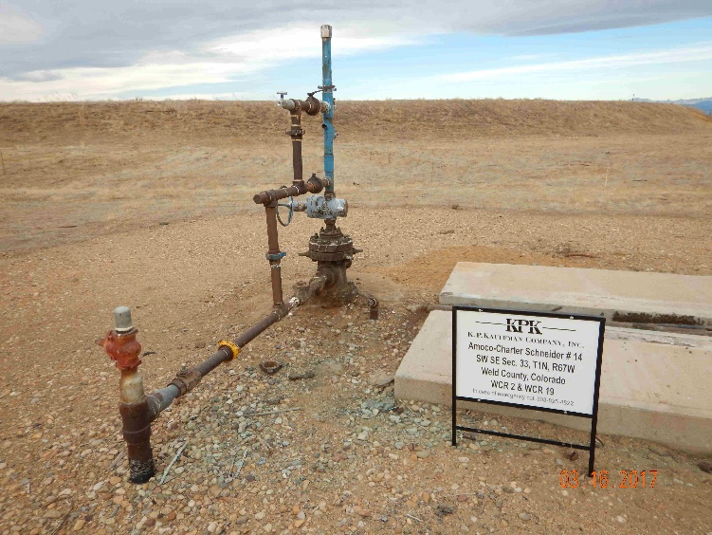
Inspection Photos
Location Name: Bayswater Ritch Battery
API: 05-123-32135
Location Photo

