Slide 1
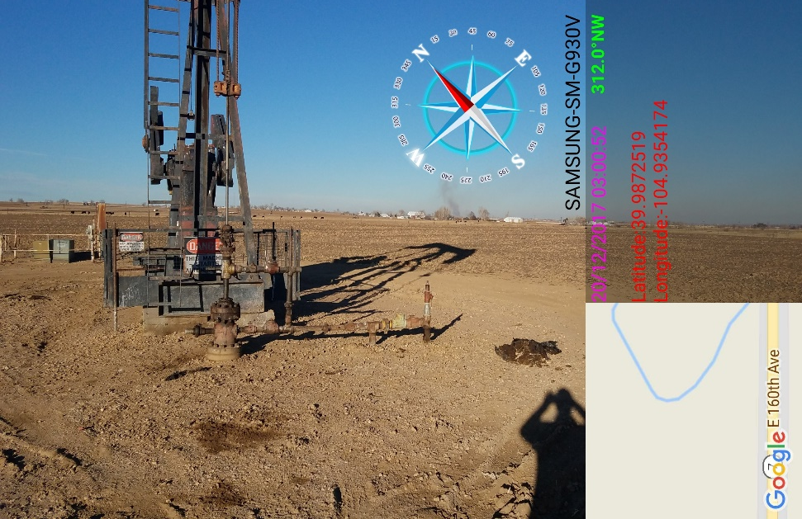
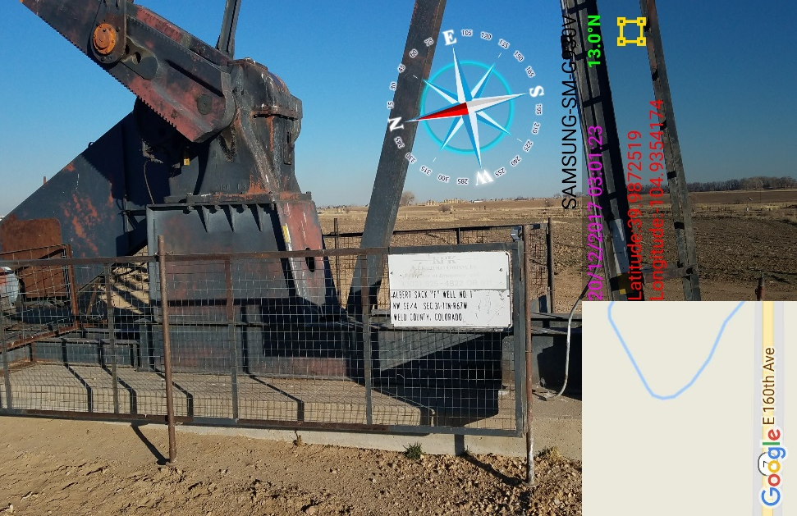
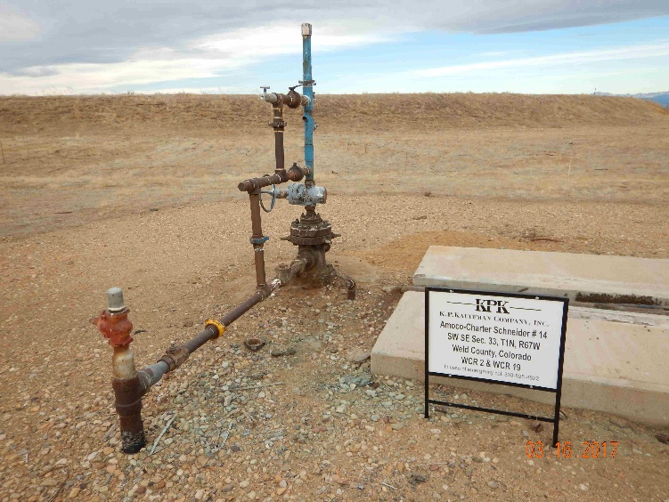
Inspection Photos
Location Name: KPK Albert Sack F #1
API: 05-123-10092
Debris and stained soil
Faded KPK Emergency phone #

