Slide 1
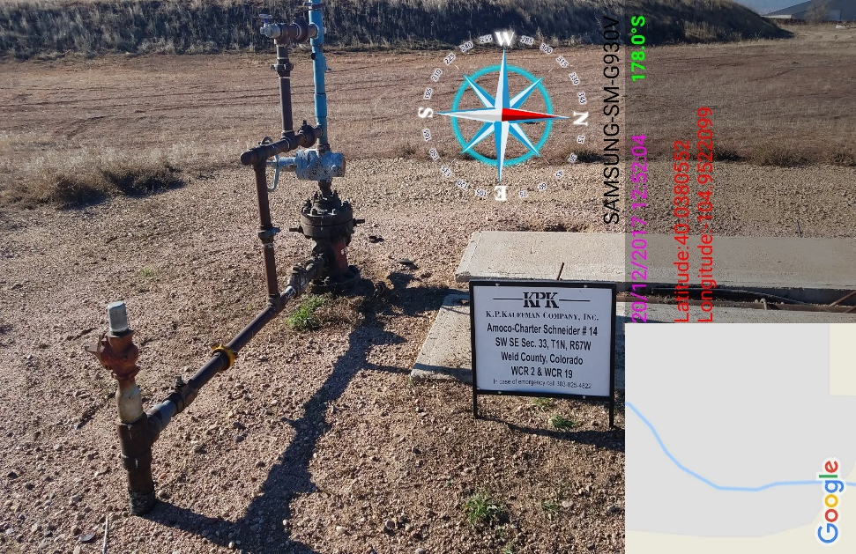
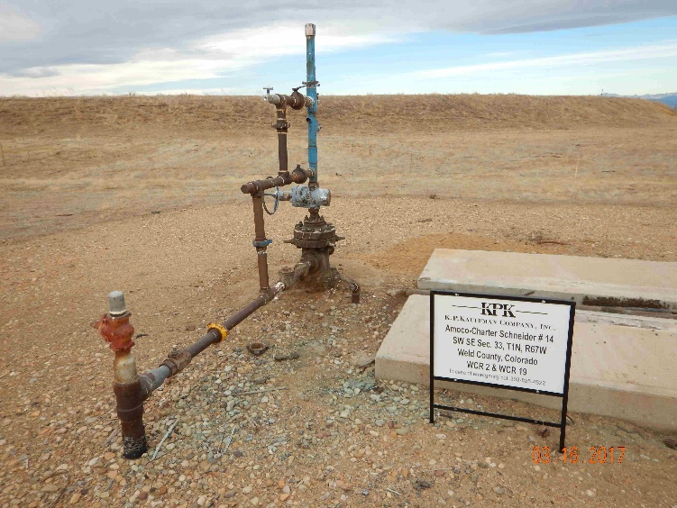
Inspection Photos
Location Name: KPK Amoco-Charter Schnider #14
API: 05-123-309703
Photo from inspection Doc#67200004
Photo appears to same debris from previous inspection

Slide 2
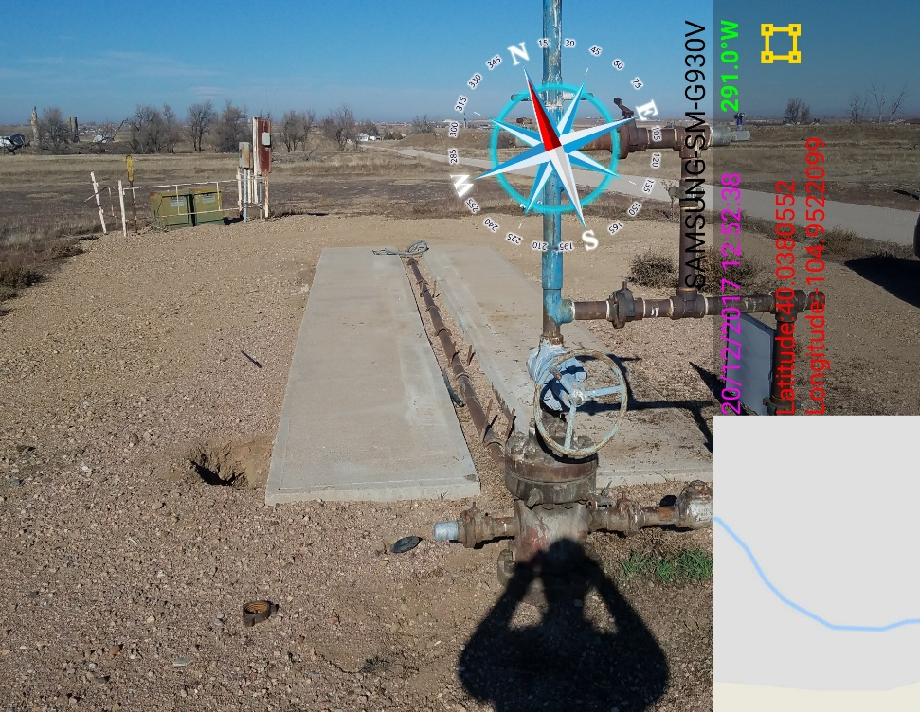
Inspection Photos
Location Name: KPK Amoco-Charter Schnider #14
API: 05-123-309703
Photo showing concrete and wiring and unused electrical equipment

