Slide 1
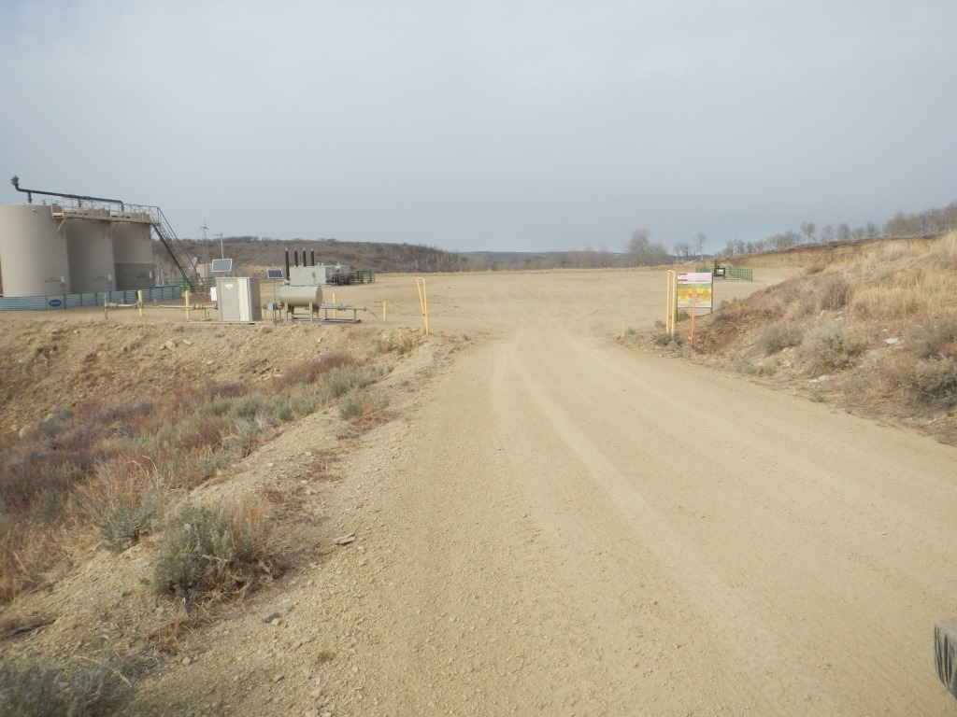

Photo#1:
Overview of Location from Entry to North.

Slide 2
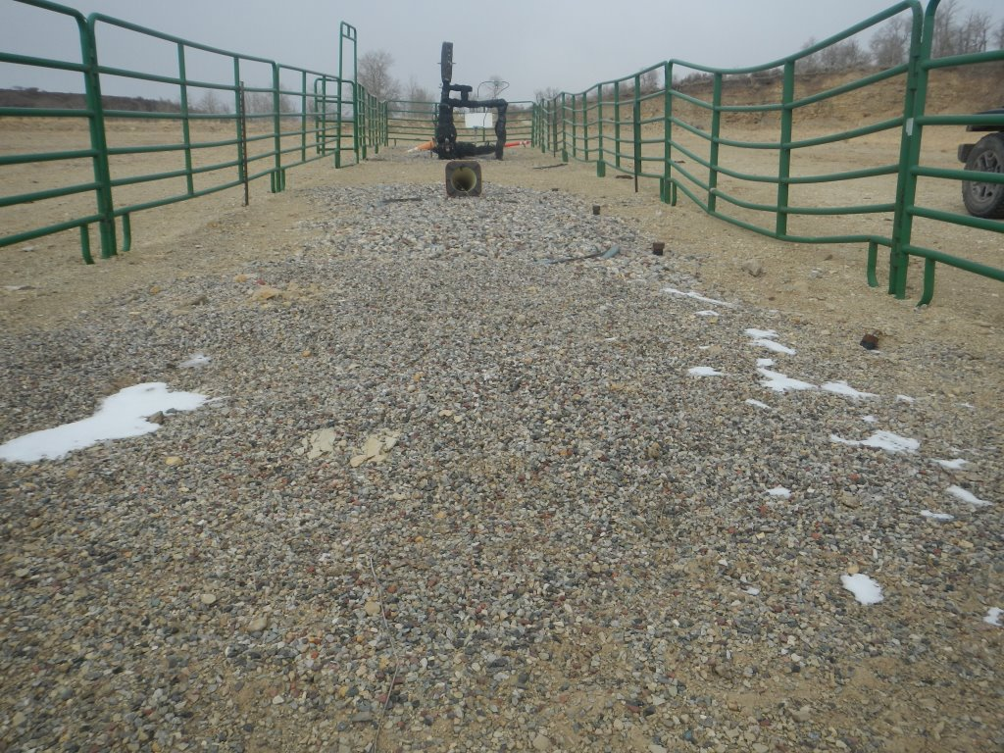
Photo#2:
View from South to North over Well lineup & Gravel filled Cellars.

Slide 3
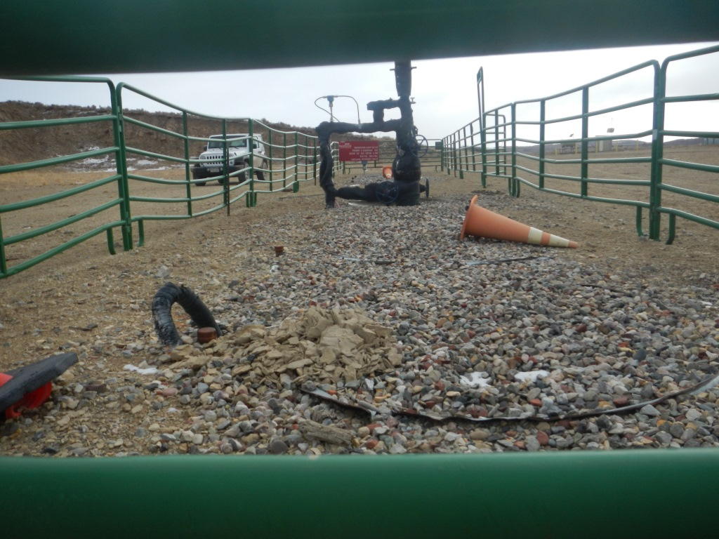
Photo#3:
View from North South over Well lineup & Gravel filled Cellars.

Slide 4
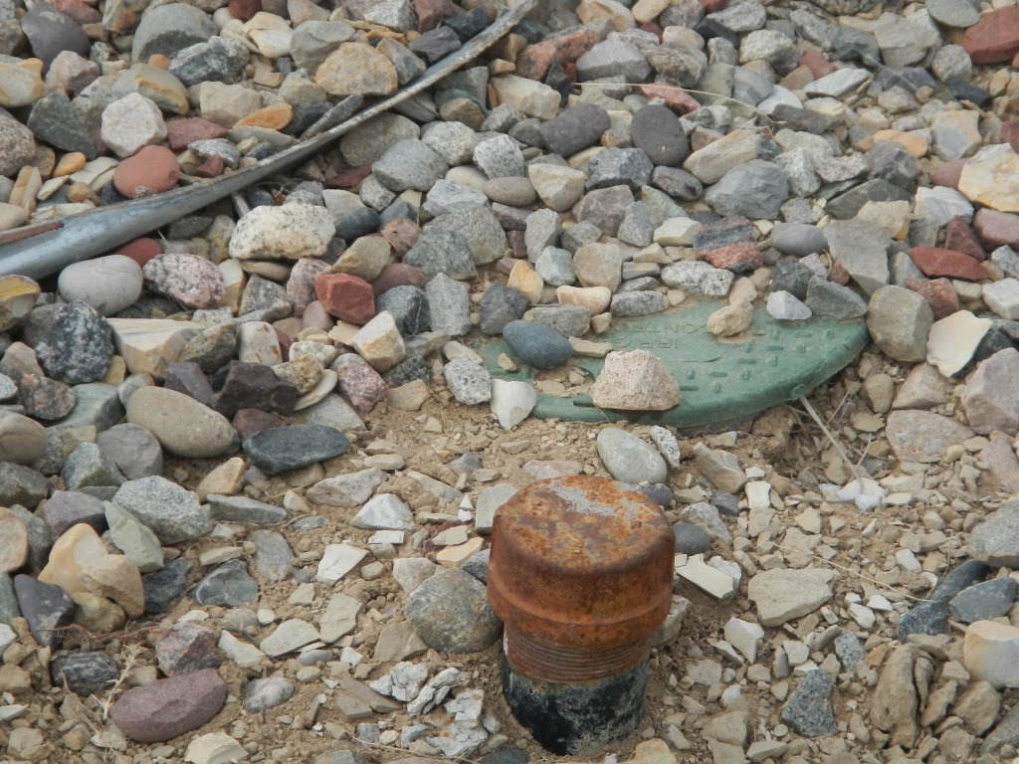
Photo#4:
Risers / Stubbs located at back (East side) of each Cellar.

