Slide 1
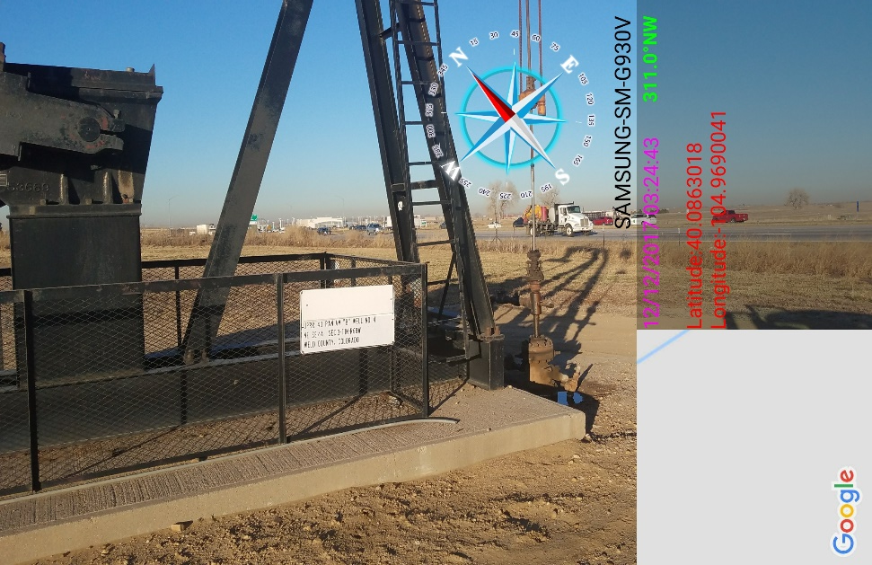
Inspection Photos
Location Name: KPK UPPR 43 PAN AM B 4
API: 05-123-09428
Pump Jack at wellhead faded sign at wellhead

