Slide 1
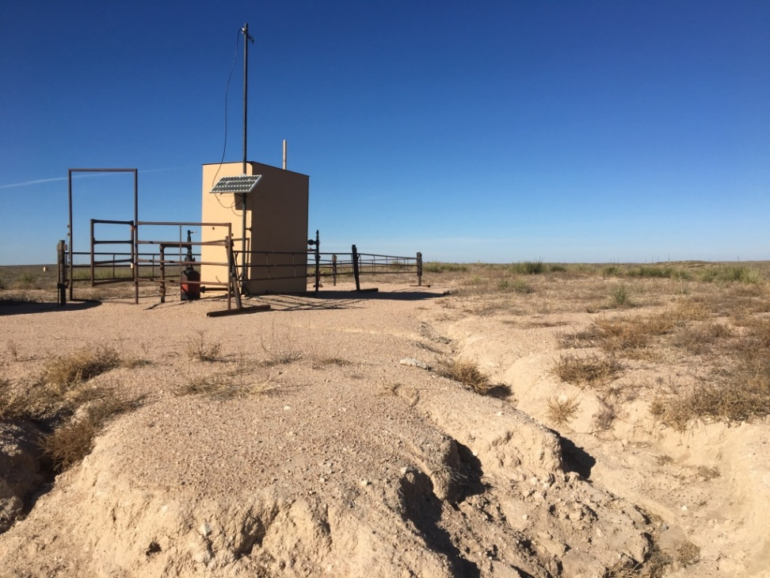
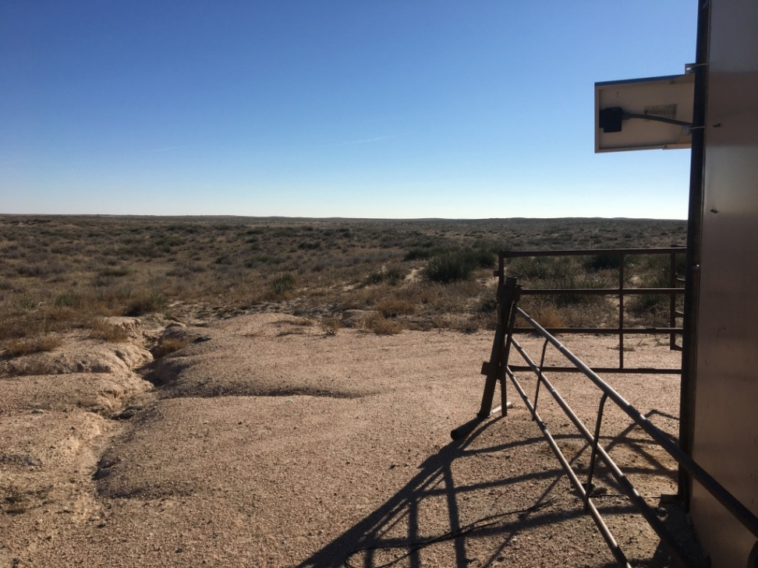
Inspection Photos
Location Name: Meeker 20-13
API: 05-125-11812
1. Looking North at erosion
2. Standing next to metal shed looking South

Slide 2
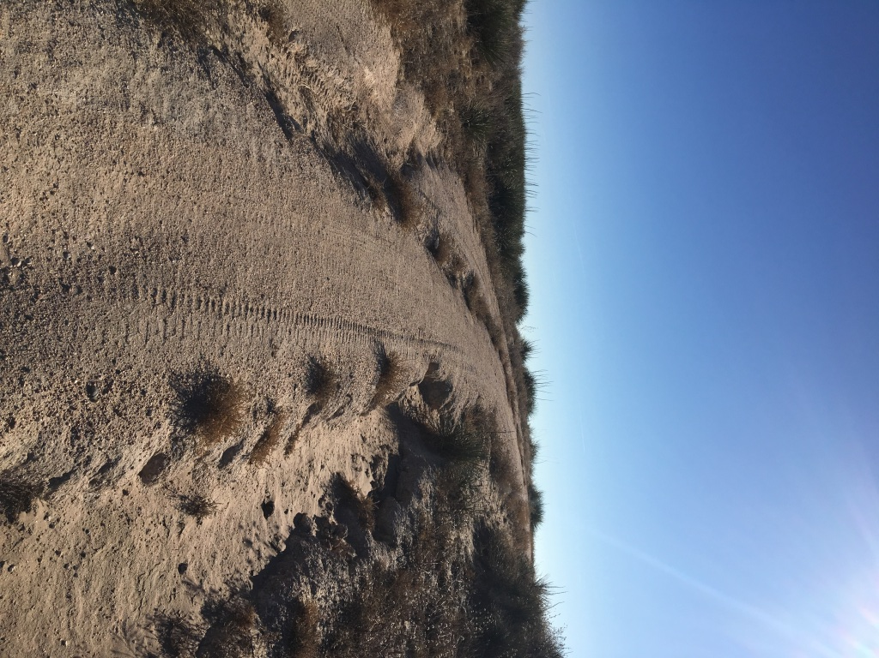
Inspection Photos
Location Name: Meeker 20-13
API: 05-125-11812
3. Erosion on access

