Slide 1
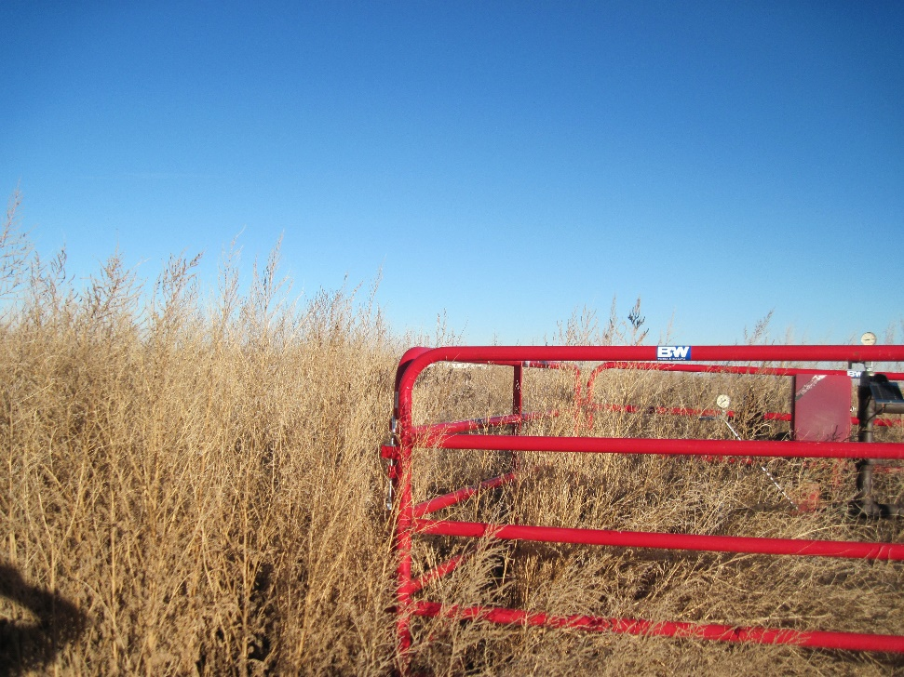
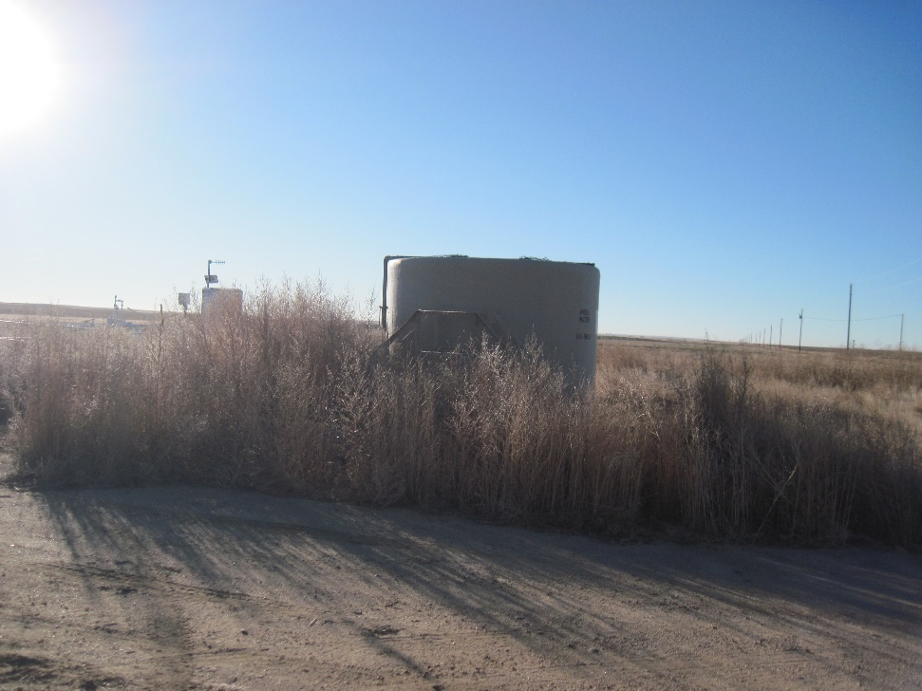
Inspection Photos
Location Name: [Allison #1]
API: 05-001-07169
Weeds around wellhead
Weeds around water tank

