Slide 1
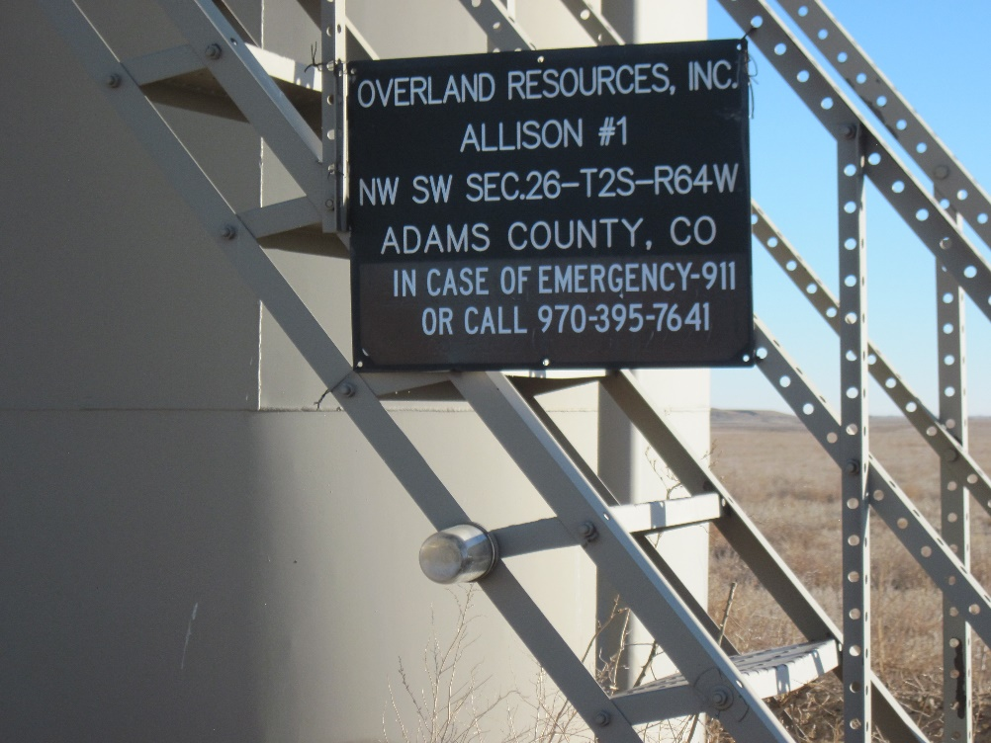
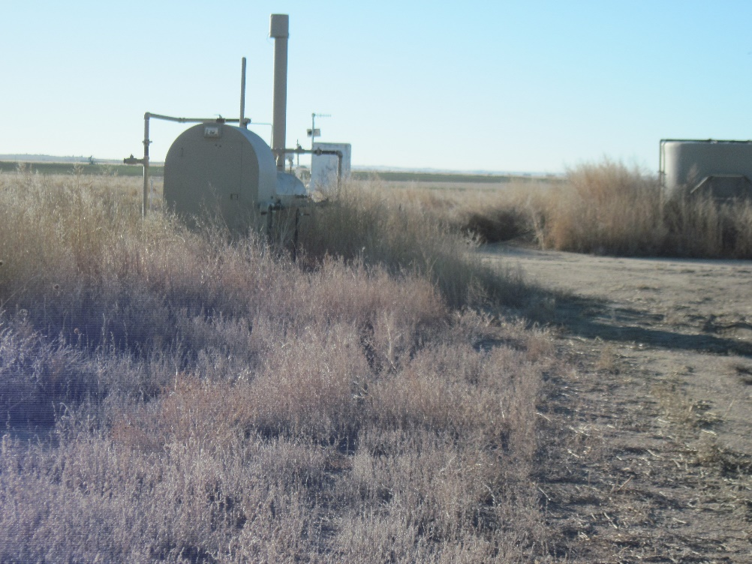
Inspection Photos
Location Name: [ALLISON #1]
API: 05-123-07169
BATTERY SIGN
WEEDS AROUND LOCATION

