Slide 1

Diamond Operating, Inc., Walters 1
121-07603
Inspection #688300768
12/7/2017
Routine Inspection

Slide 2
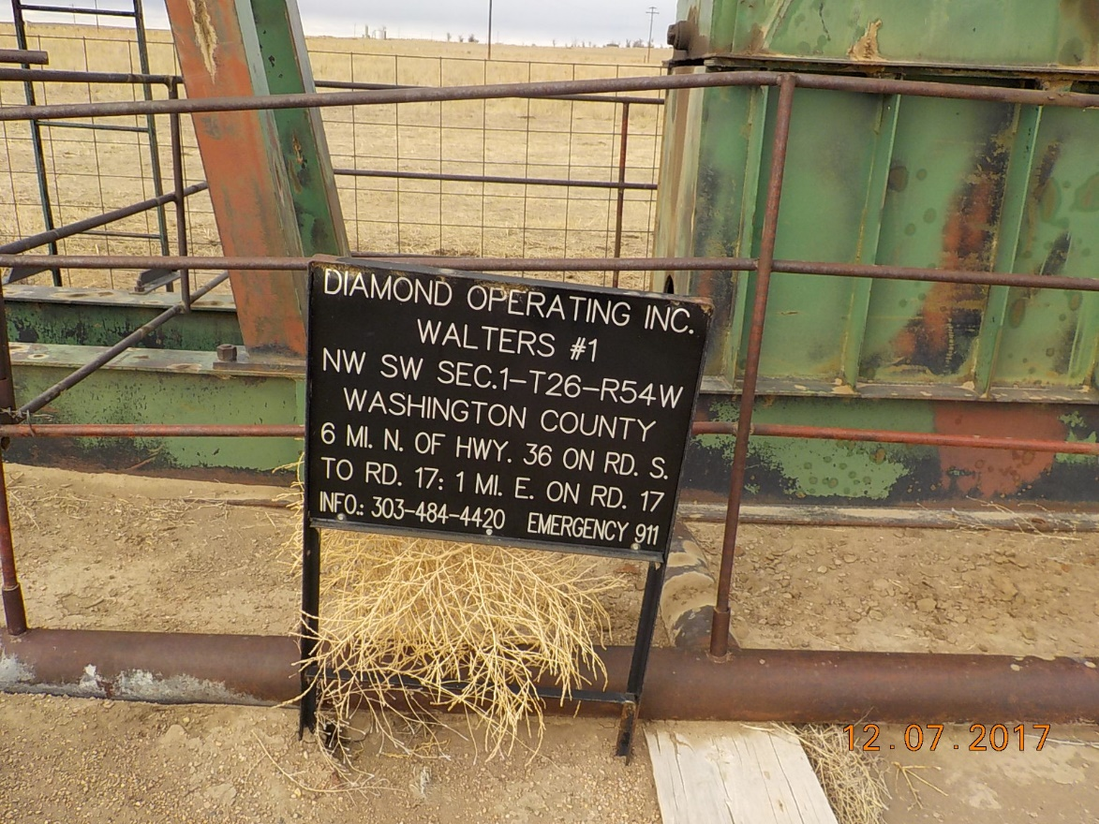

Slide 3
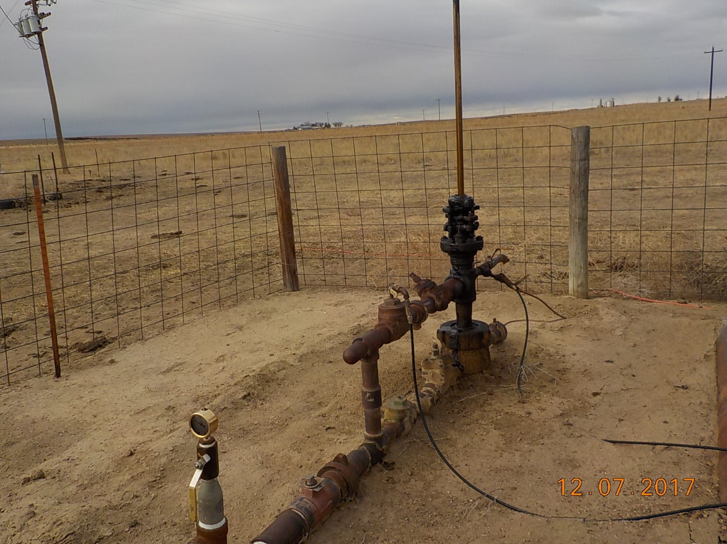

Slide 4
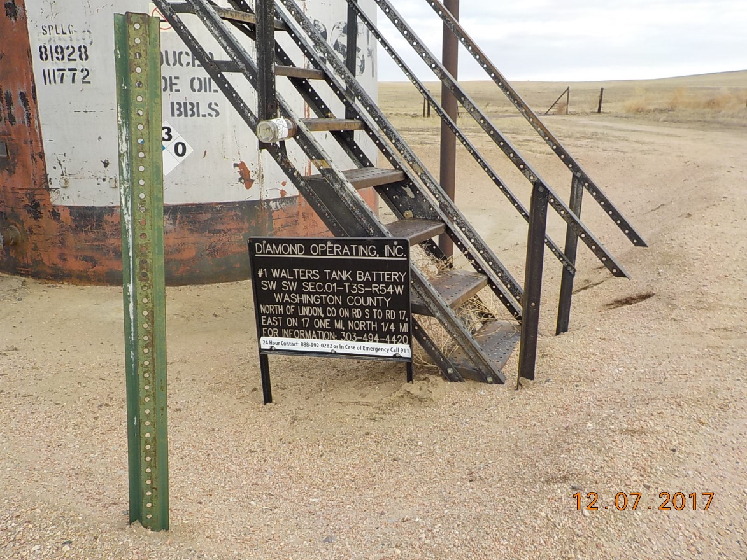

Slide 5
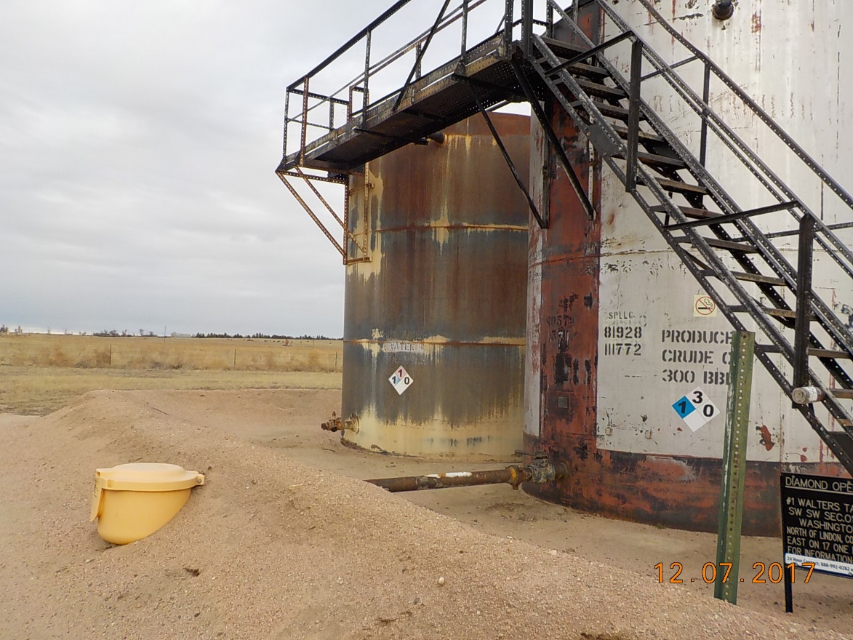

Slide 6
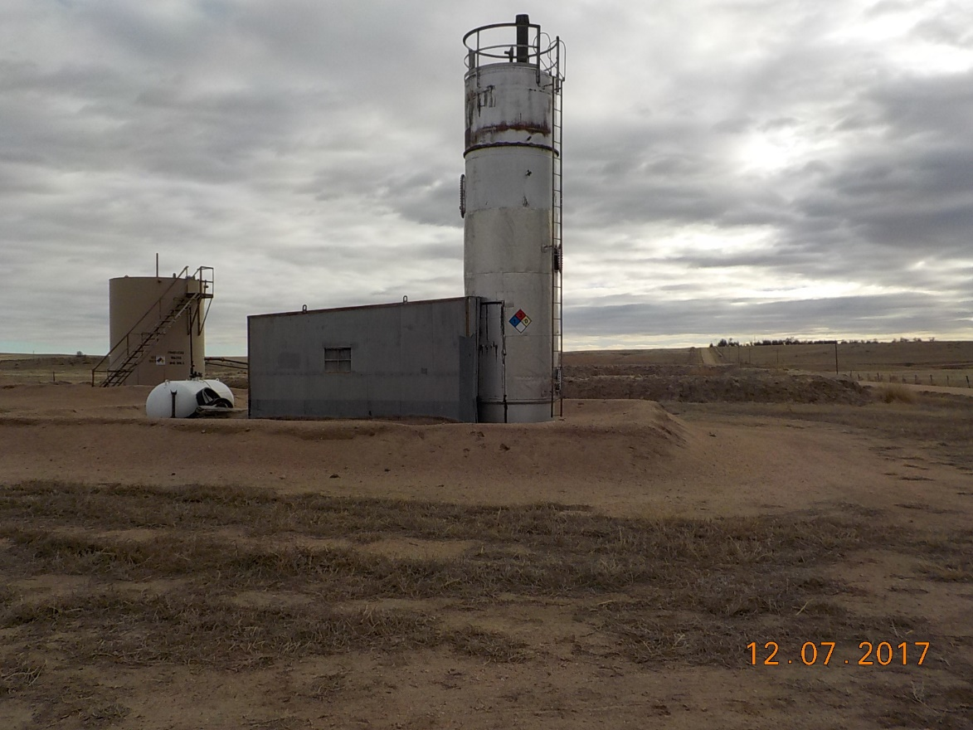

Slide 7
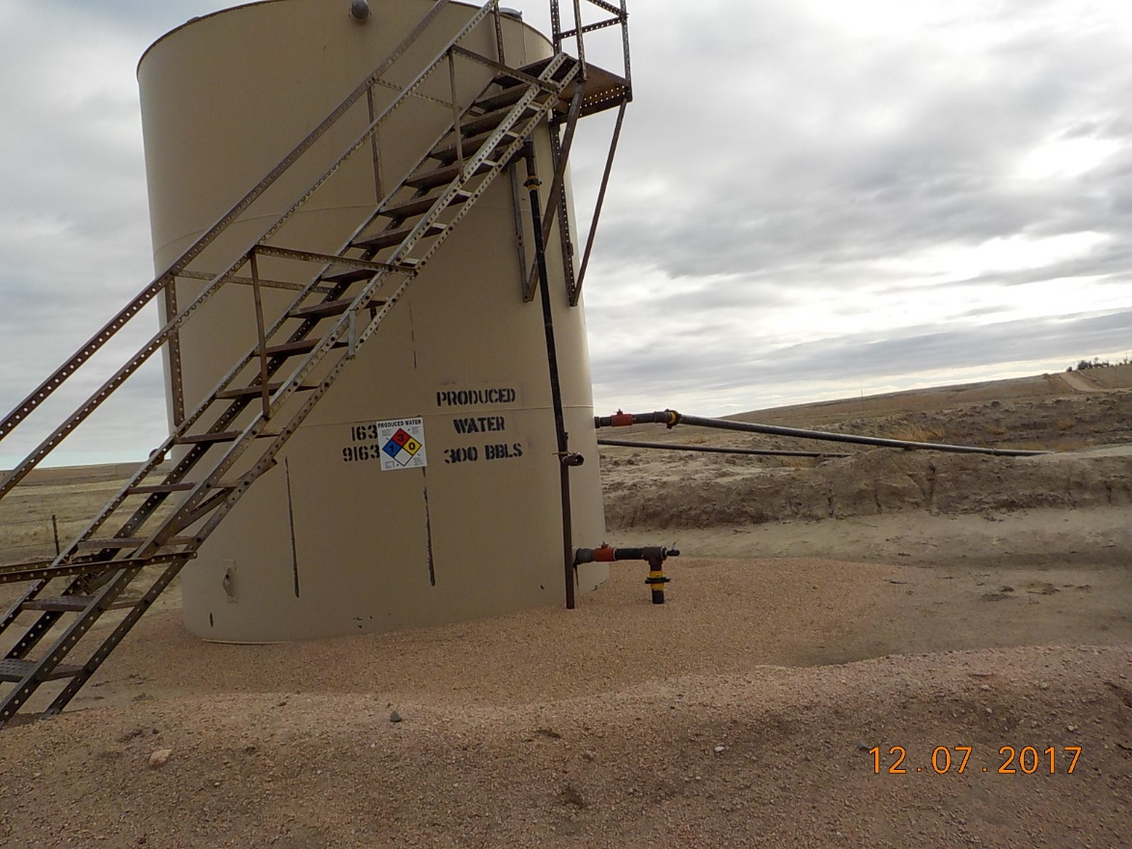

Slide 8
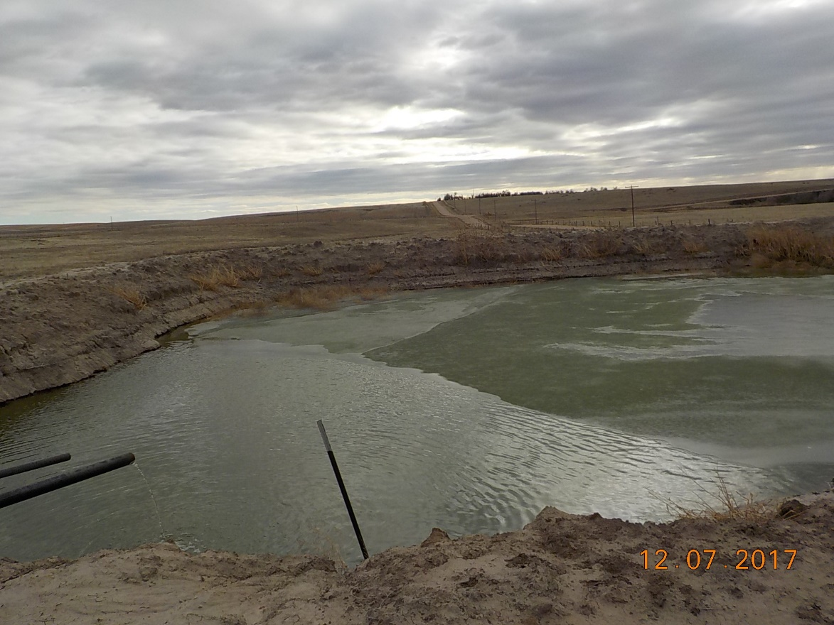

Slide 9
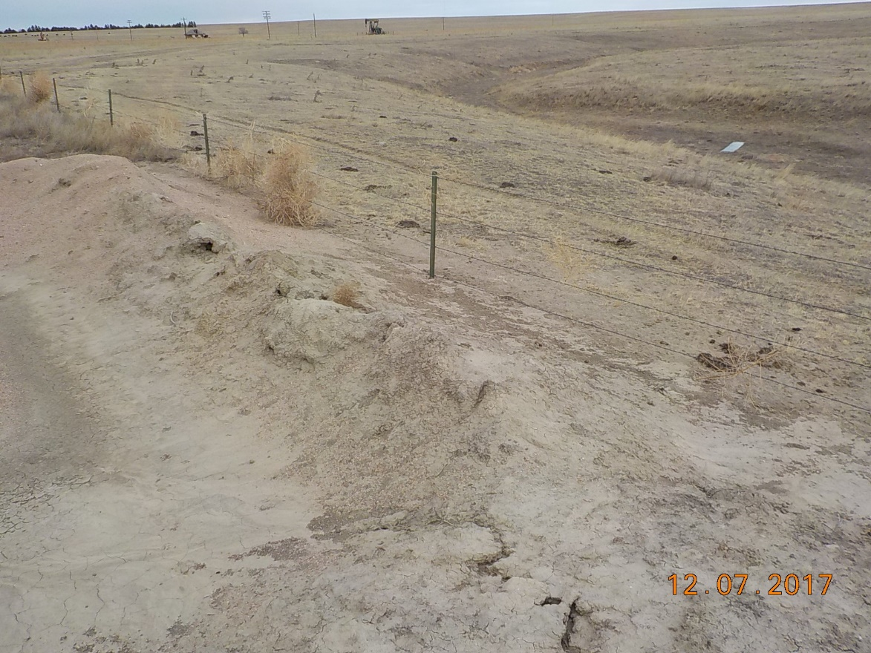
Maintain berms on drainage side of produced tank at the pit.

Slide 10
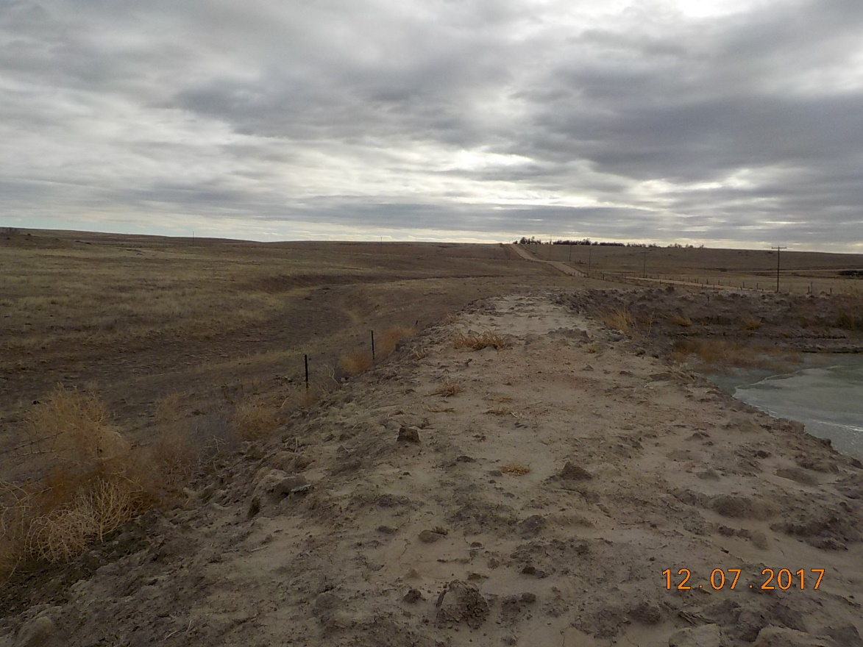
Drainage east of produced water pit.

Slide 11
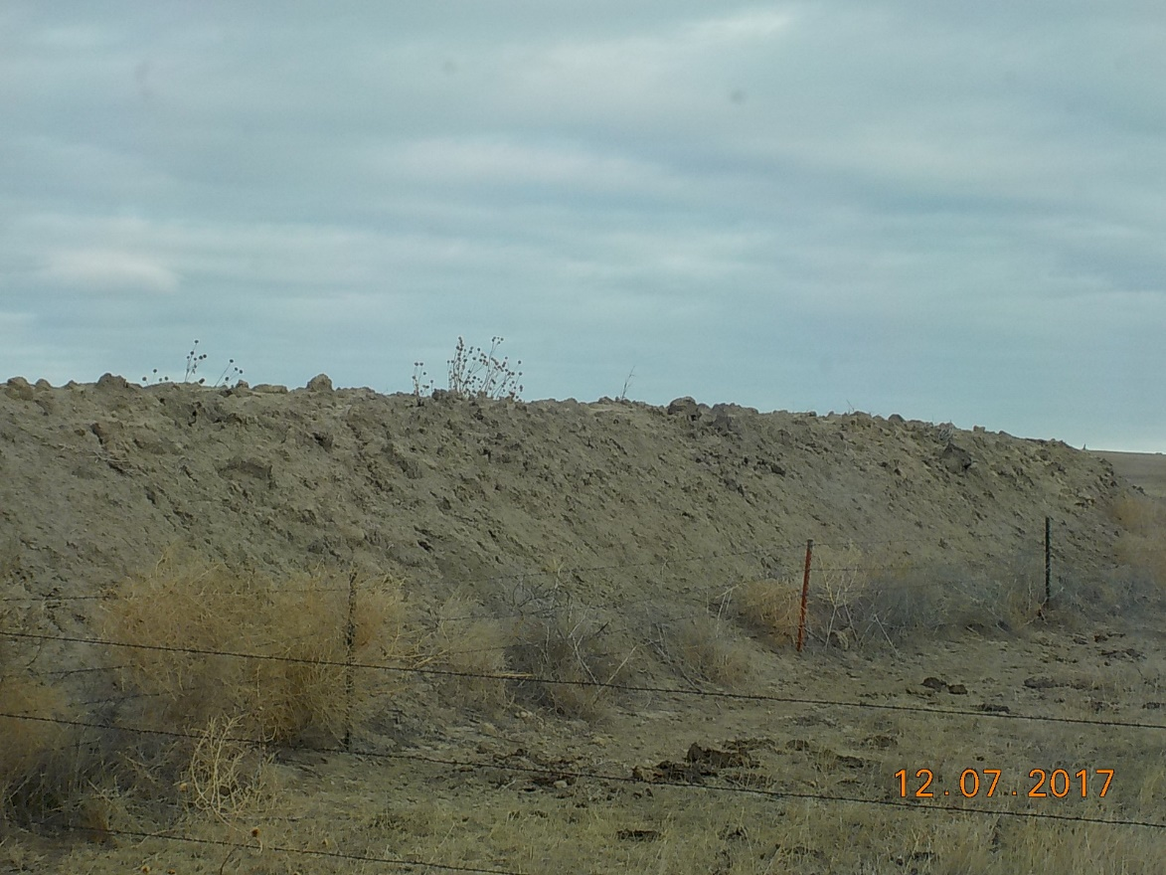
Outside berms on south side of produced water pit.

