Slide 1
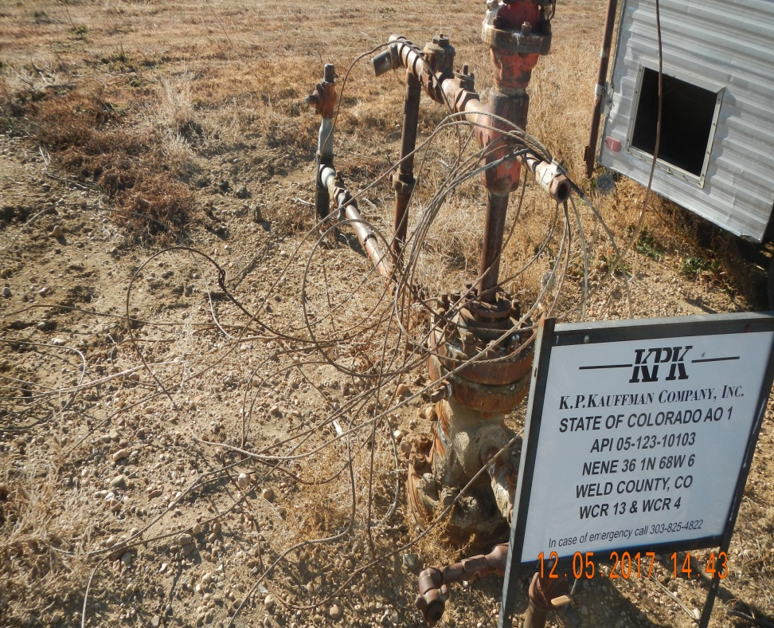
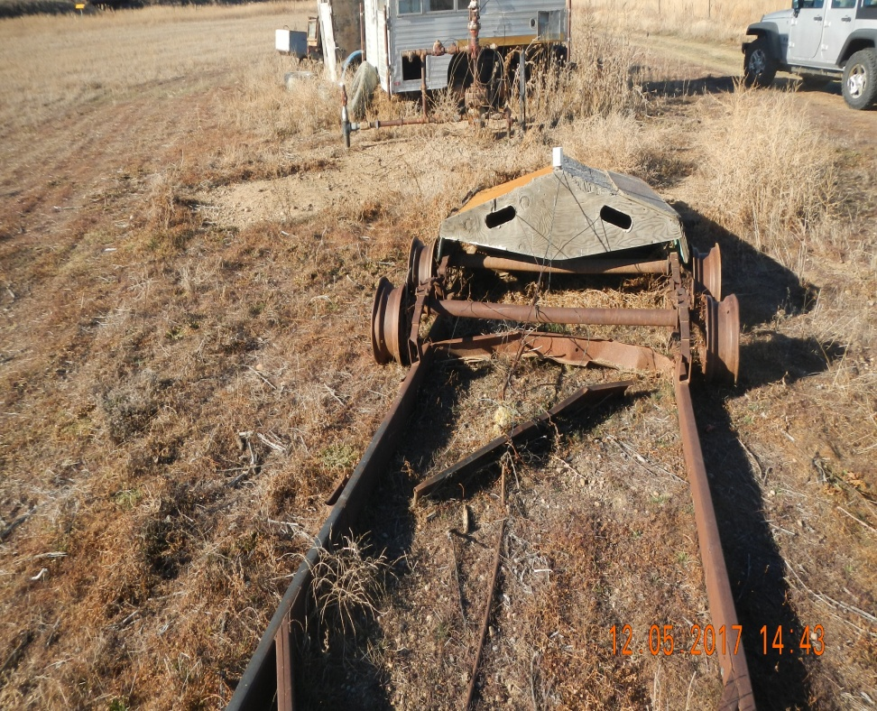
API # 123-10103
State of Colorado AO 1
Well with cable and debris
Debris at well

