Slide 1
Location 333229

Slide 2
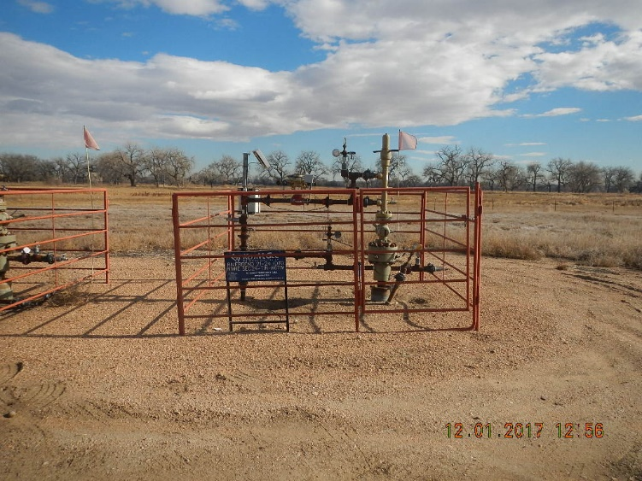
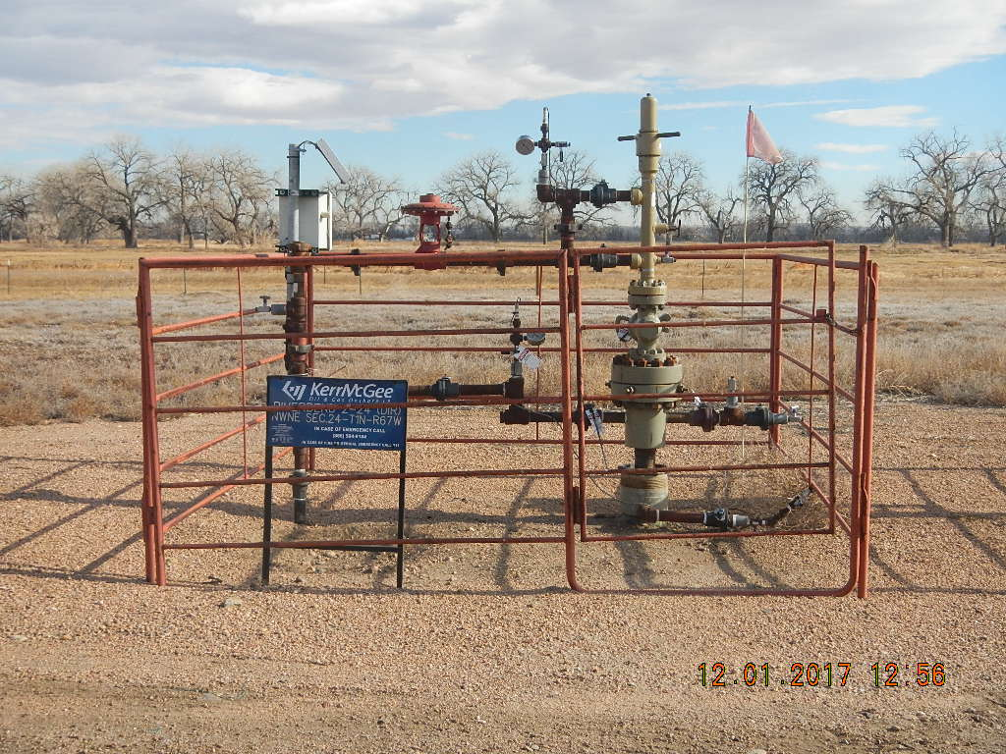
Photo 1 Wellhead 05-123-33843
Photo 2 Wellhead 05-123-33836

