Slide 1
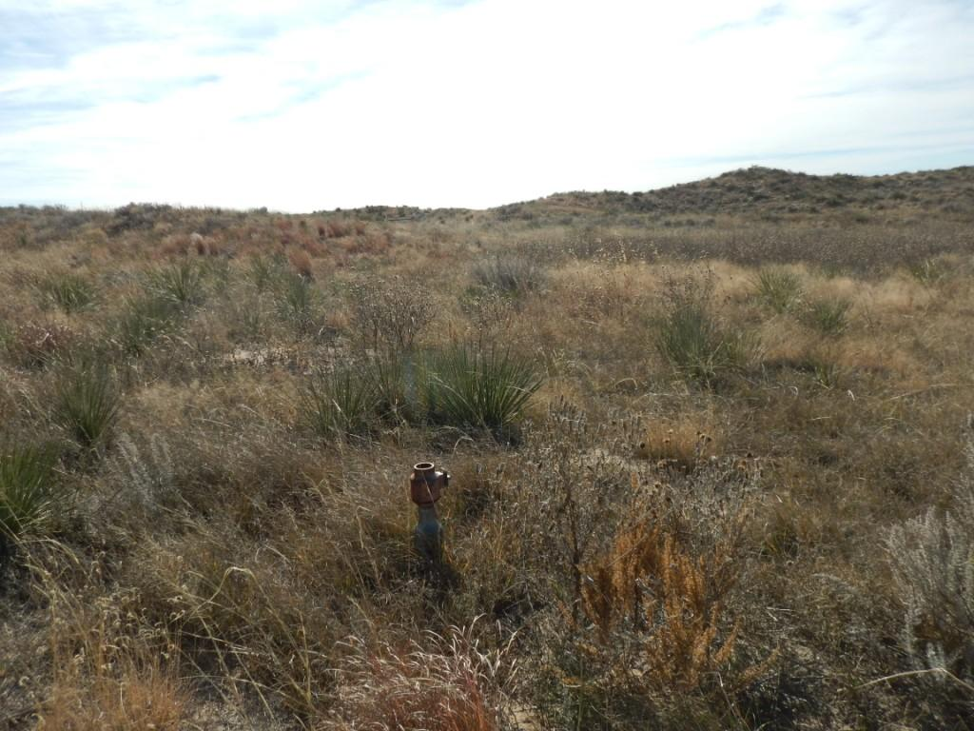
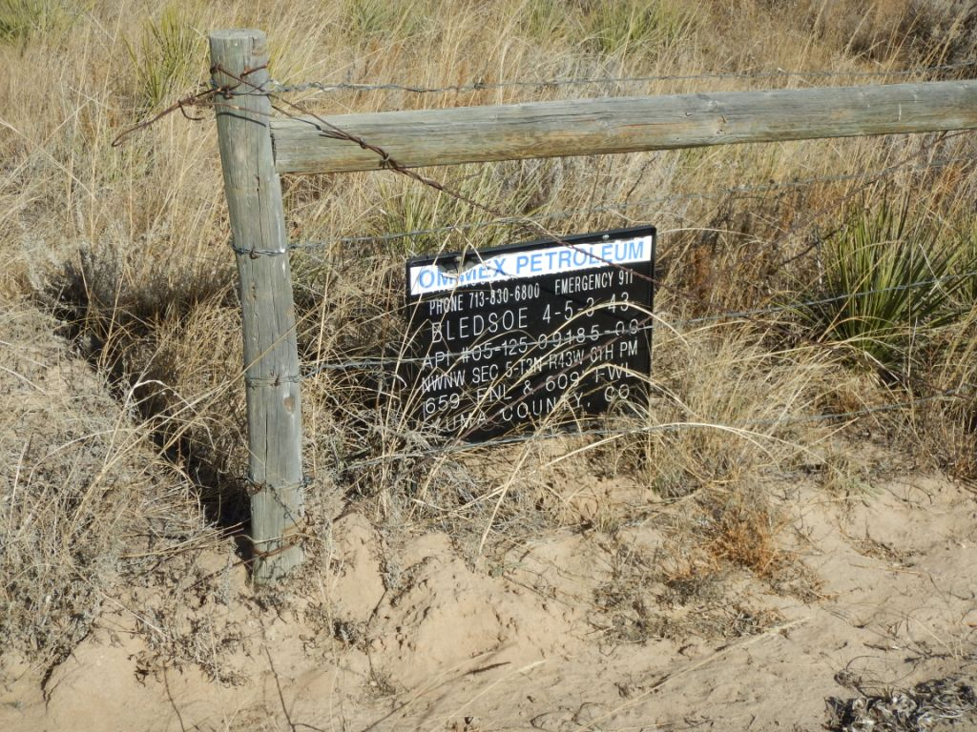
Inspection Photos
Location Name: Bledsoe 4-5-3-43
API: 05-125-09185
1. Wellhead
2. Lease sign

Slide 2
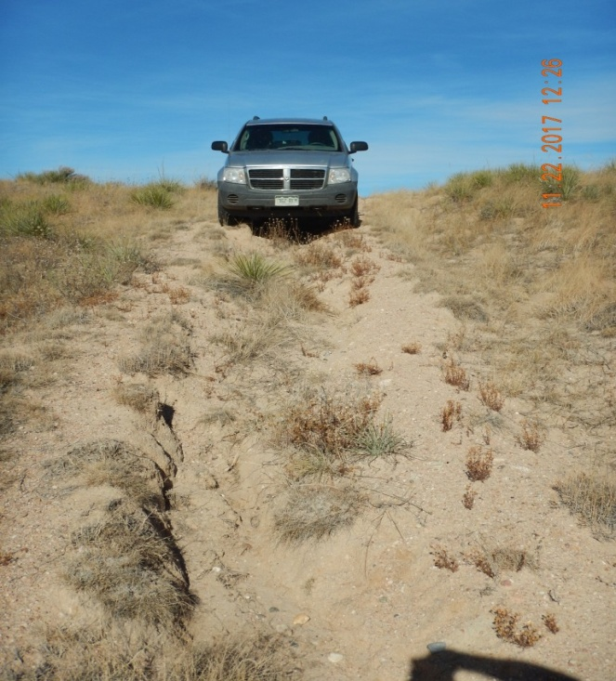
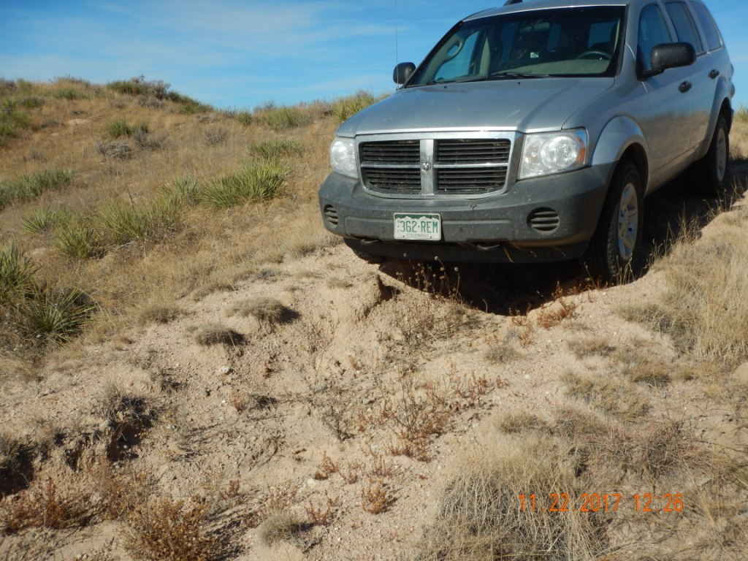
Inspection Photos
Location Name: Bledsoe 4-5-3-43
API: 05-125-09185
3. Access erosion
Repair and maintain erosion
4. Access erosion
Repair and maintain erosion

