Slide 1
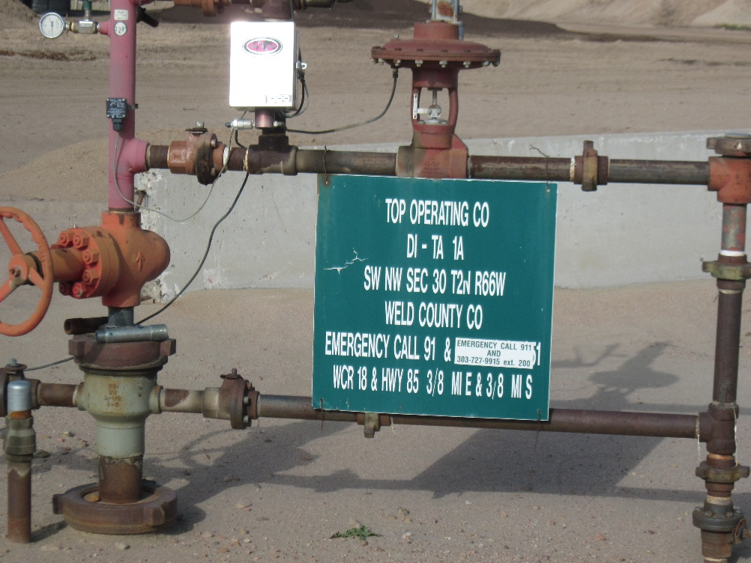
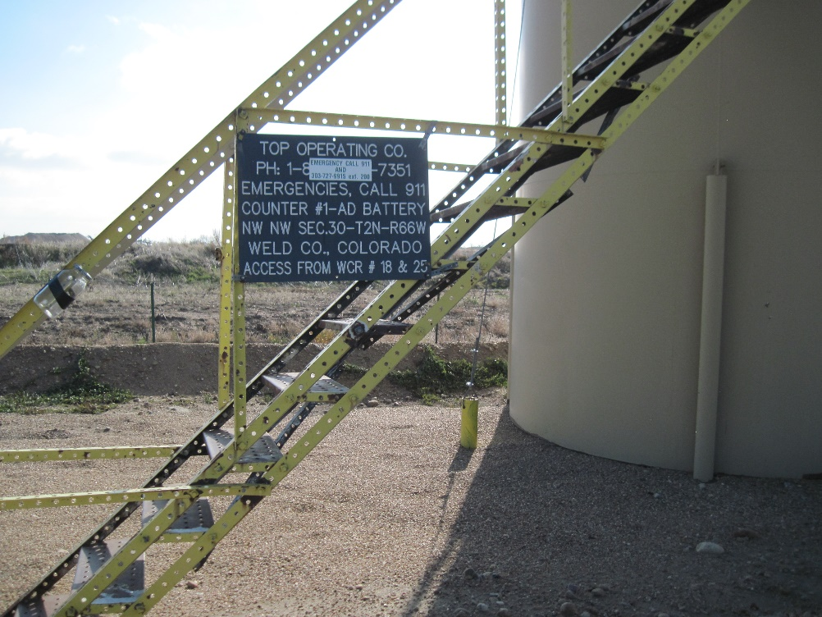
Inspection Photos
Location Name: [dItA#1]
API: 05-123-08487
WELLHEAD
TANK BATTERY

