Slide 1
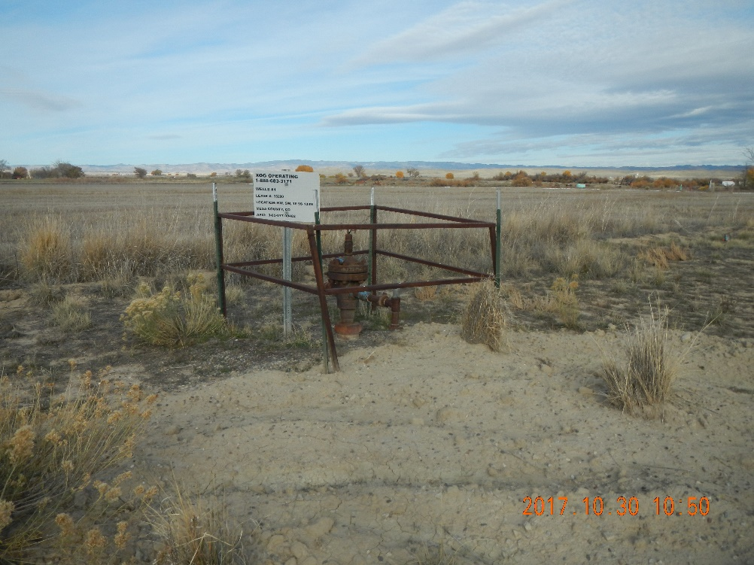
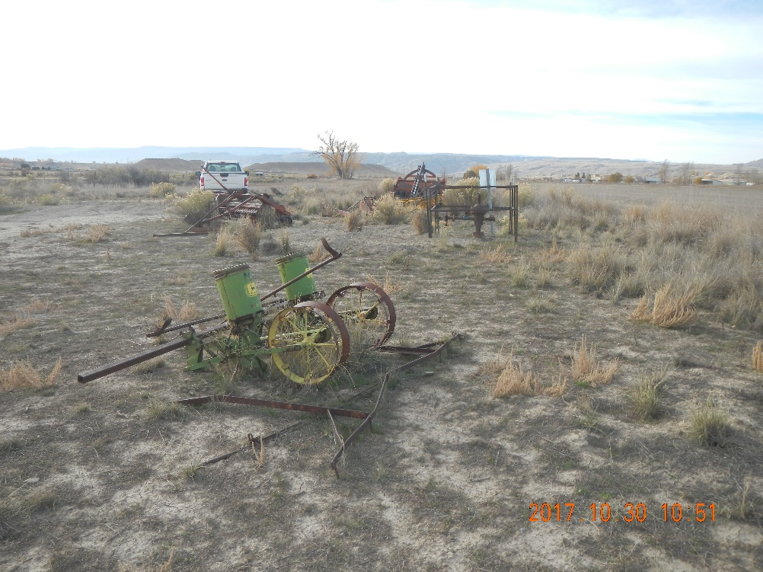
Inspection Photos
Location Name: XOG Wells #1
Location ID #312540
API: 05-077-08482
Well head with sign
Land owner equipment on the pad

Slide 2
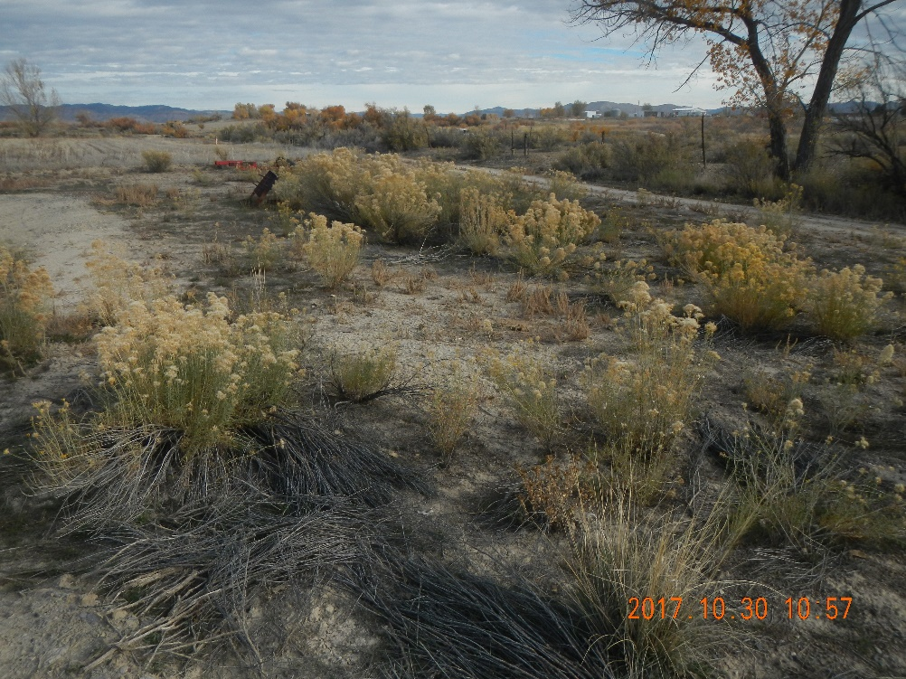
Inspection Photos
Location Name: XOG Wells #1
Location ID #312540
API: 05-077-08482
Pad and some landowner equipment
2011 aerial photo shows the open top tank NE of the well head

