Slide 1
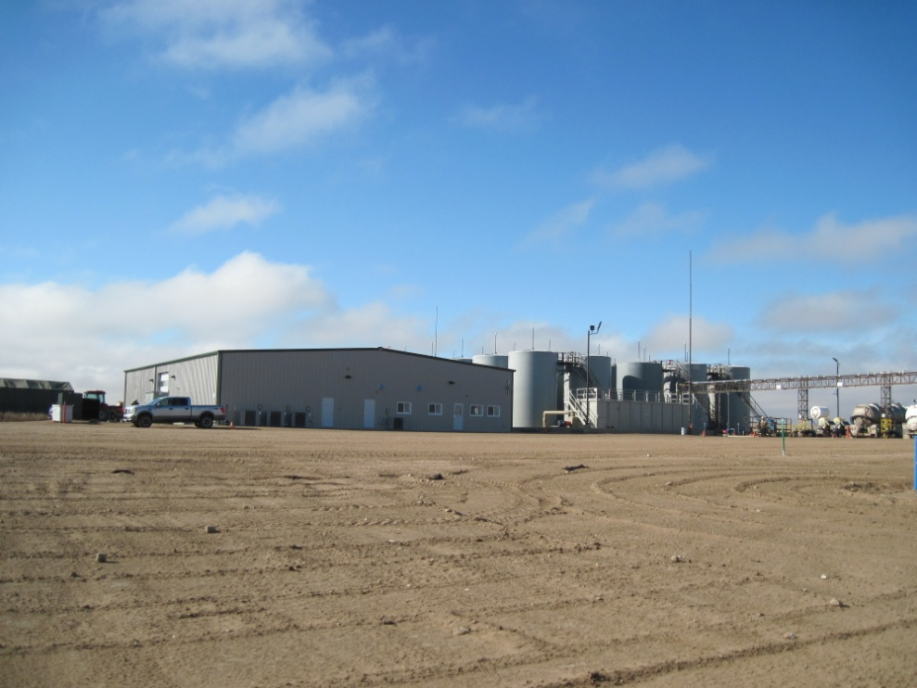
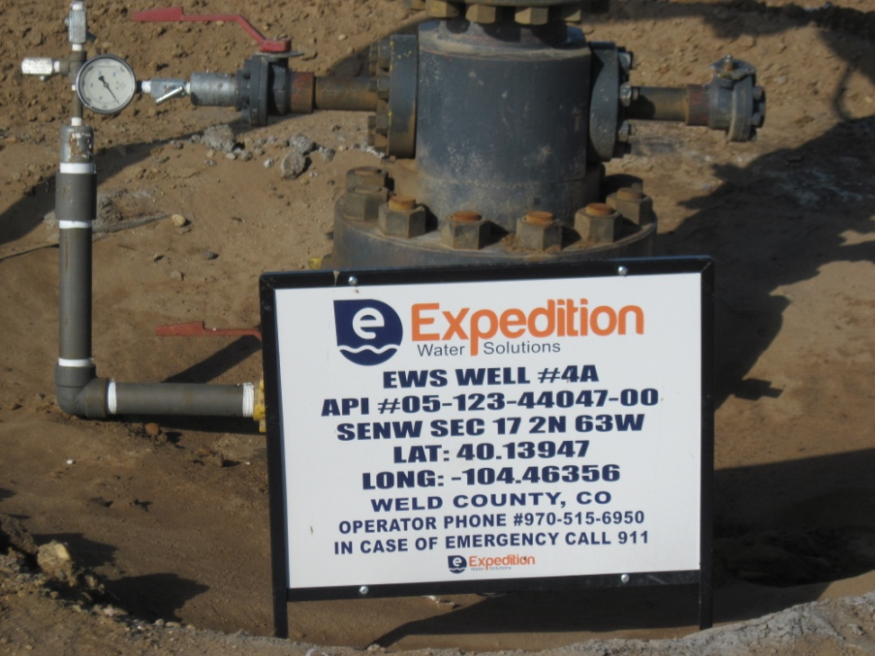
Inspection Photos
Location EWS #4A
API: 05-123-44047
TANK BATTERY INJECTION PLANT
WELL SIGN

