Slide 1
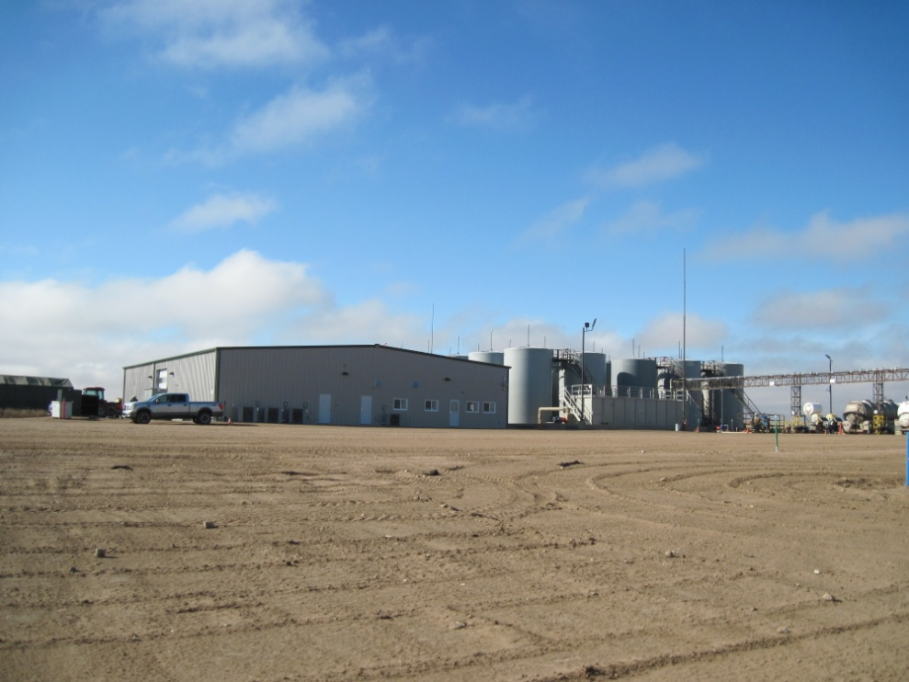
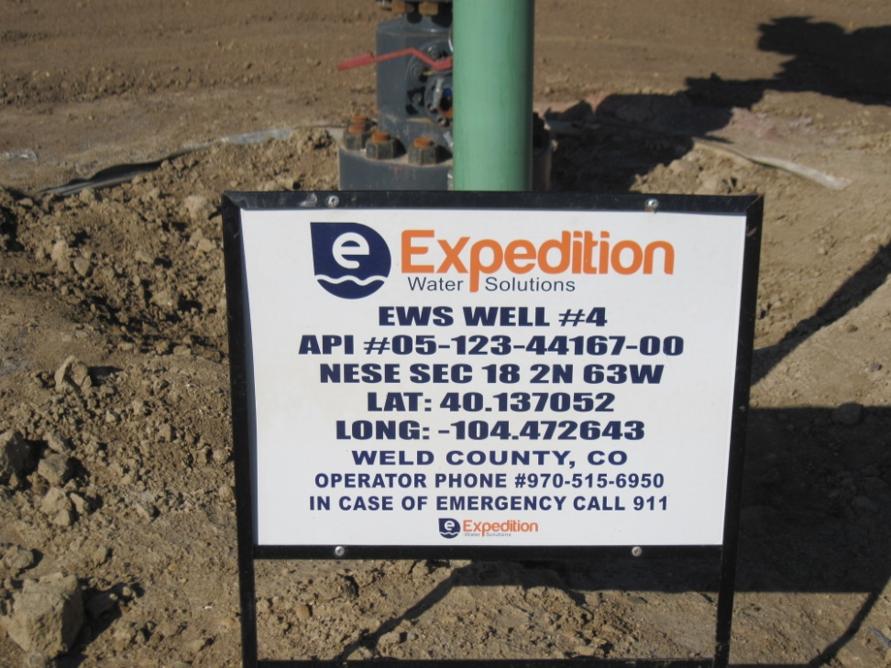
Inspection Photos
Location EWS #4
API: 05-123-44167
TANK BATTERY INJECTION PLANT
WELL SIGN

