Slide 1
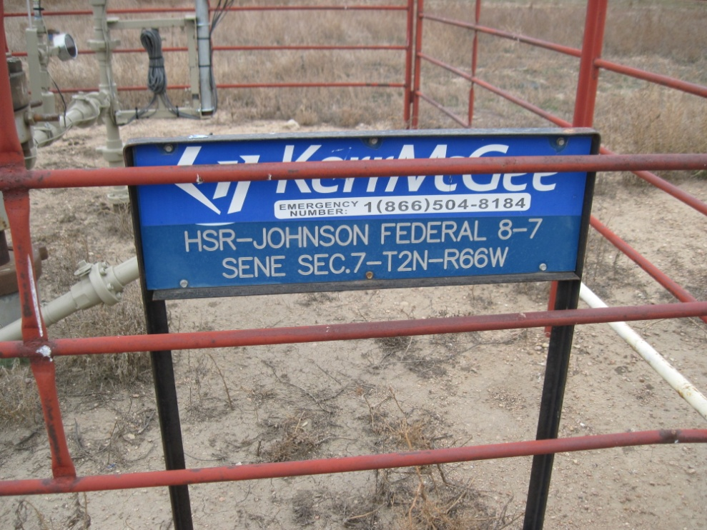
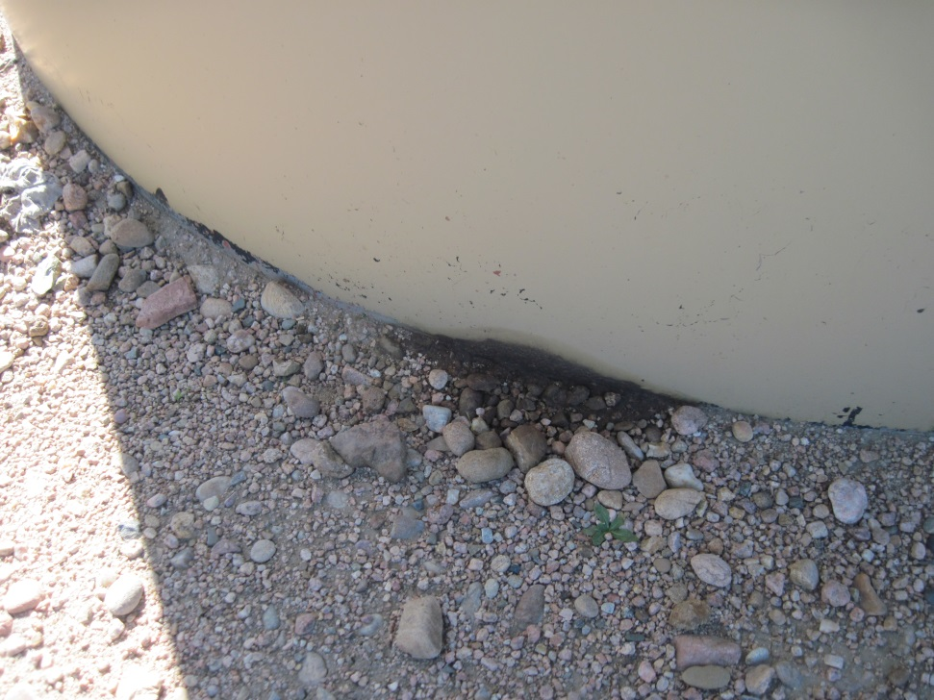
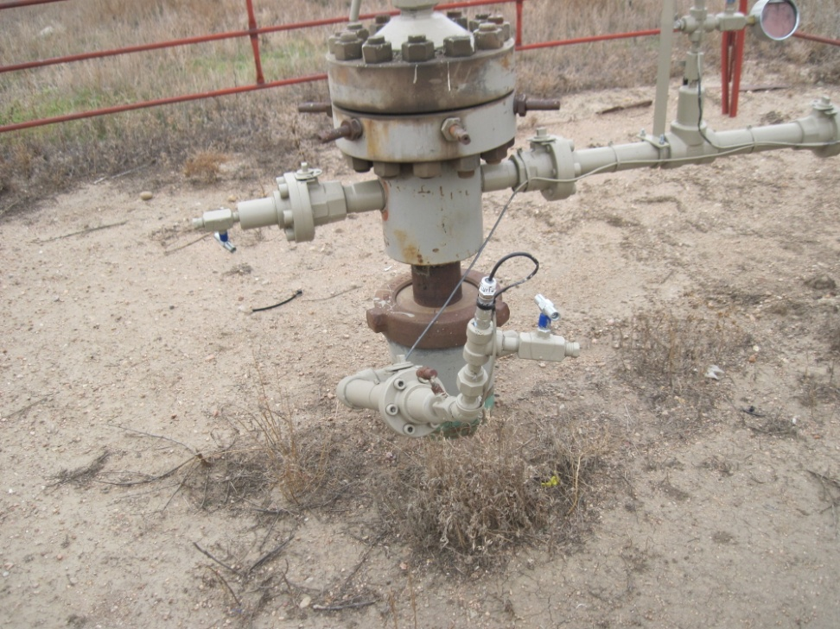
Inspection Photos
Location HSR-JOHNSON FEDERAL 8-7
API: 05-123-20459
WELL SIGN
BRADENHEAD PLUMBED TO SURFACE

