Slide 1
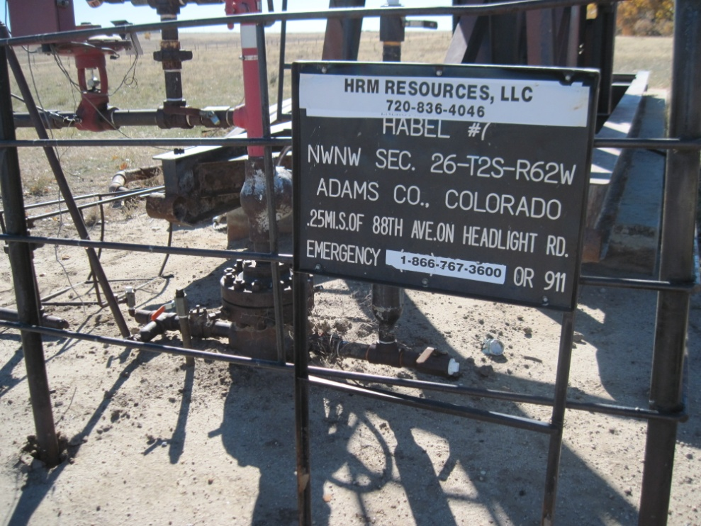
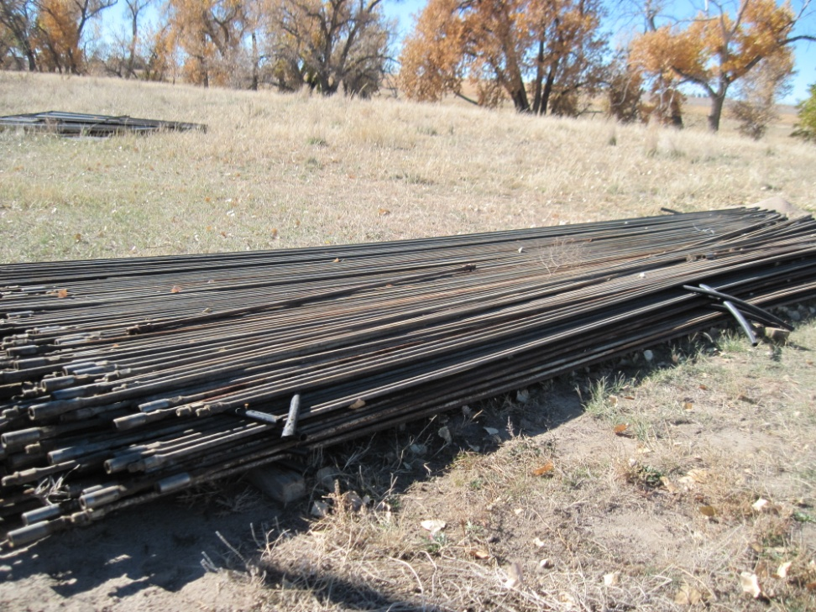
Inspection Photos
Location HABEL 7
API: 05-001-07305
WELL SIGN
UNUSED EQUIPMENT SUCKER RODS

