Slide 1
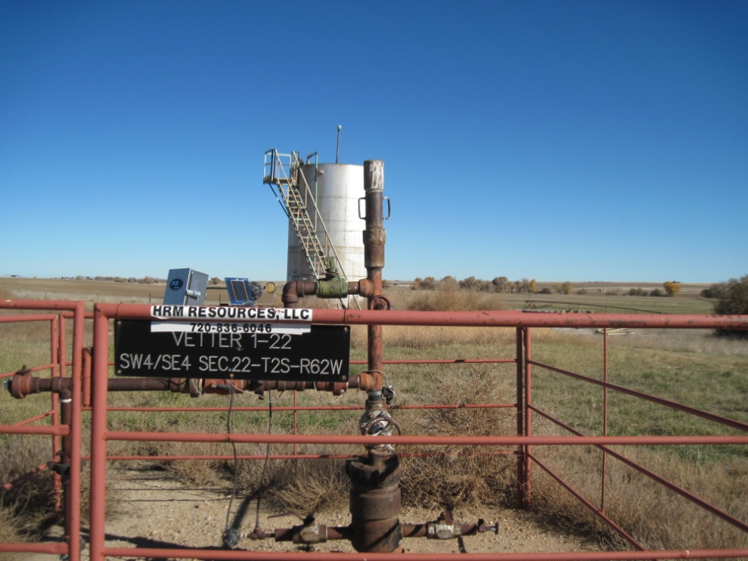
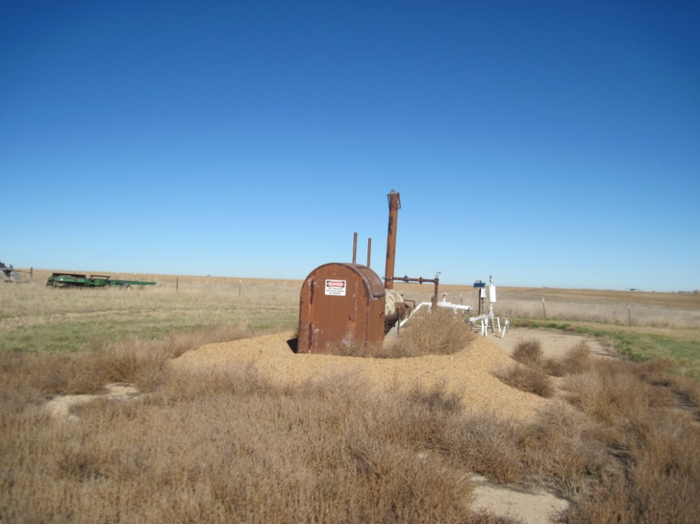
Inspection Photos
Location VETTER 1-22
API: 05-001-06408
WELL SIGN
WEEDS AROUND SEPERATOR

