Slide 1
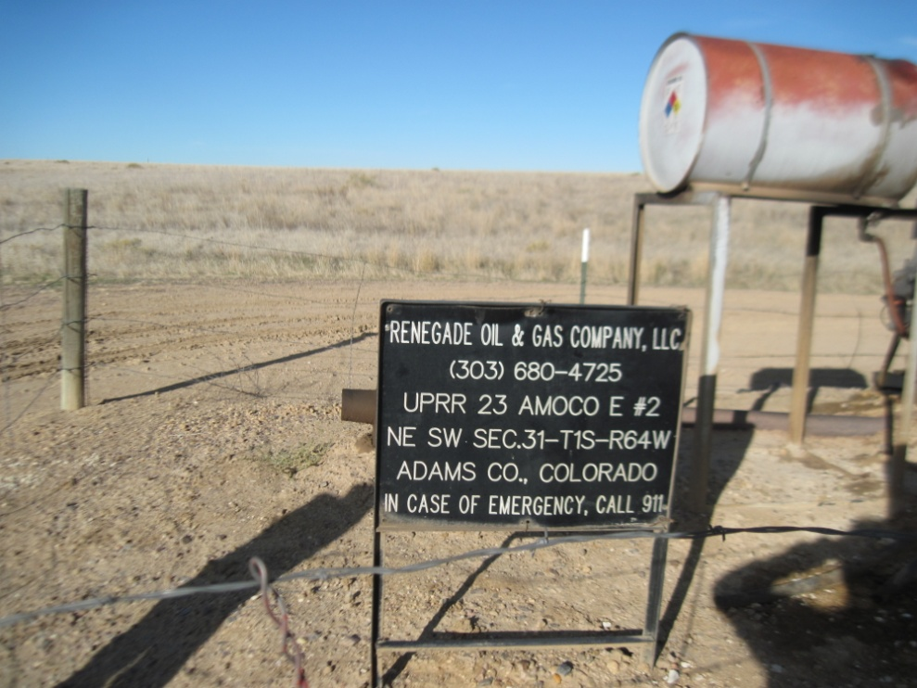
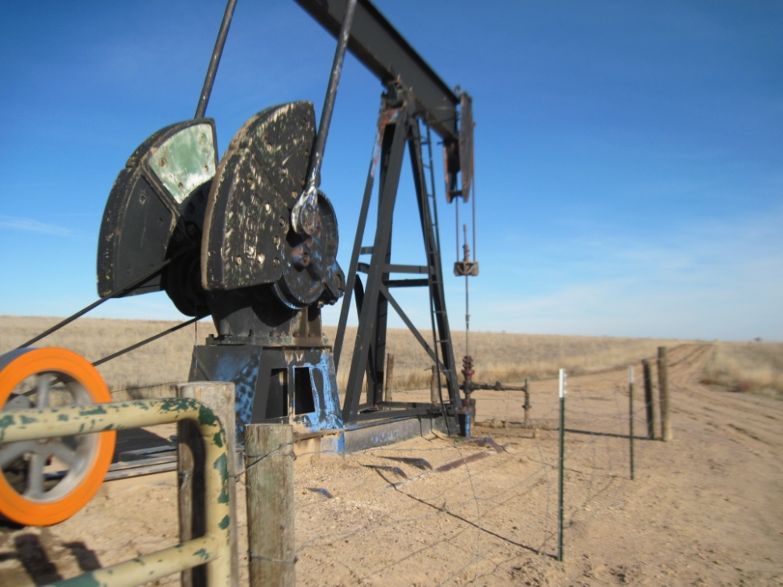
Inspection Photos
Location Name UPRR 23 AMOCO E-2
API: 05-001-07278
WELL SIGN
PUMP JACK

