Slide 1
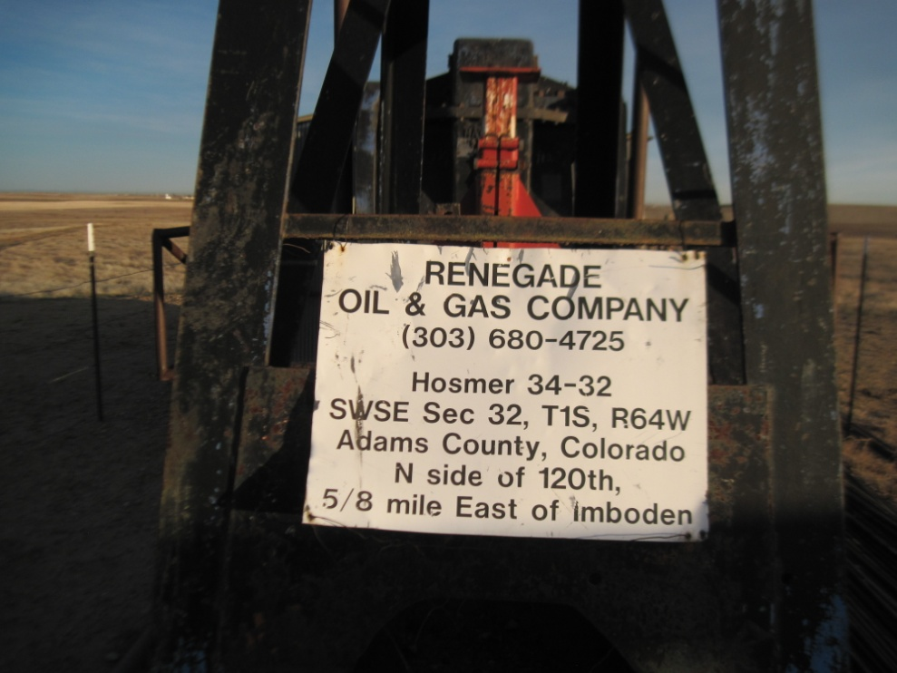
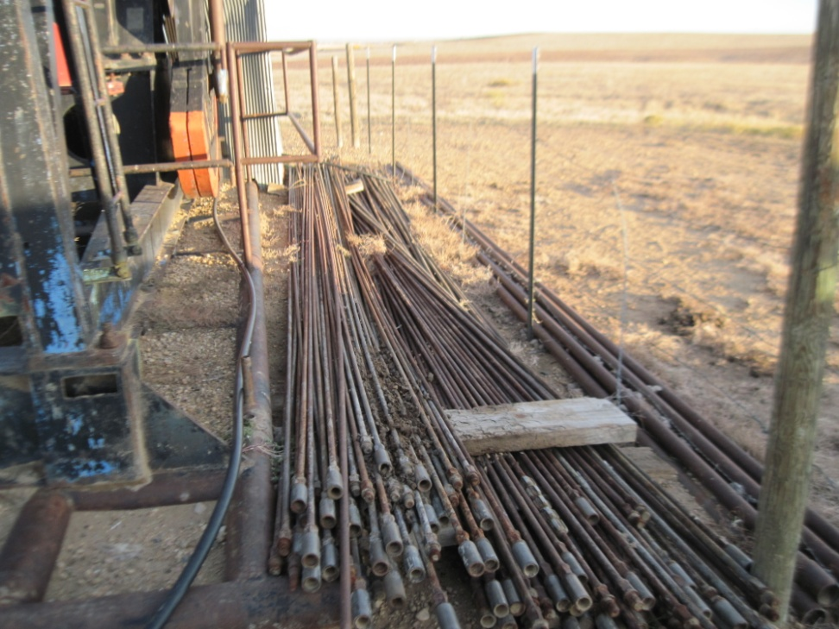
Inspection Photos
Location Name HOSMER 34-32
API: 05-001-07336
WELL SIGN
UNUSED EQUIPMENT

