Slide 1
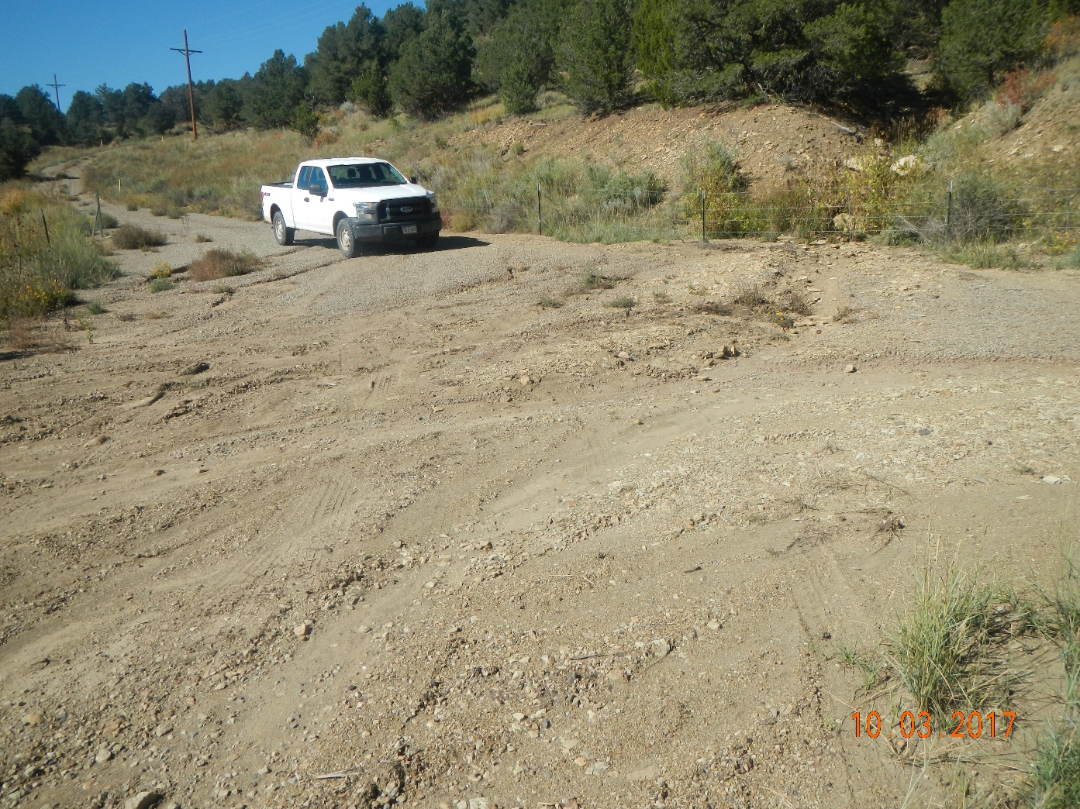

Inspection Photos
Photo 1. Facing northwest at the beginning of the access road standing near Hwy 12. Stormwater is being directed from the drainage in upper right of photo and down along the access road which is causing erosion and directing stormwater towards the highway shown in the next photo.

Slide 2
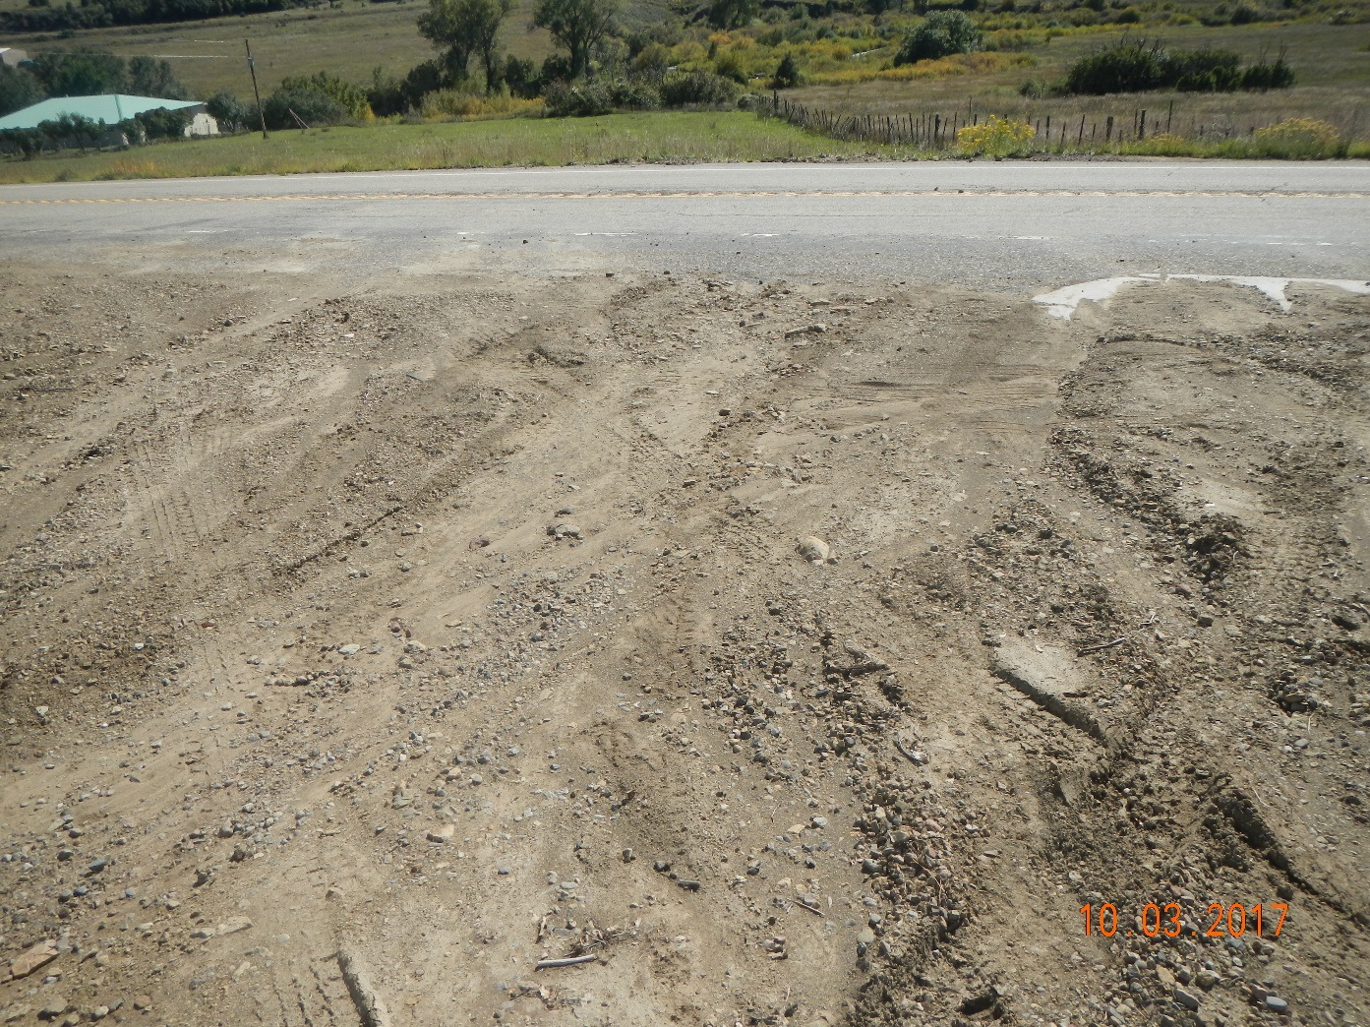
Inspection Photos
Photo 2. There is signs sediment is being deposited on to the highway from stormwater and vehicle tracking.

Slide 3
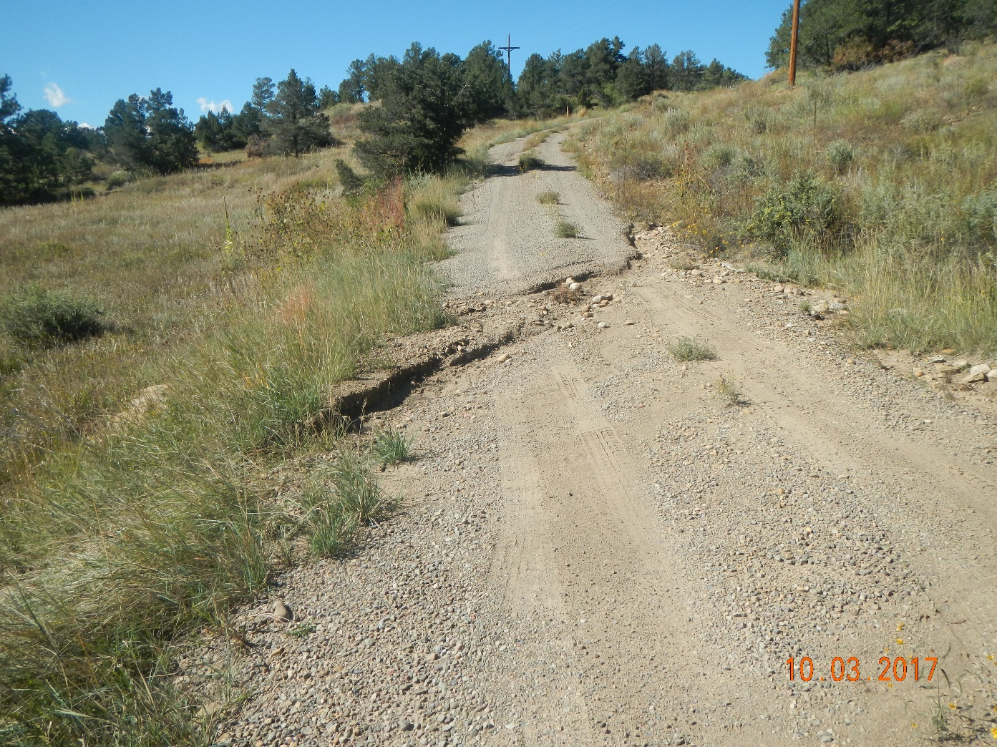
Inspection Photos
Photo 3. There is stormwater directed across the road which is causing erosion of the road.

Slide 4
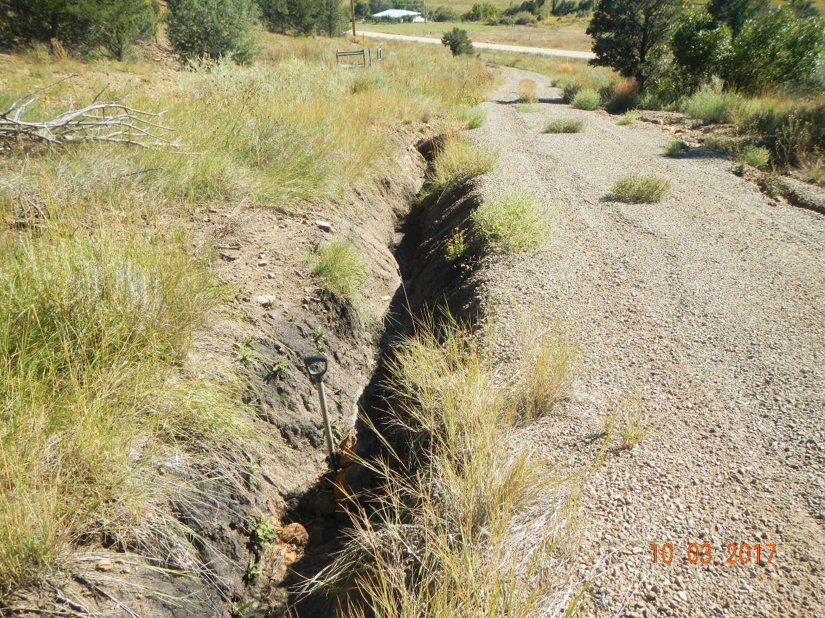
Inspection Photos
Photo 4. The side of the access road has eroded creating a 3.5ft gully shown by arrow which is pointing toward the 3.ft shovel.

Slide 5
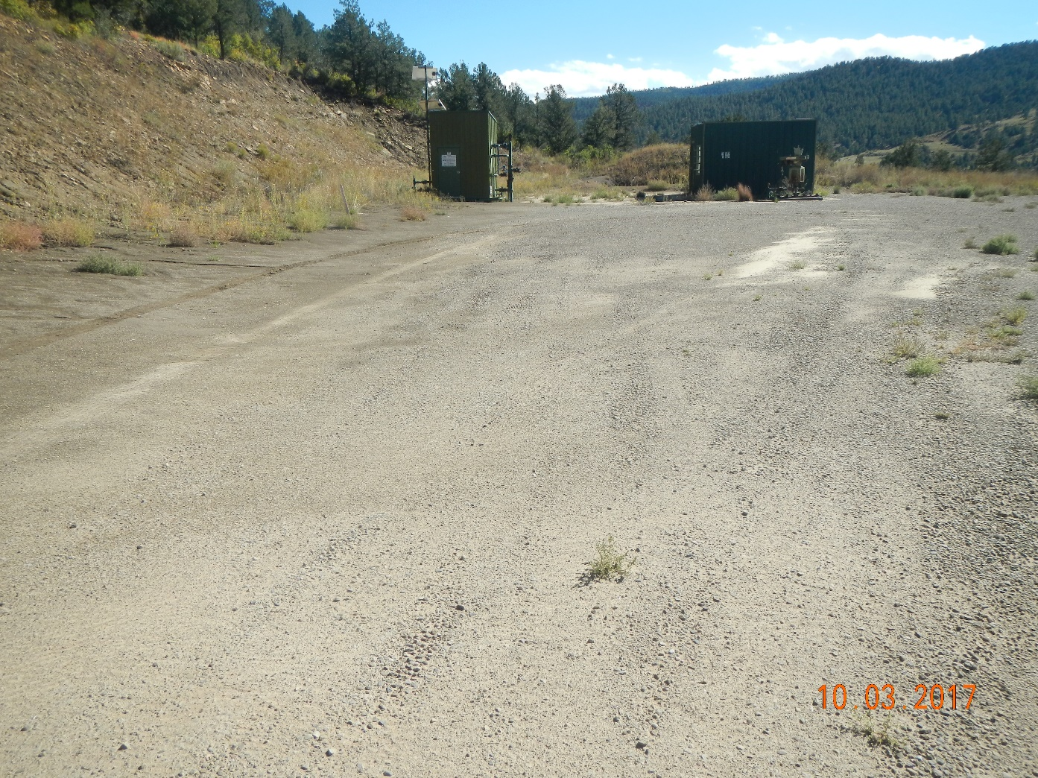
Inspection Photos
Photo 5. Facing southwest toward the location.

Slide 6
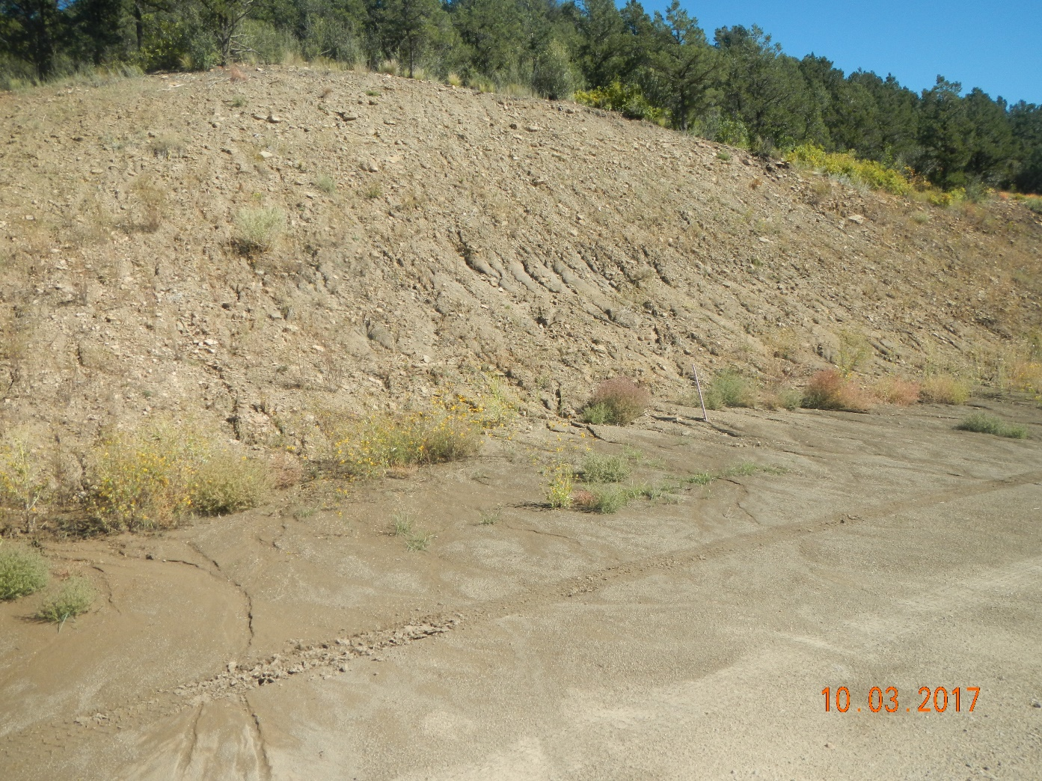
Inspection Photos
Photo 6. Facing toward the east cut slope of the location which is not adequately stabilized.

