Slide 1
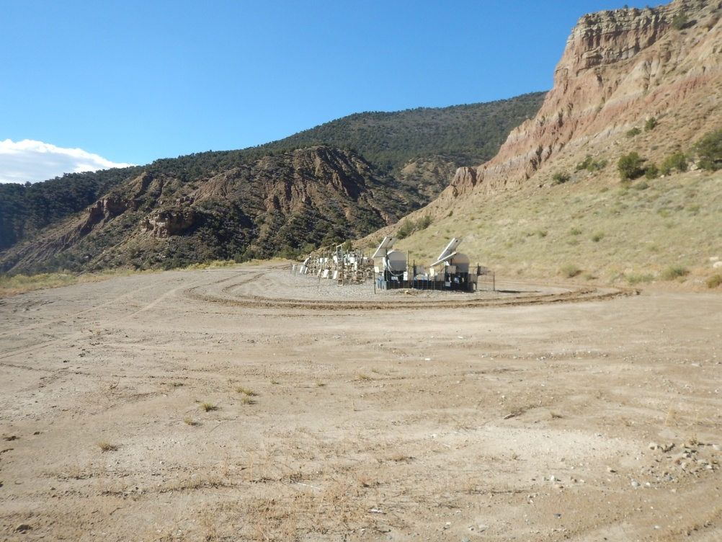
Inspection Photos
Location Name: TEP/FED RWF 311-9
API: 05-045-12801
location

