Slide 1
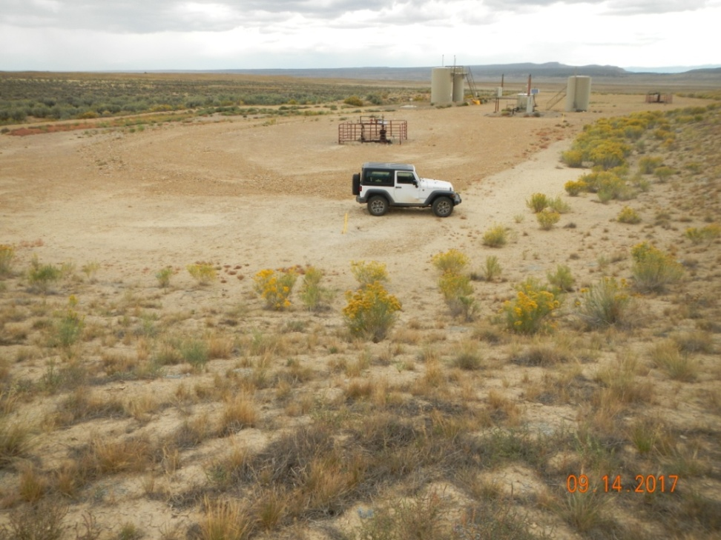
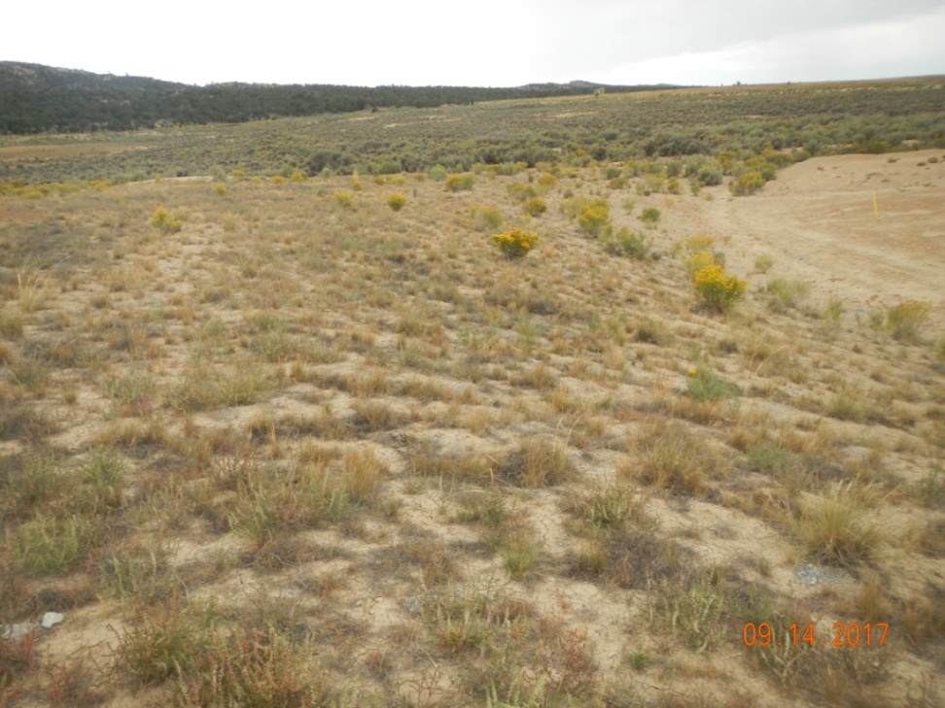
Photo 1: View of the project area from the southeastern corner facing center.
Photo 2: View of the southern portion of the project area from the southeastern corner facing westward. Revegetation is progressing with grasses and shrubs such as western wheatgrass (Pascopyrum smithii), James galleta (Pleuraphis jamesii), and winterfat (Kraschenninekovia lanata).

Slide 2
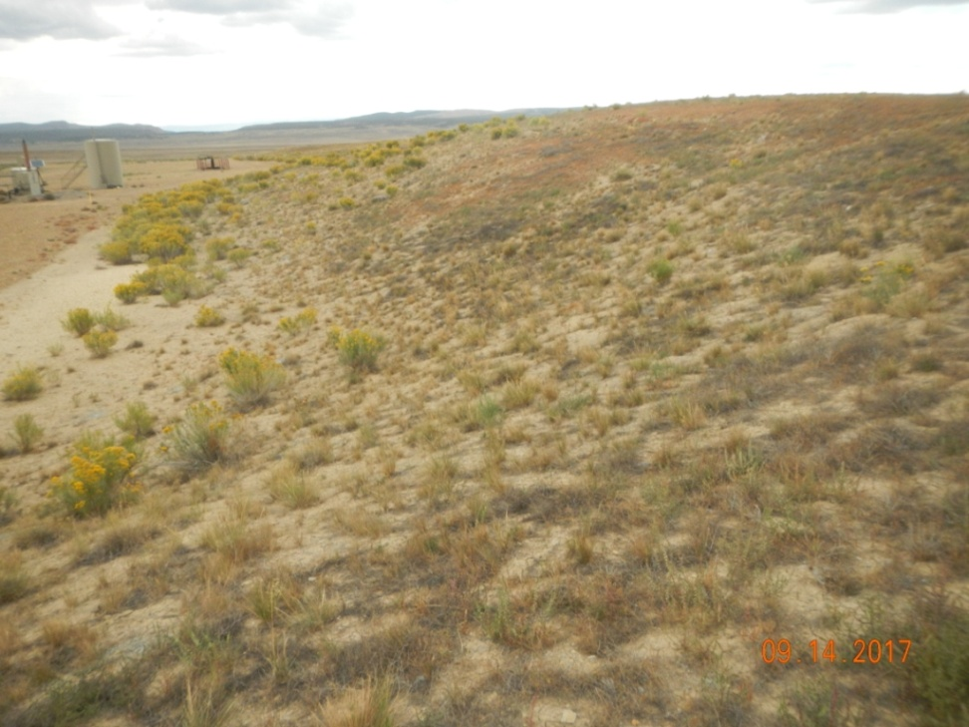
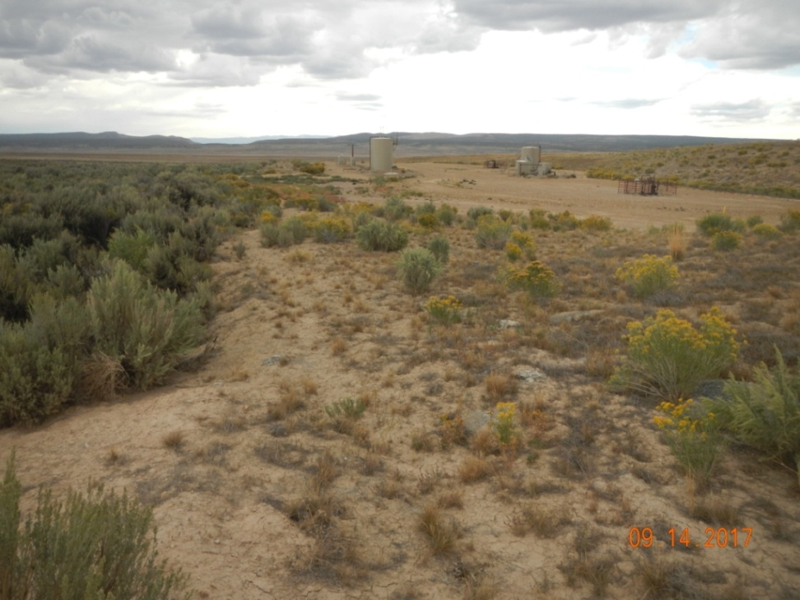
Photo 3: View of the eastern portion of the project area from the southeastern corner facing northward.
Photo 4: View of the northern portion of the project area from the northeastern corner facing westward.

