Slide 1
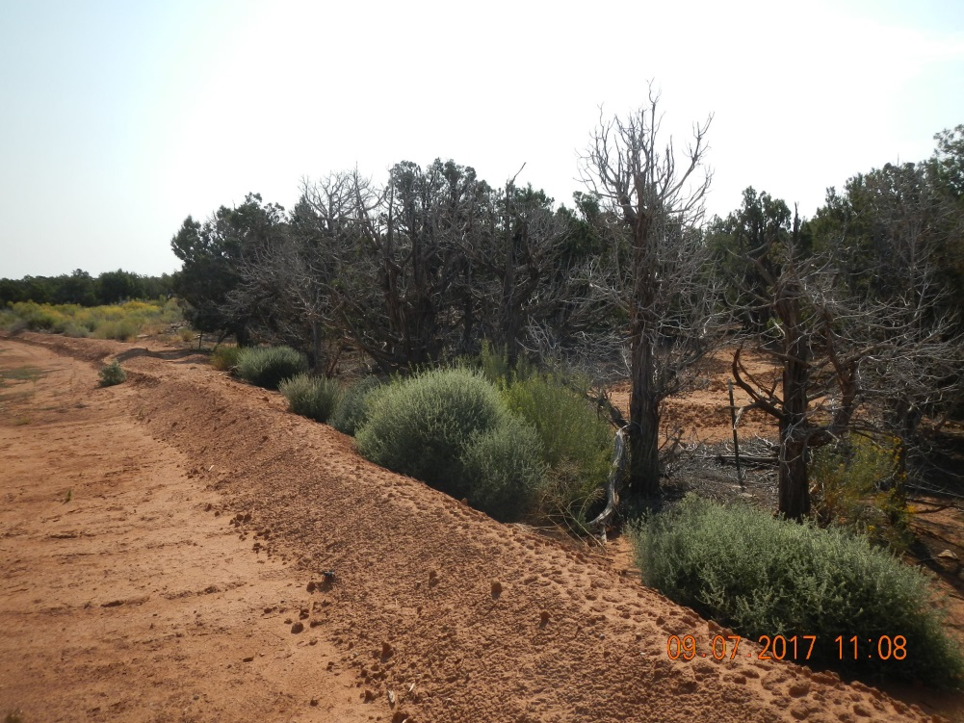
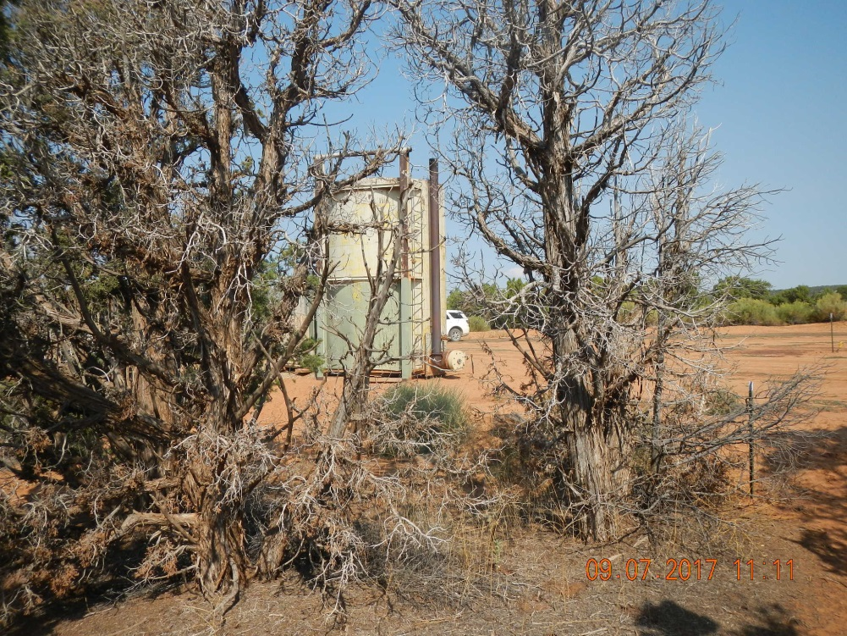
Inspection Photos
Location Name: QEP Island Butte 2 #7-AH
API: 05-083-06542
Location berm with dead juniper trees near the southwest corner.
Proximity of dead trees in relation to production equipment.

Slide 2
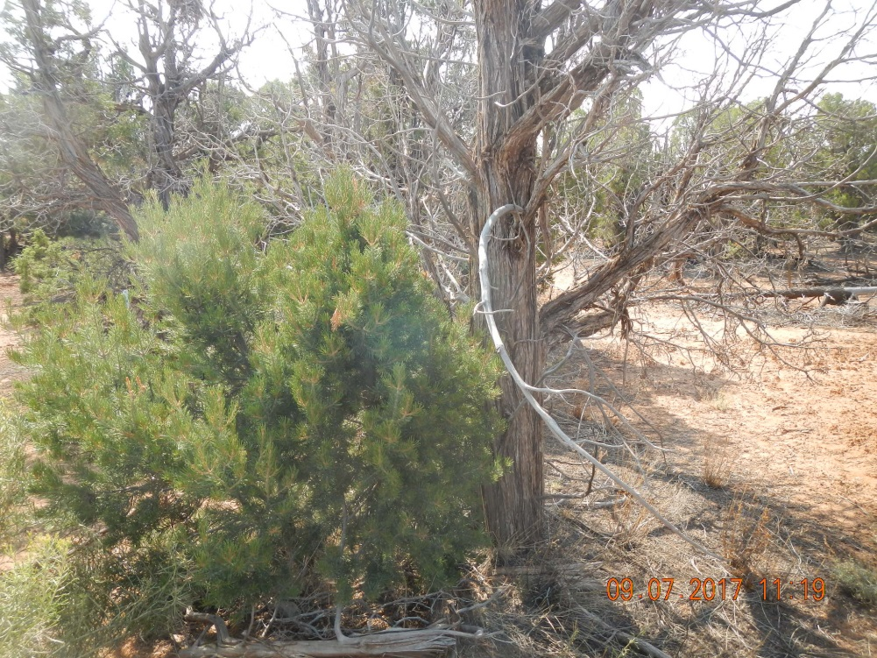
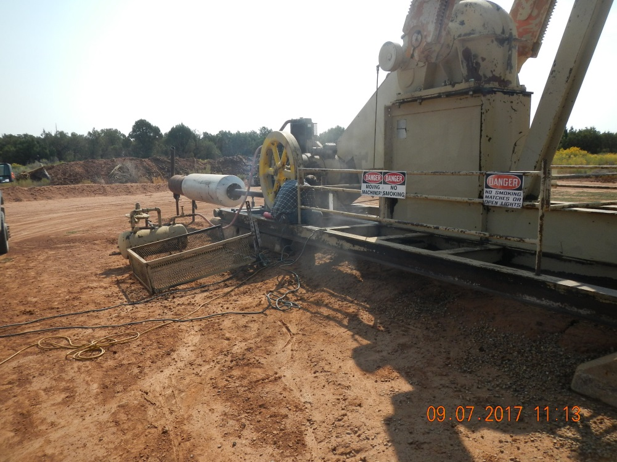
Inspection Photos
Location Name: QEP Island Butte 2 #7-AH
API: 05-083-06542
4-6’ tall Pinyon Pine tree adjacent to dead juniper.
Welder repairing prime mover mounts.

Slide 3
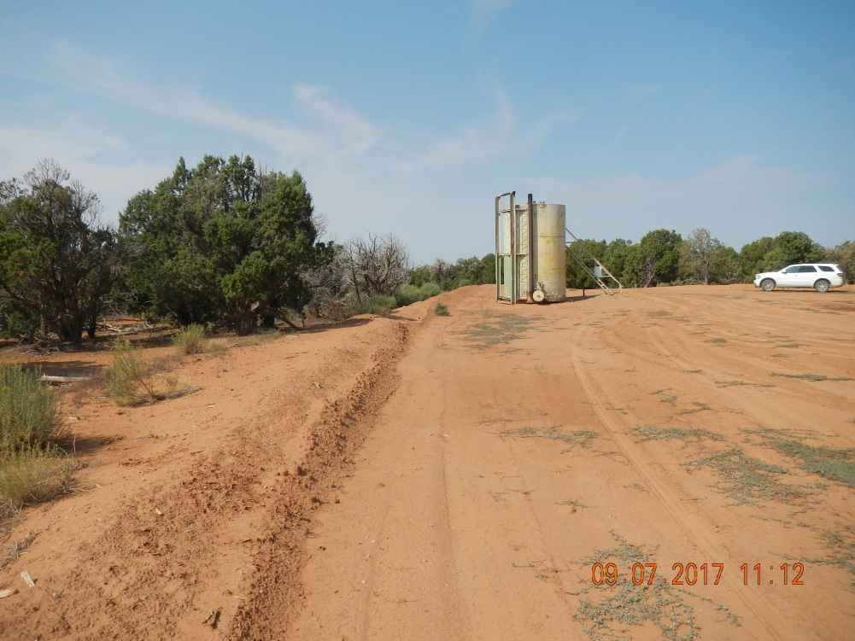
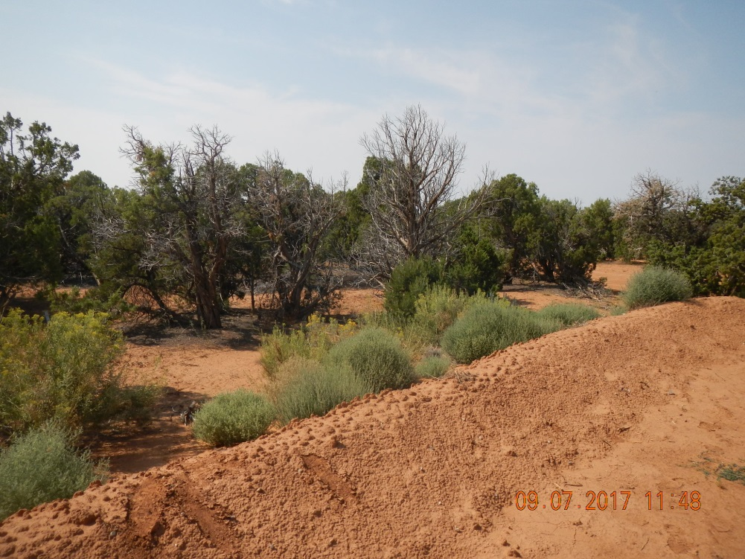
Inspection Photos
Location Name: QEP Island Butte 2 #7-AH
API: 05-083-06542
Dead trees near fresh water AST in SW corner of location.
Alternate view of dead junipers near SW corner of location.

