Slide 1
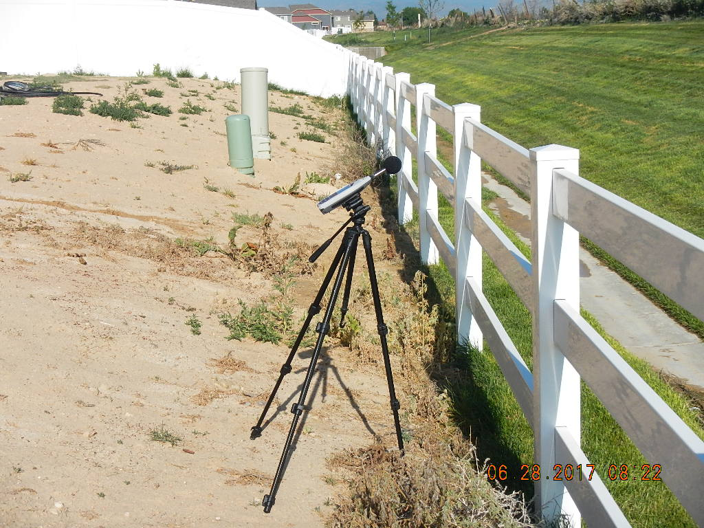
Inspection Photos
Location Number: 440858
Photo 1 Photo of sound meter from east.
Photo 2

Slide 2
Inspection Photos
Photo 3
Photo 4

Slide 3
Inspection Photos
Photo 5
Photo 6

