Slide 1
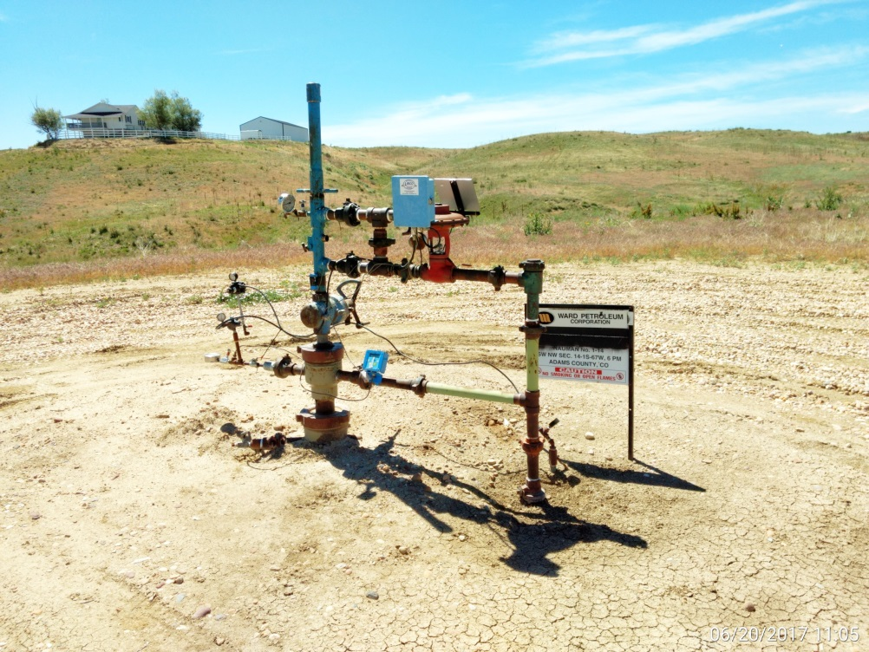
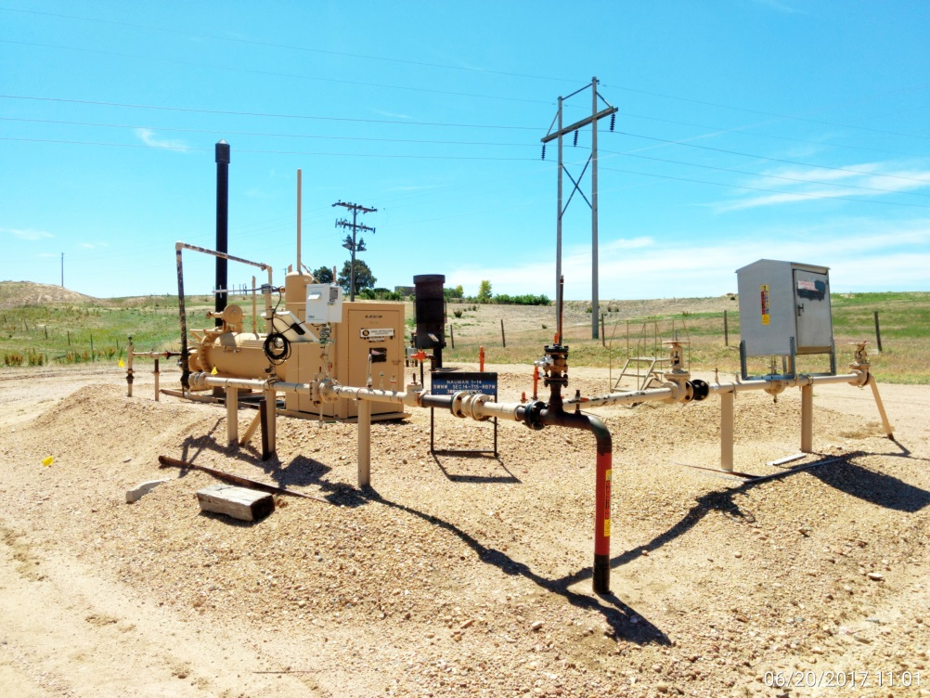
Inspection Photos
Location Name: Nauman 1-14
API: 05-001-09512
Wellhead
Battery

