Slide 1
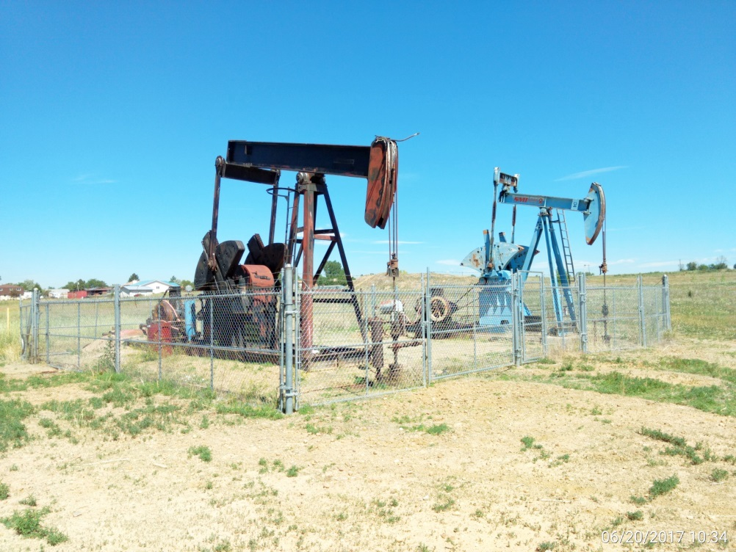
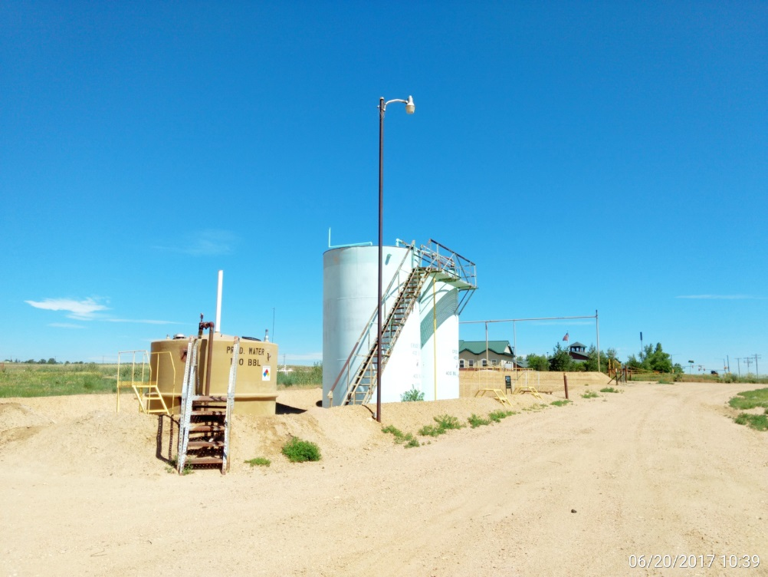
Inspection Photos
Location Name: Hi-Land 10B
API: 05-001-08767
Wellhead
Battery

Slide 2
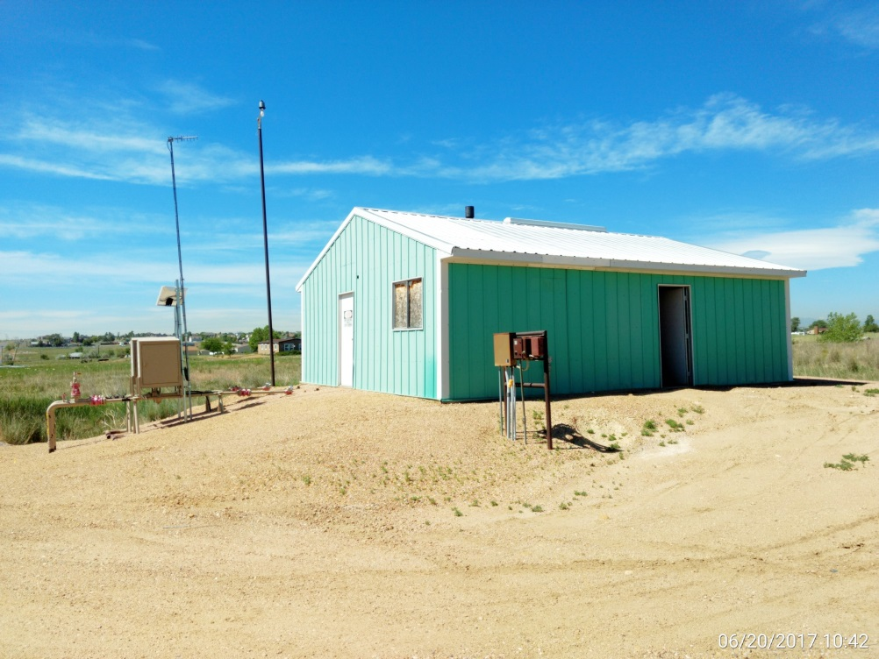
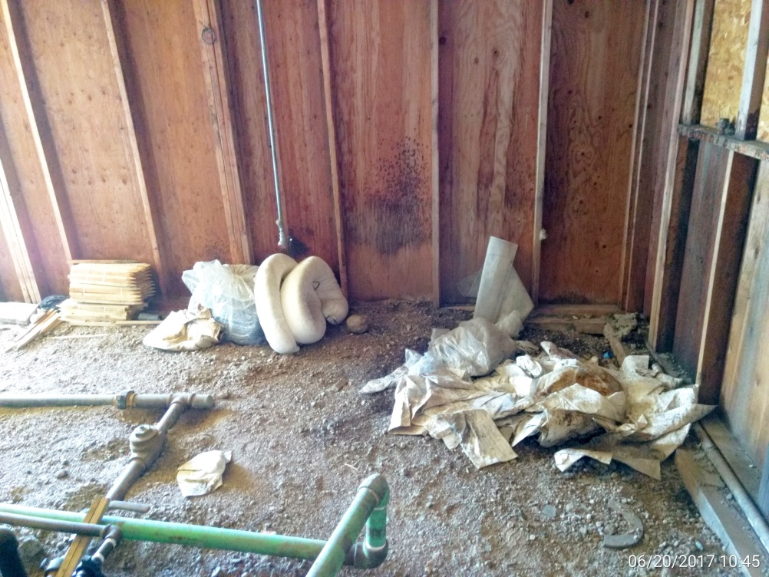
Inspection Photos
Location Name: Hi-Land 10B
API: 05-001-08767
Separator housing
Corrective Action: Trash inside separator housing shed

Slide 3
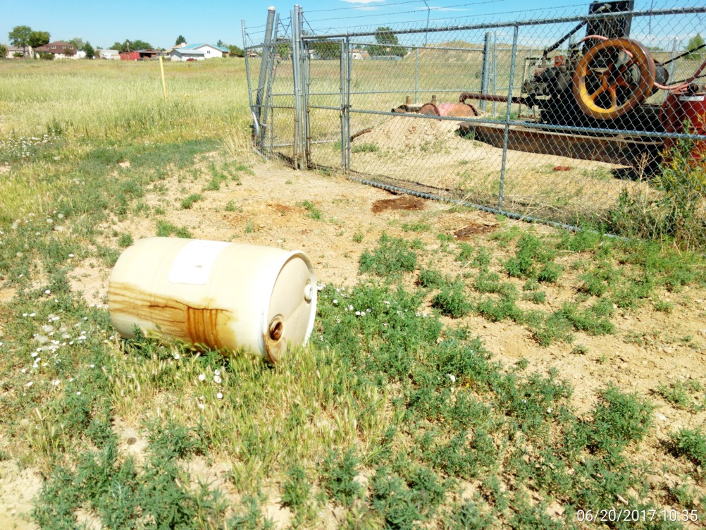
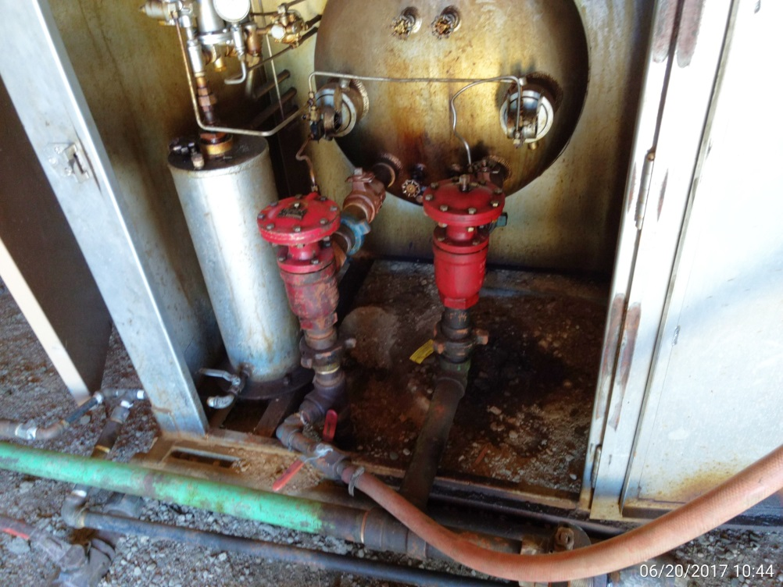
Inspection Photos
Location Name: Hi-Land 10B
API: 05-001-08767
Corrective action: Trash at wellhead
Corrective action: Stained soil around separator

Slide 4
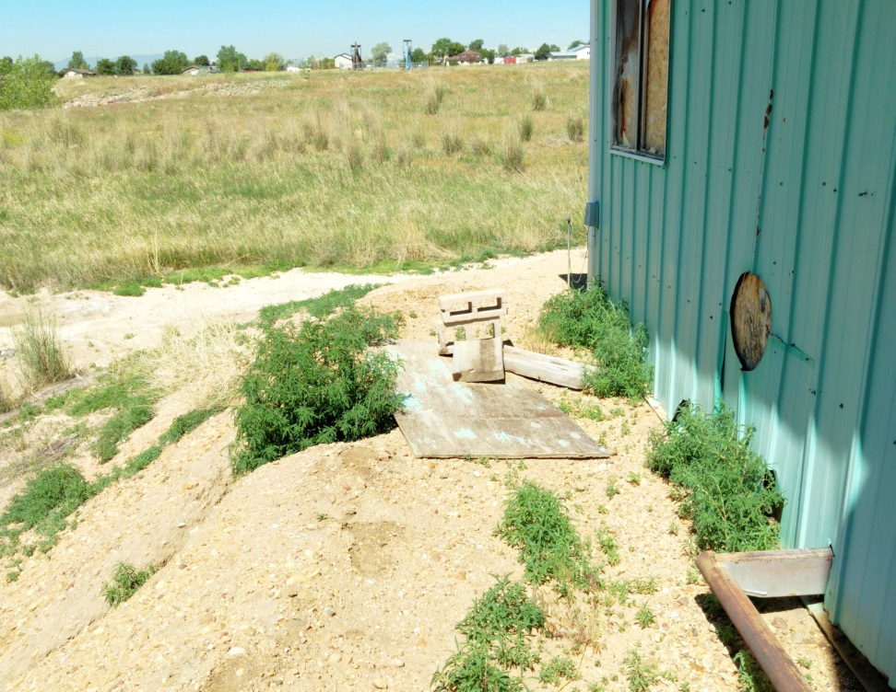
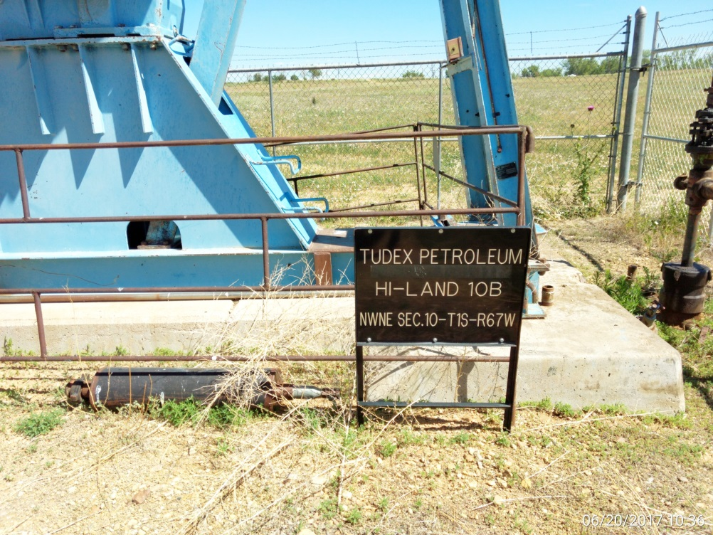
Inspection Photos
Location Name: Hi-Land 10B
API: 05-001-08767
Corrective action: Trash outside of separator housing shed
Corrective action: No emergency contact information on signage

