Slide 1
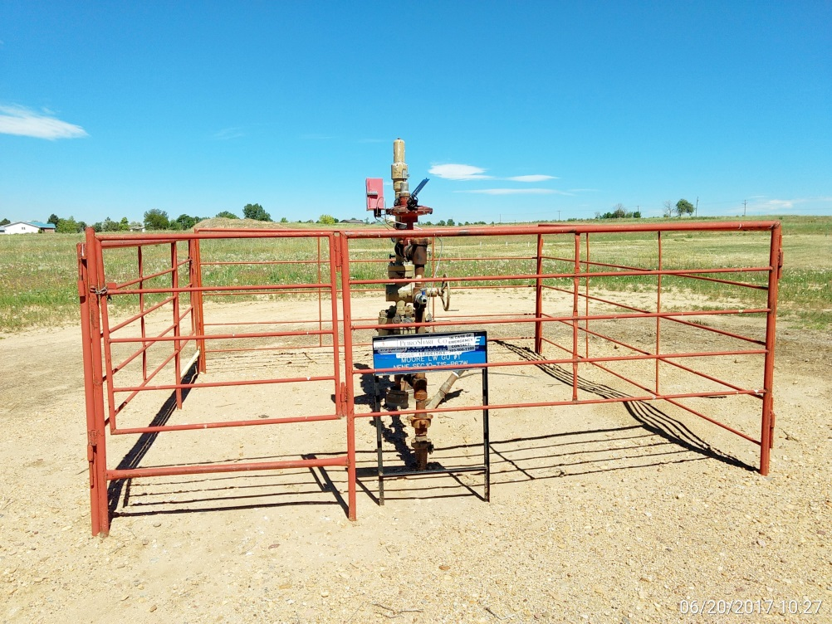
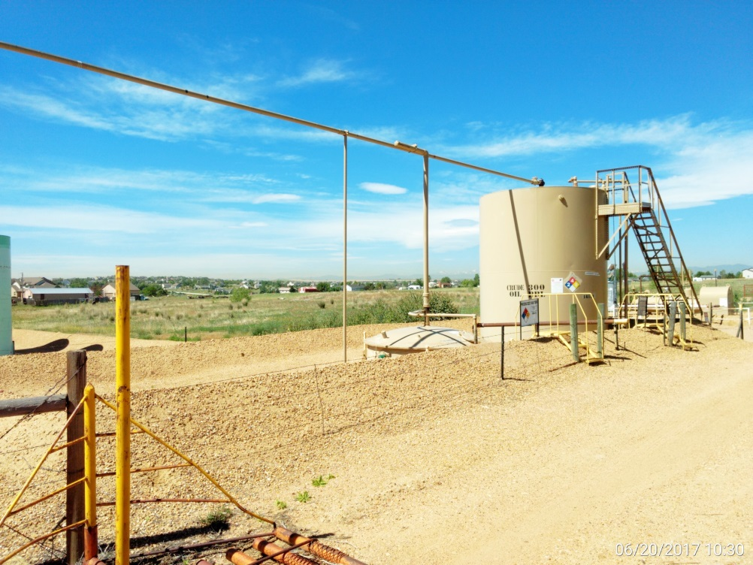
Inspection Photos
Location Name: L.W. Moore #1
API: 05-001-07074
Wellhead
Battery

