Slide 1
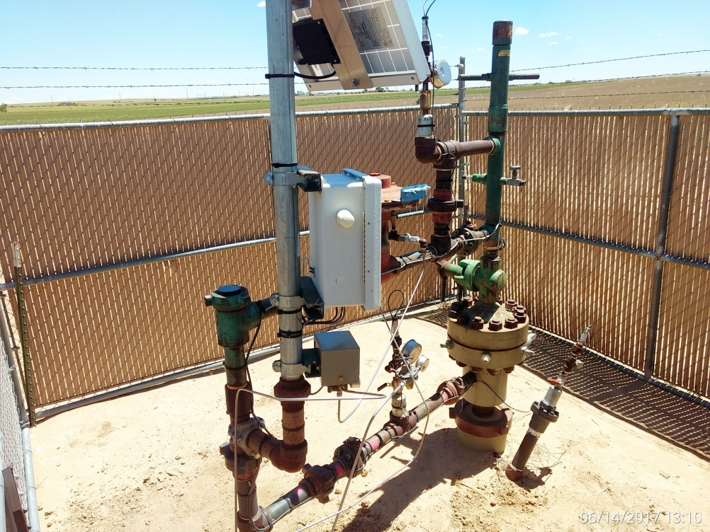
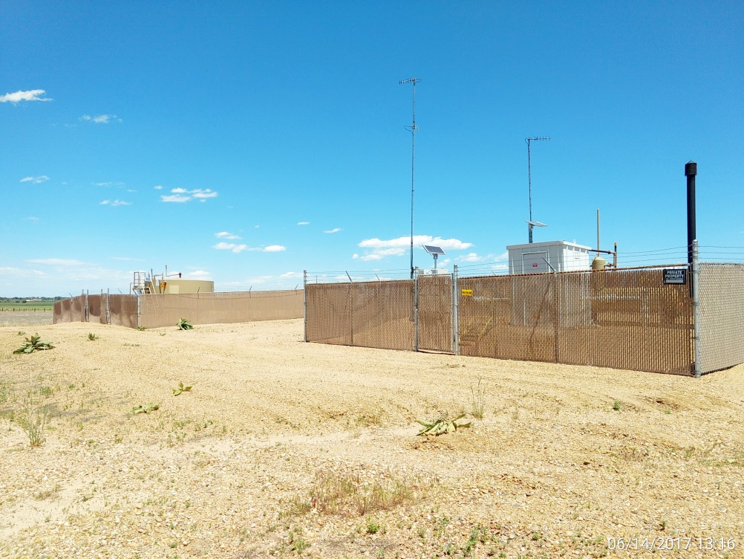
Inspection Photos
Location Name: Price 7-19
API: 05-001-09525
Wellhead
Battery

Slide 2
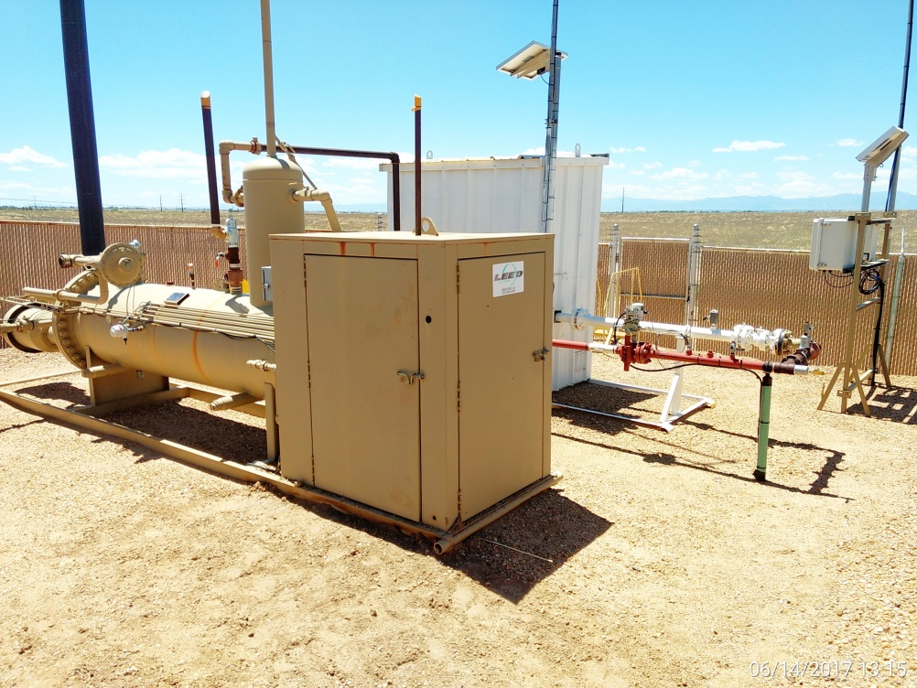
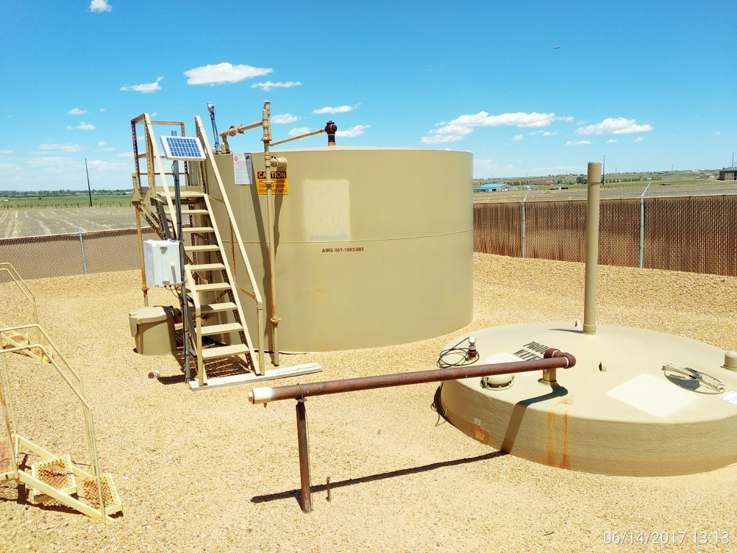
Inspection Photos
Location Name: Price 7-19
API: 05-001-09525
Separator, meter run, & RTU
Production and water tank

