Slide 1
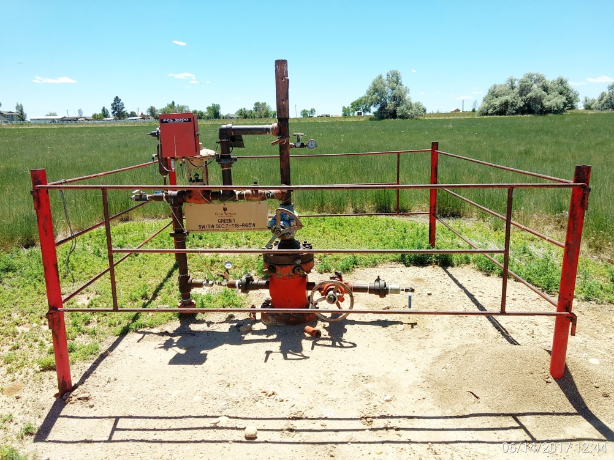
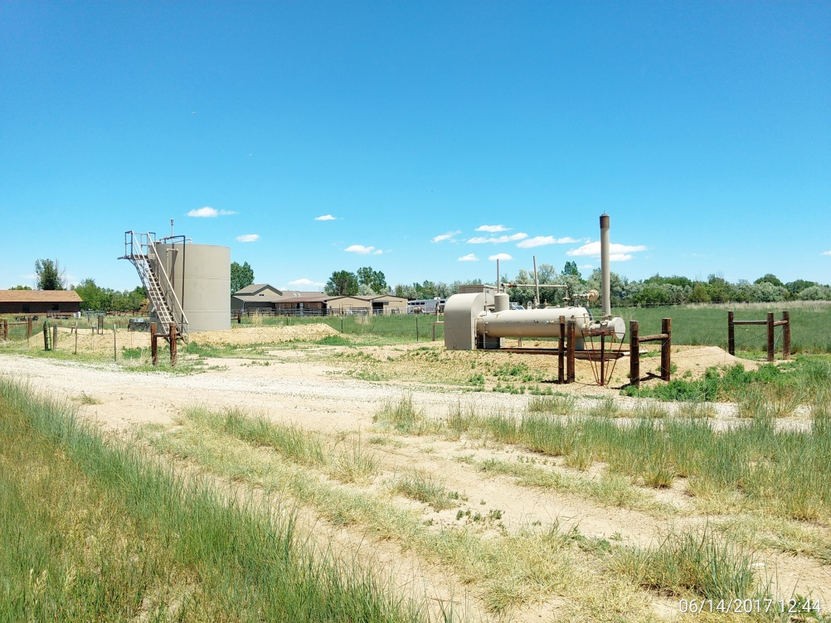
Inspection Photos
Location Name: Green 1
API: 05-001-08327
Wellhead
Battery

