Slide 1
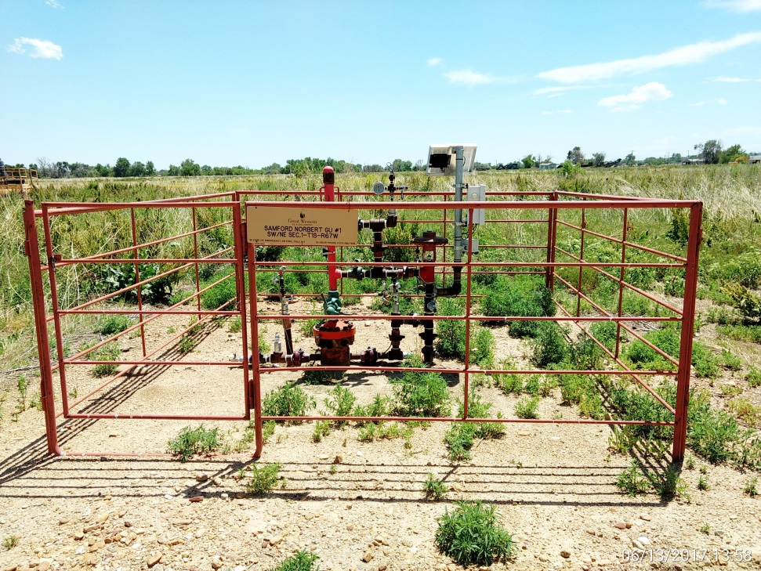
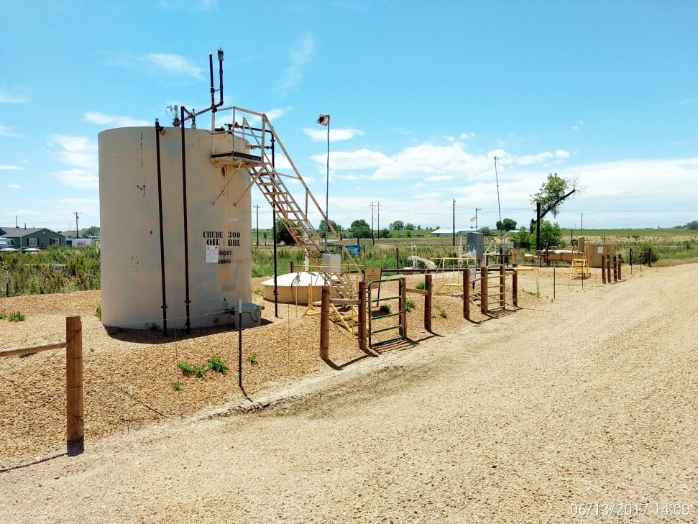
Inspection Photos
Location Name: Samford Norbert GU #1
API: 05-001- 07140
Wellhead
Battery

