Slide 1
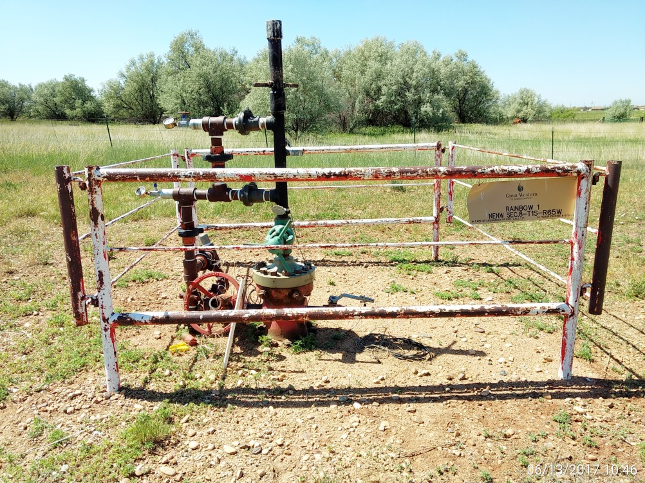
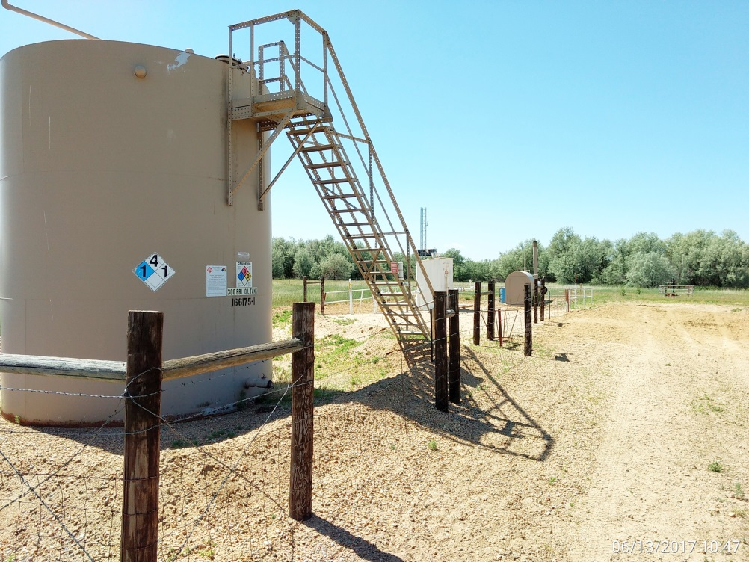
Inspection Photos
Location Name: Rainbow 1
API: 05-001-08117
Wellhead
Battery

