Slide 1
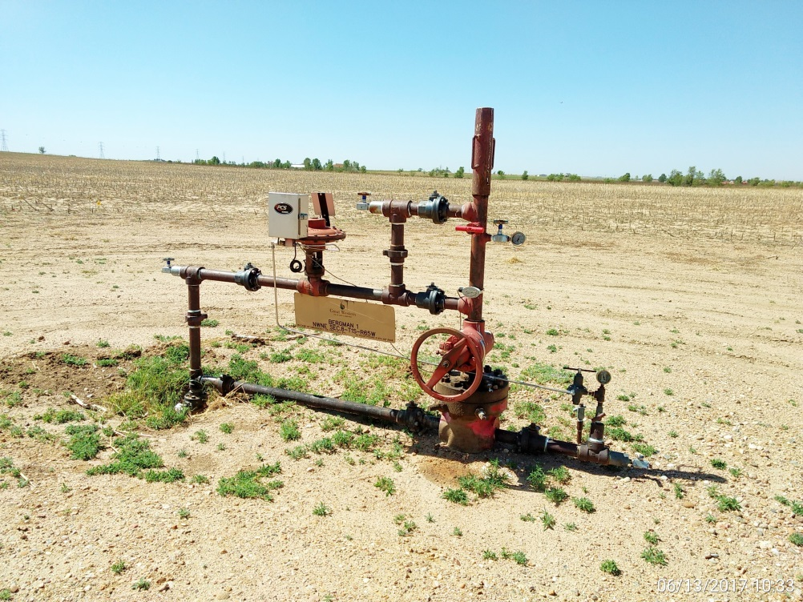
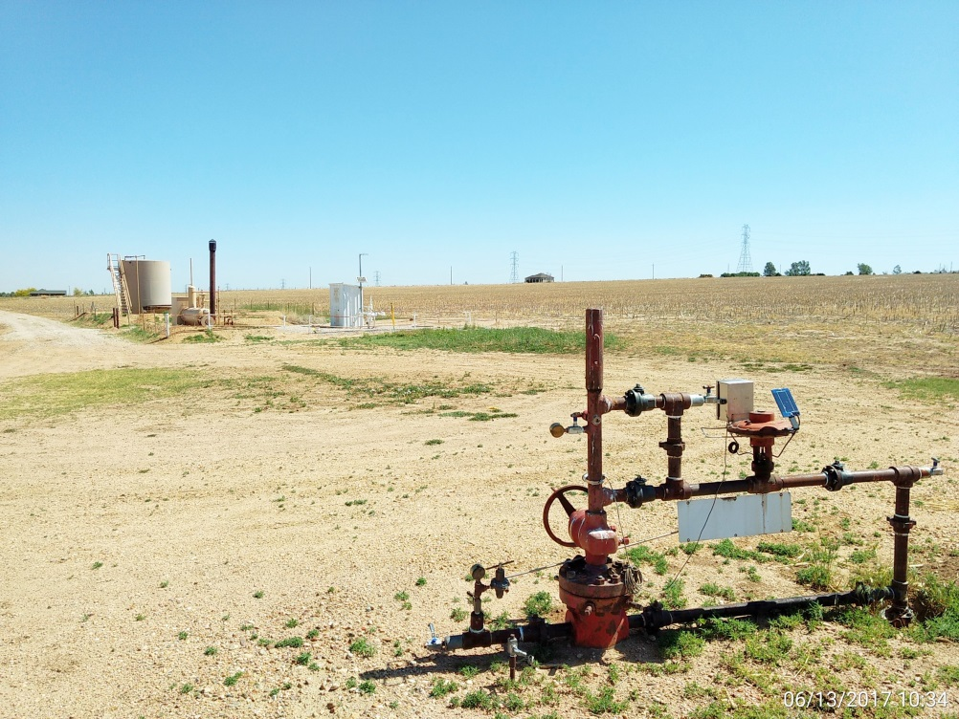
Inspection Photos
Location Name: Bergman 1
API: 05-001-07415
Wellhead
Battery

