Slide 1
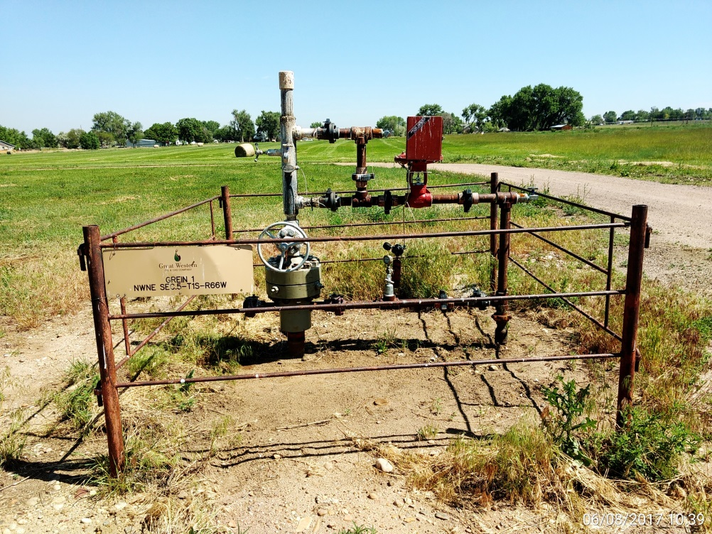
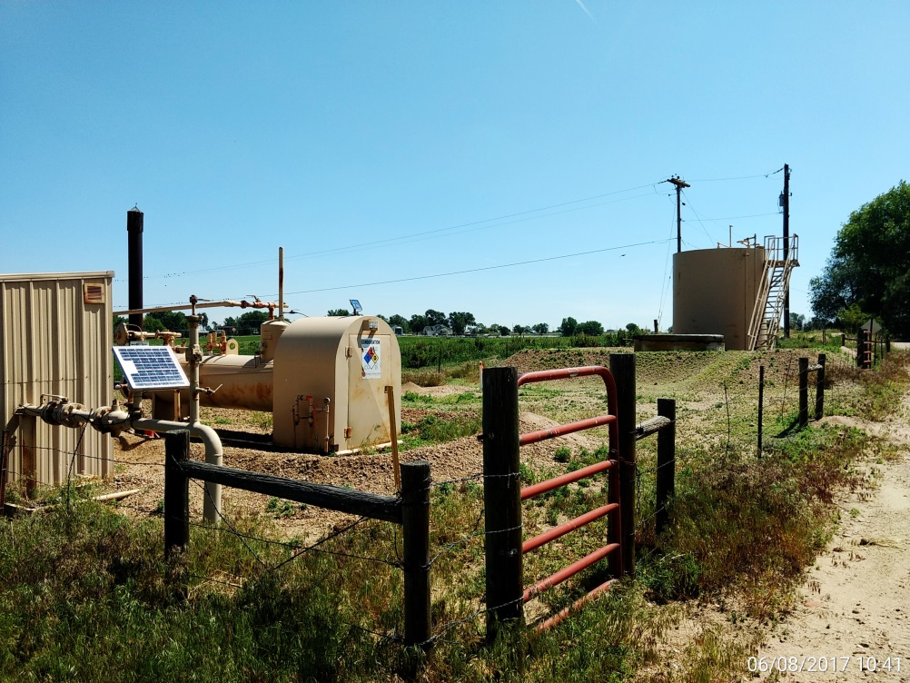
Inspection Photos
Location Name: Grein 1
API: 05-001-08315
Wellhead
Battery, CA: Weeds growing on berms and within location.

