Slide 1
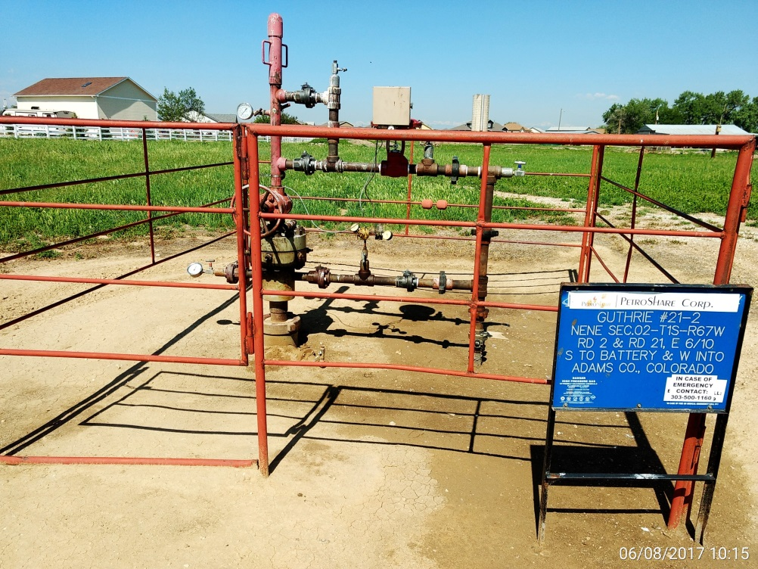
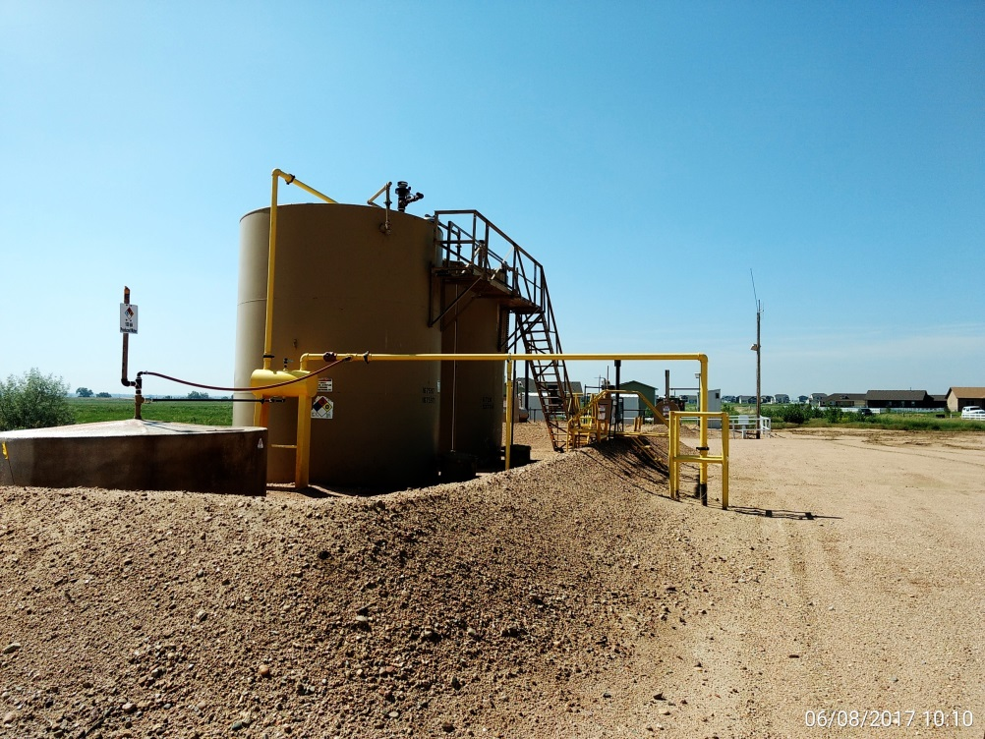
Inspection Photos
Location Name: Guthrie 21-2
API: 05-001-09463
Wellhead
Battery

