Slide 1
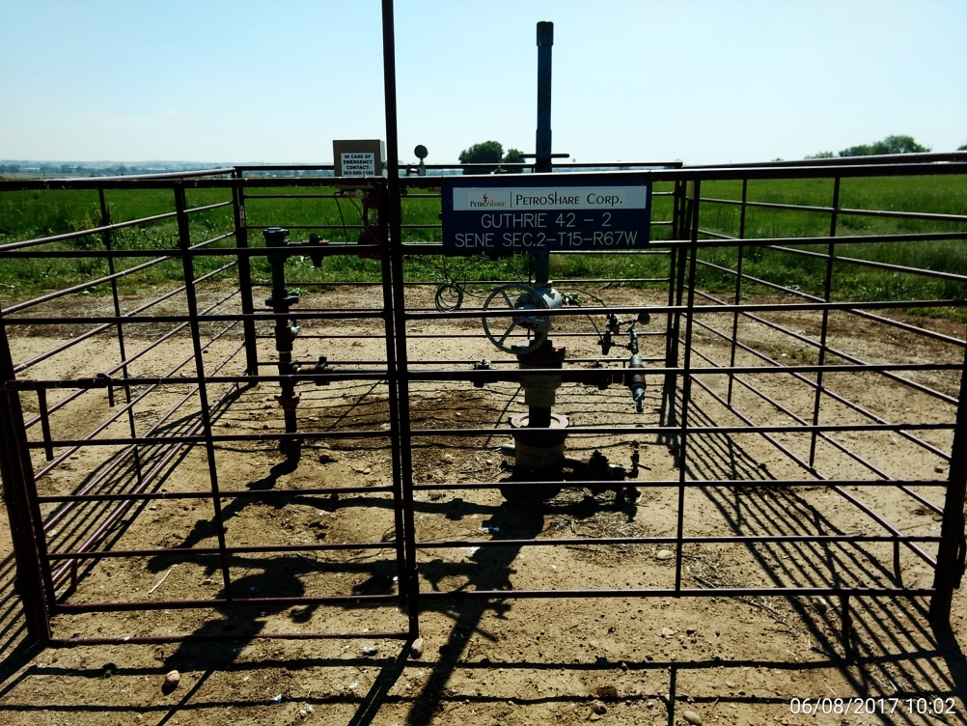
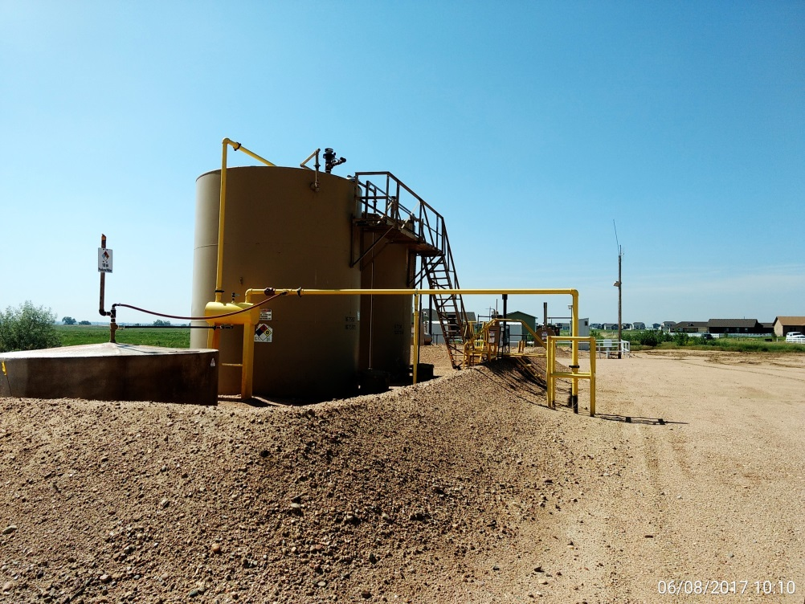
Inspection Photos
Location Name: Guthrie 42-2
API: 05-001-09563
Wellhead
Battery

