Slide 1
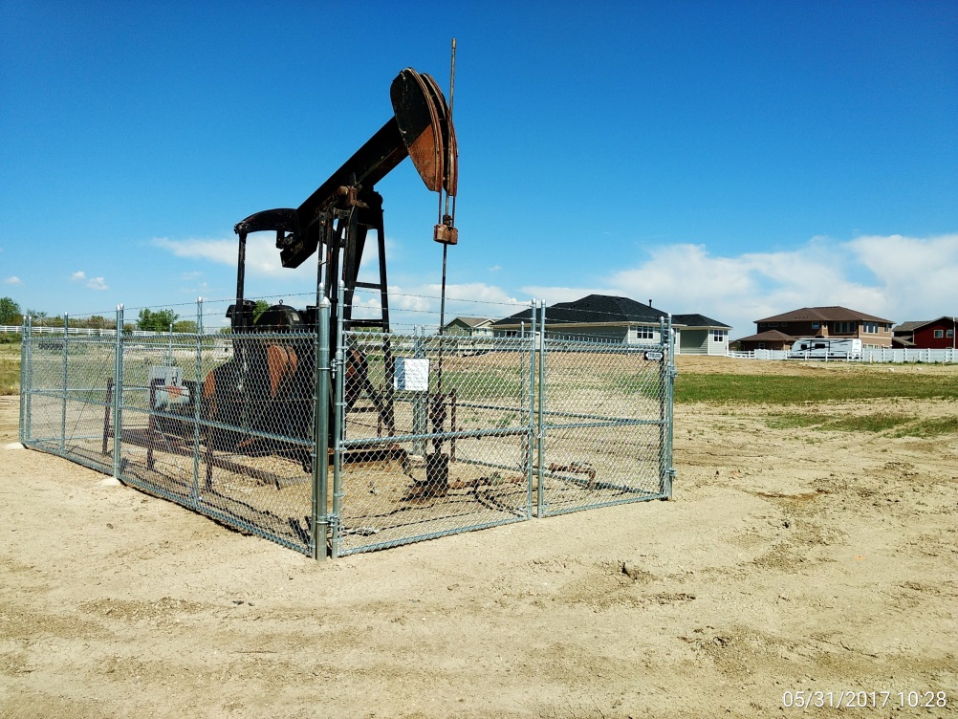
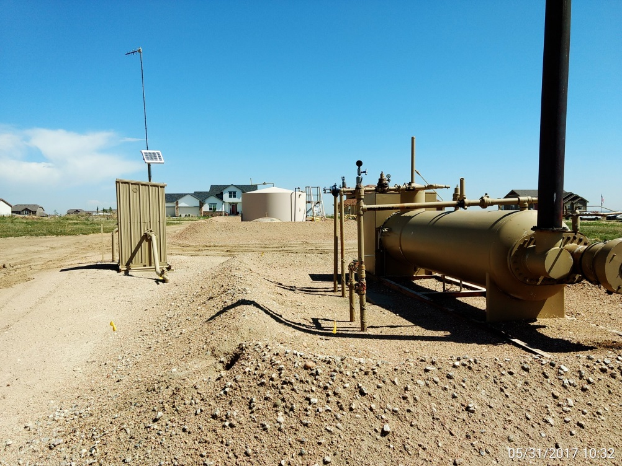
Inspection Photos
Location Name: Newlander #1
API: 05-001-08214
Wellhead, pumping unit view.
Battery View.

