Slide 1
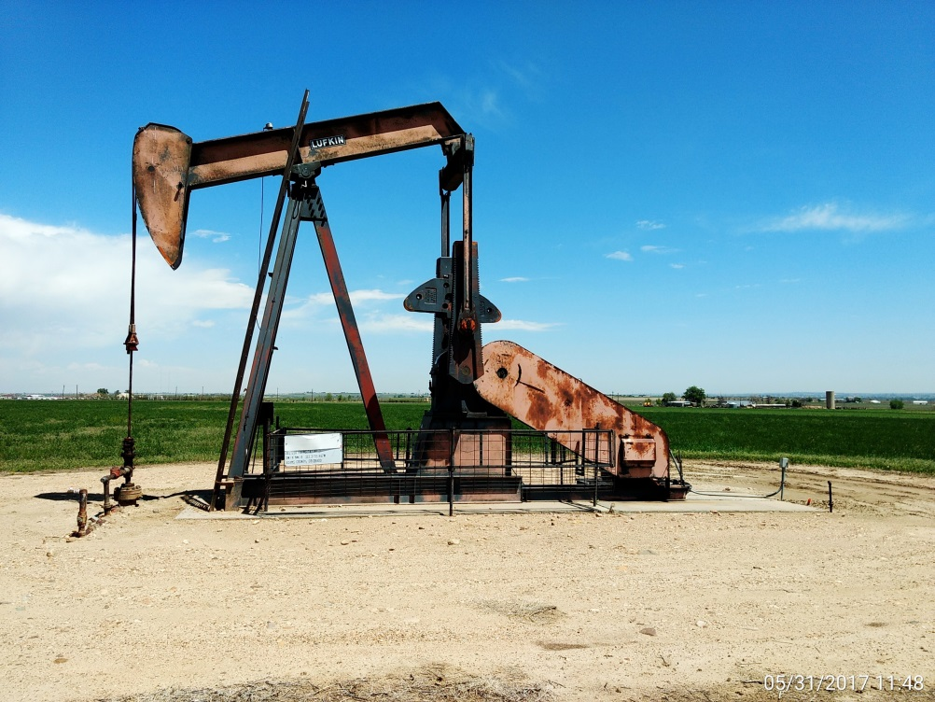
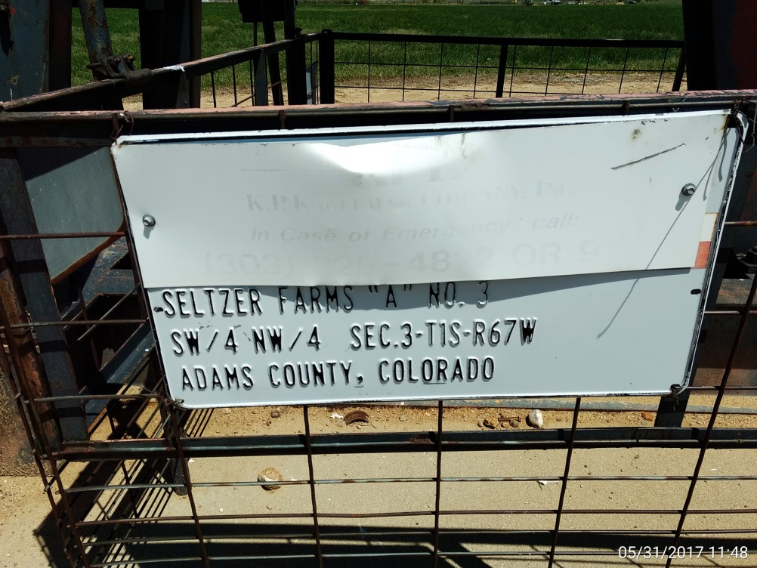
Inspection Photos
Location Name: Seltzer Farms Well A No.3
API: 05-001-08692
Wellhead view
Signage detail, CA: Missing emergency contact info.

Slide 2
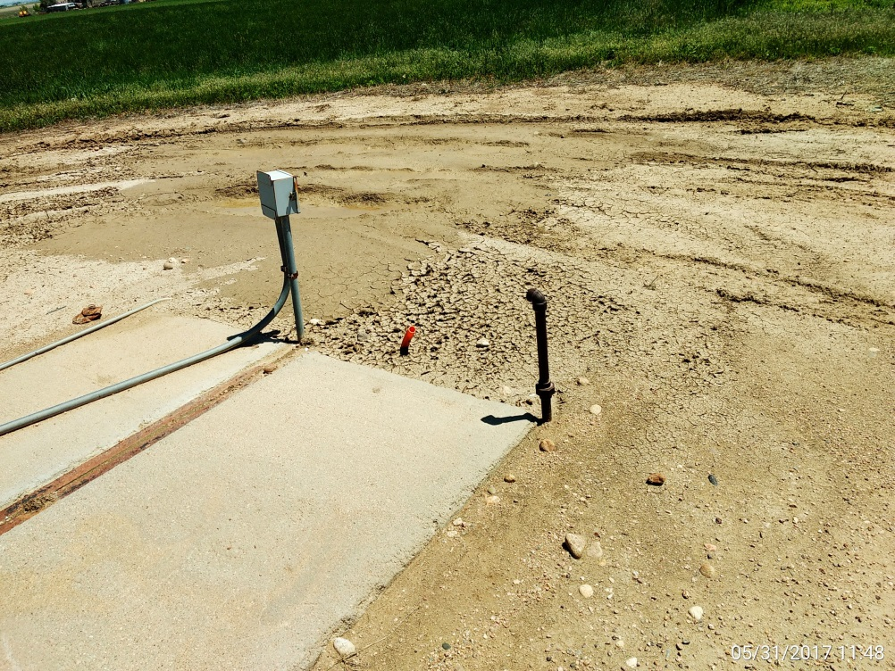
Inspection Photos
Location Name: Seltzer Farms Well A No.3
API: 05-001-08692
Pumping unit reference.
Unidentified supply line.

