Slide 1
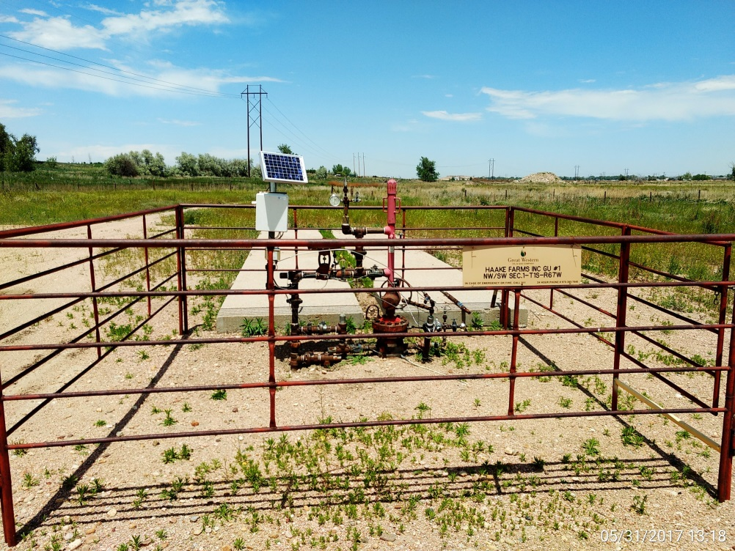
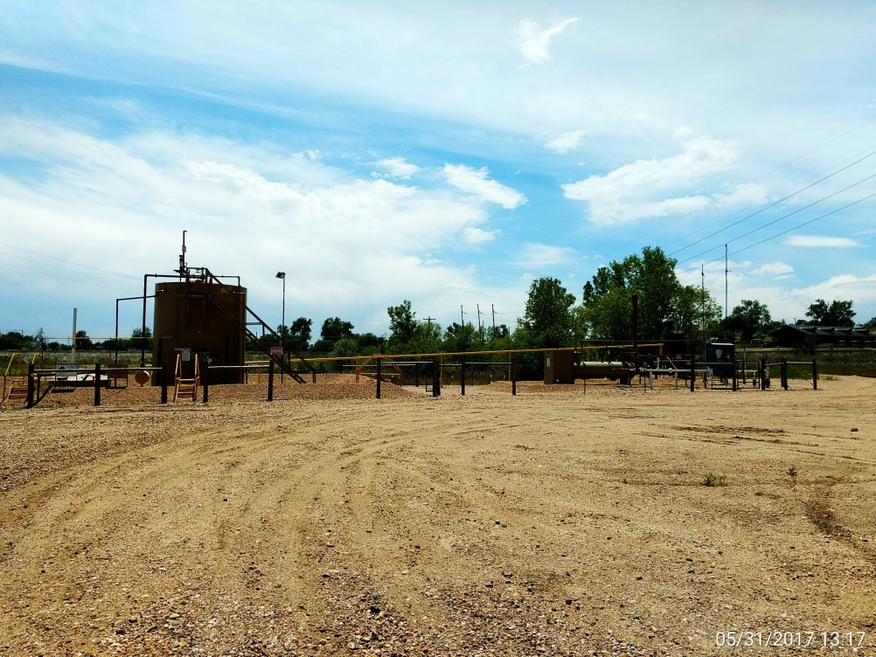
Inspection Photos
Location Name: Haake Farms GU#1
API: 05-001-06980
Wellhead, Has manifold at ground valve flow line.
Battery View

Slide 2
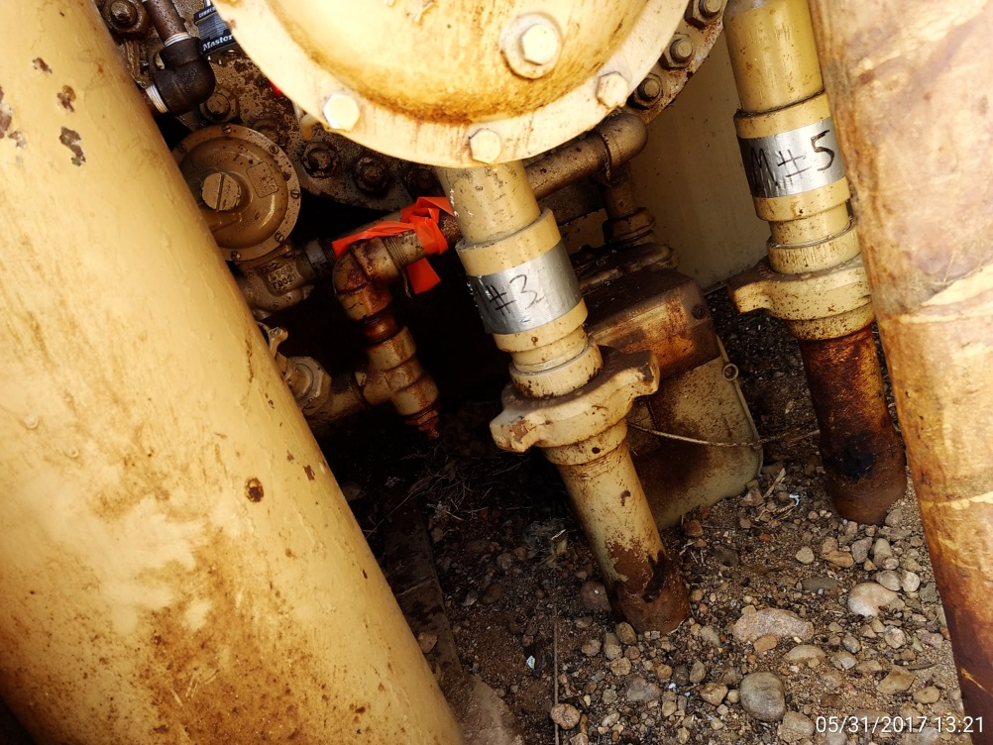
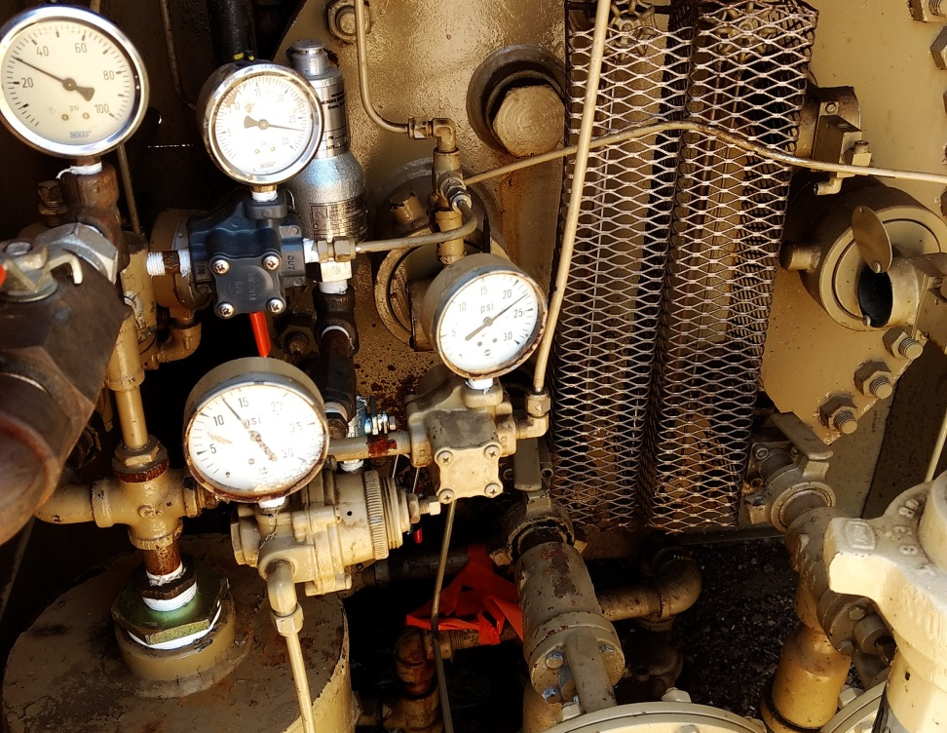
Inspection Photos
Location Name: Haake Farms GU#1
API: 05-001-06980
Supply Gas meter
Gas meter reference

