Slide 1
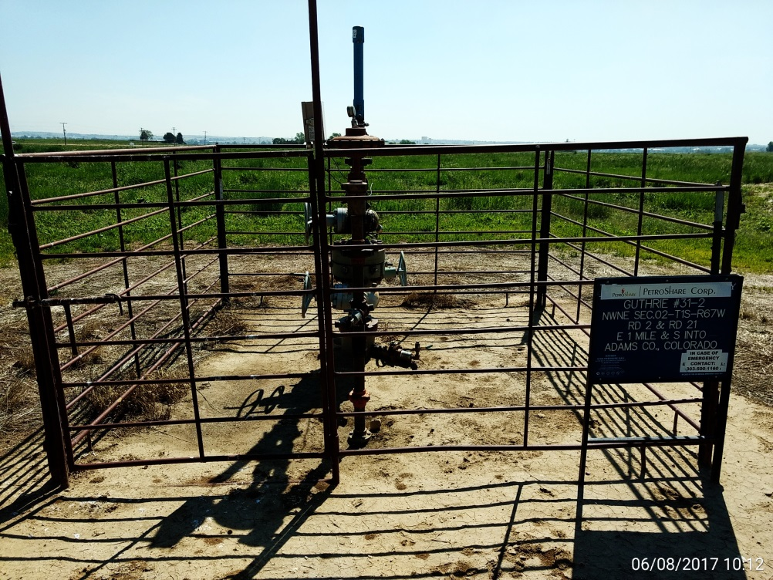
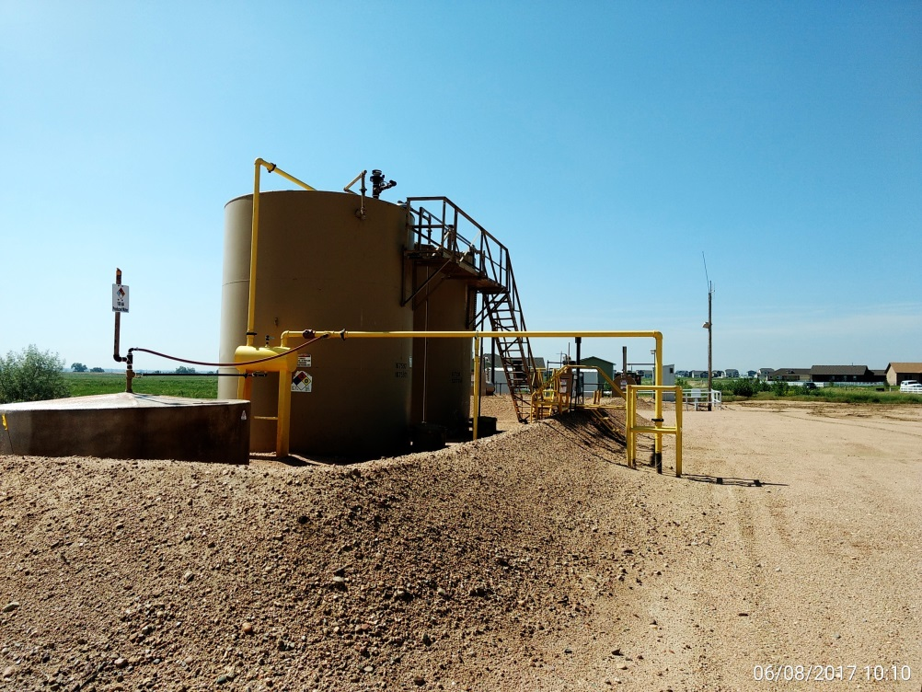
Inspection Photos
Location Name: Guthrie 31-2
API: 05-001-09541
Wellhead
Battery

