Slide 1
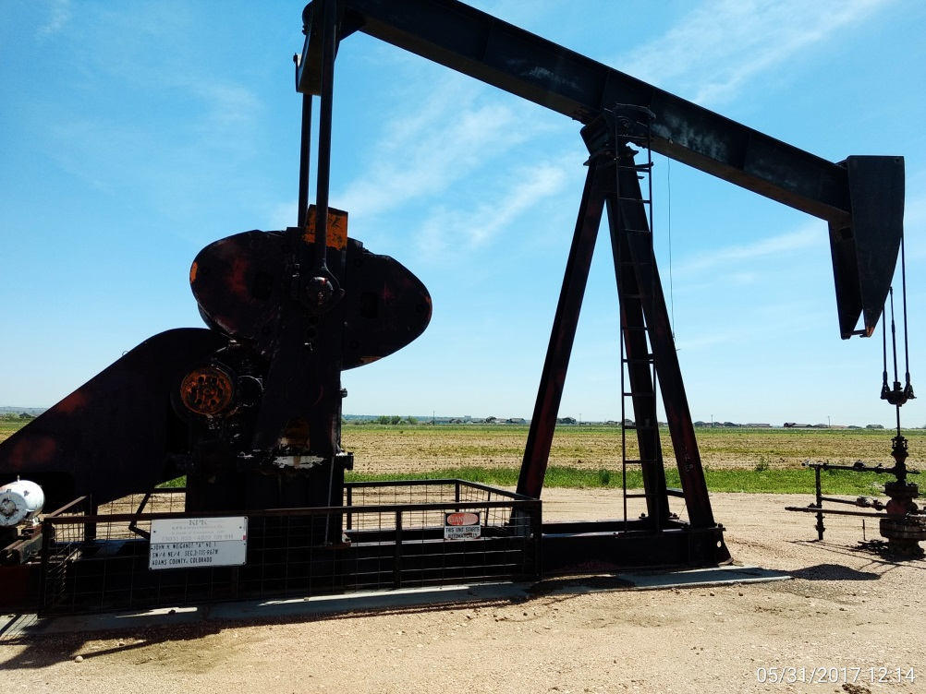
Inspection Photos
Location Name: Weigandt John H A 1
API: 05-001-08639
Wellhead View

