Slide 1
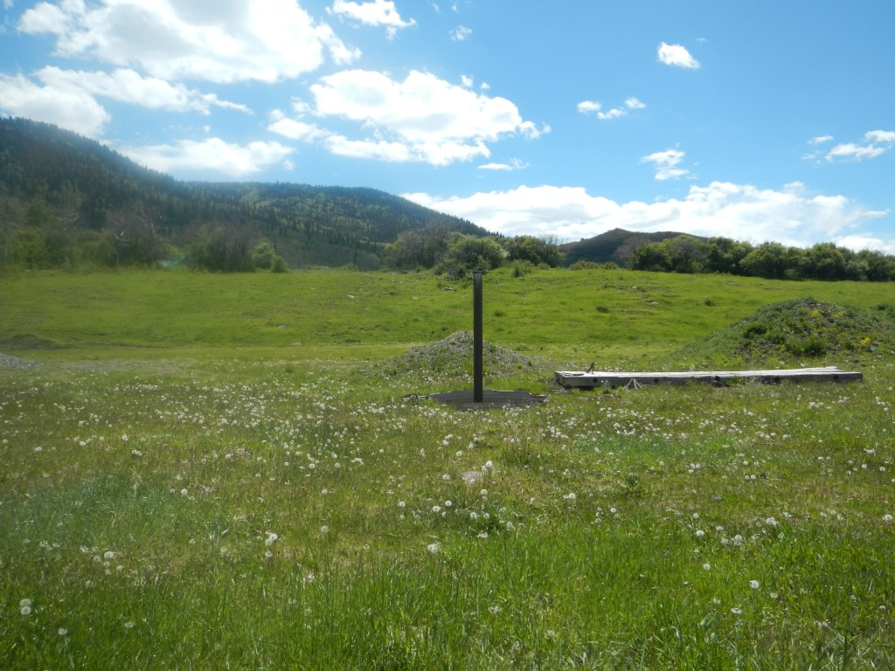

Photo#1:
Overview of Location to South. There is No visual evidence of equipment on Site.

