Slide 1
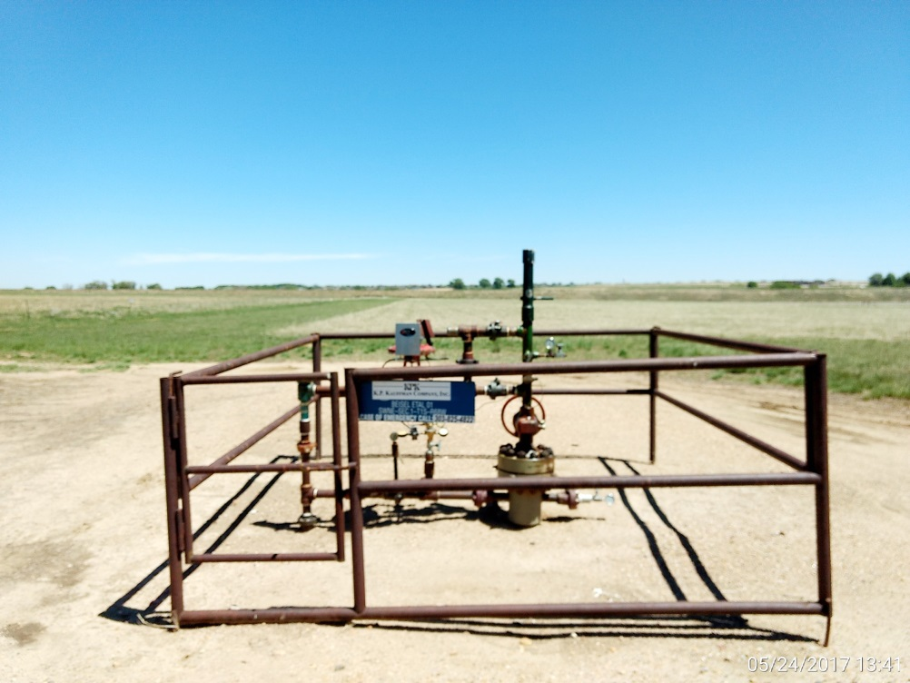
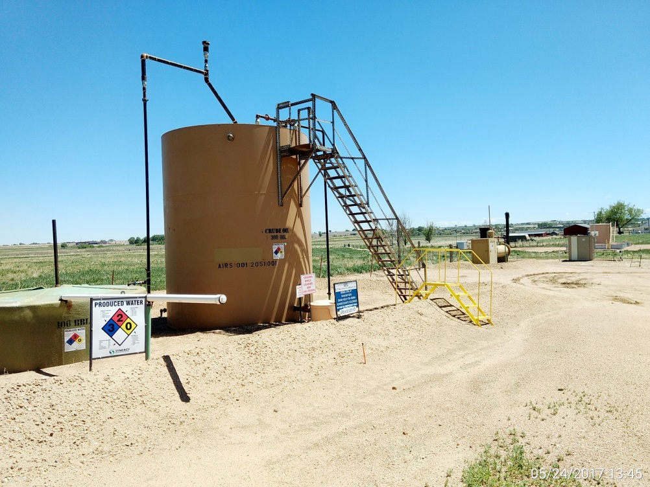
Inspection Photos
Location Name: Beisel Unit 1
API: 05-001-07108
Wellhead
Battery

Slide 2
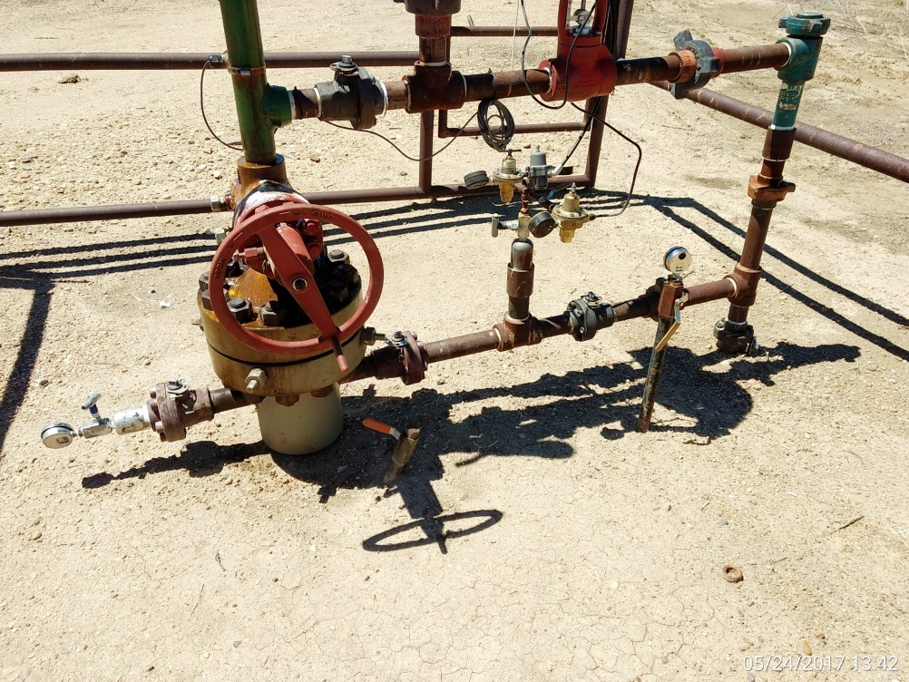
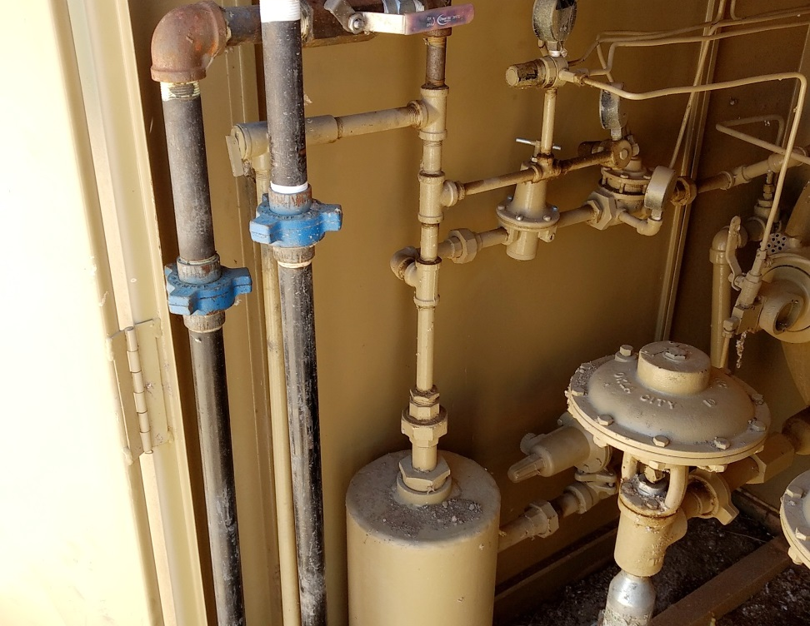
Inspection Photos
Location Name: Beisel Unit 1
API: 05-001-07108
Supply line at wellhead
Supply line tie in to scrubber

