Slide 1
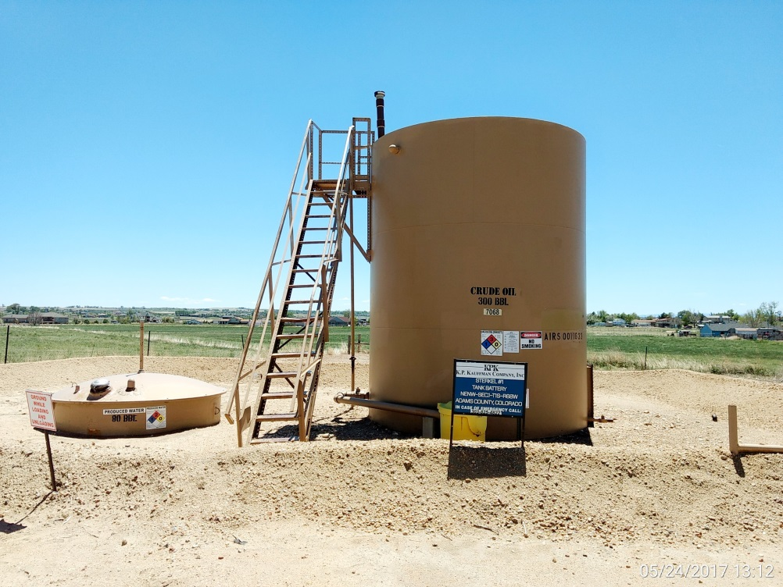
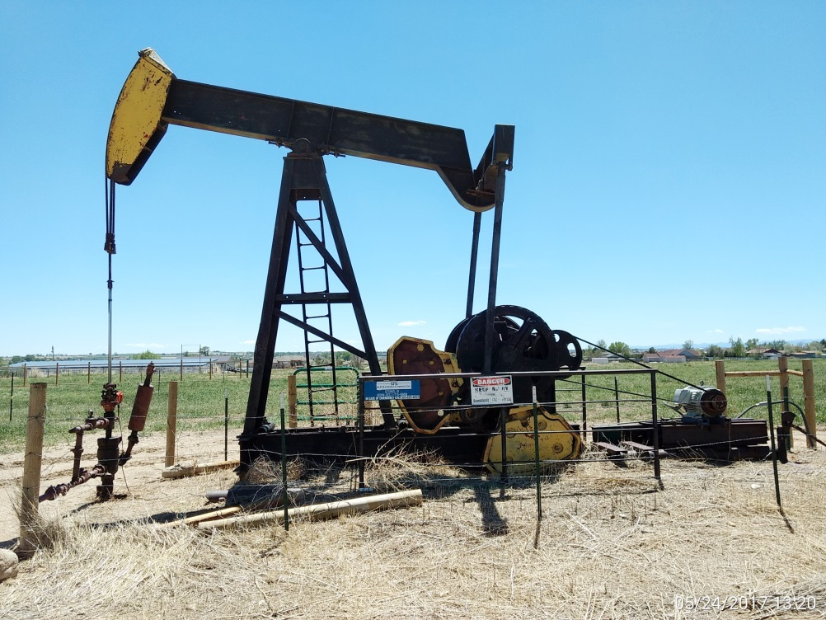
Inspection Photos
Location Name: Sterkel 1
API: 05-00-07315
Battery view
Well head, pumping unit, & prime mover

Slide 2
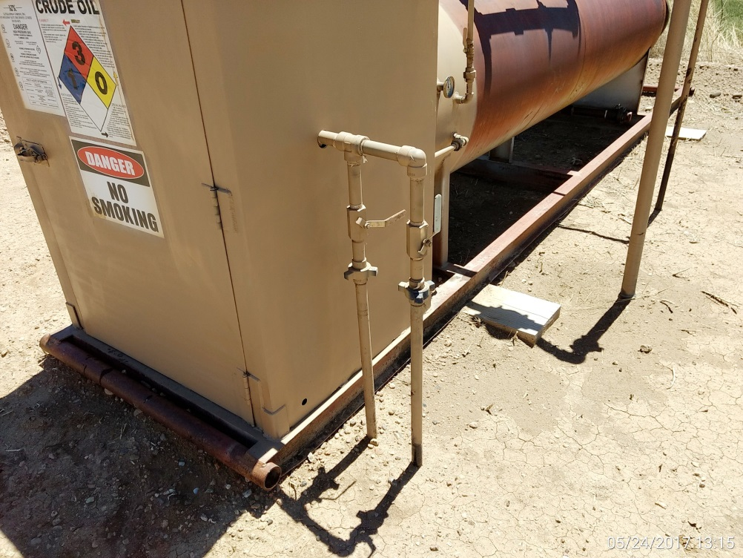
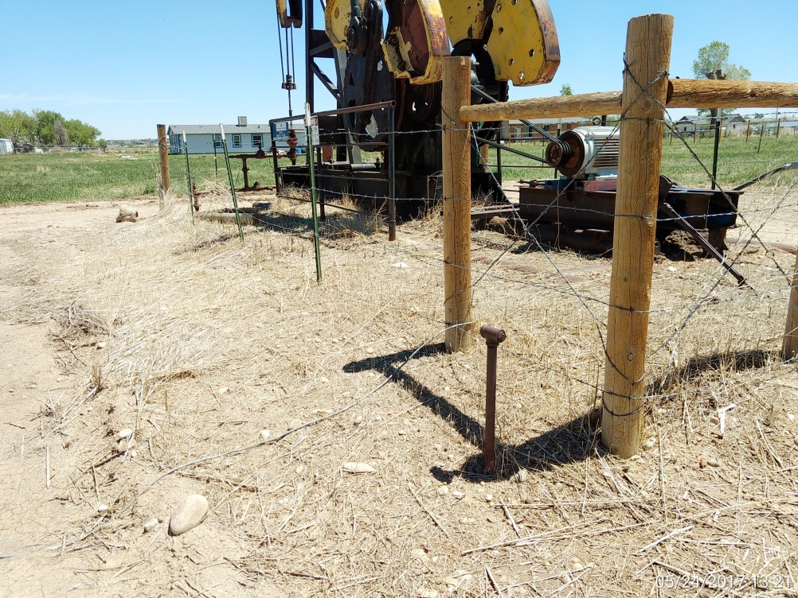
Inspection Photos
Location Name: Sterkel 1
API: 05-00-07315
1” Supply line going to pumping unit?
1” supply line at unit

