Slide 1
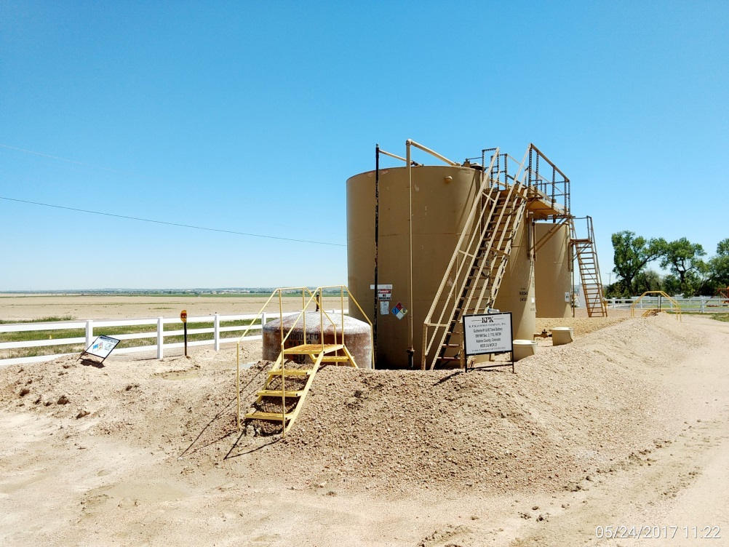
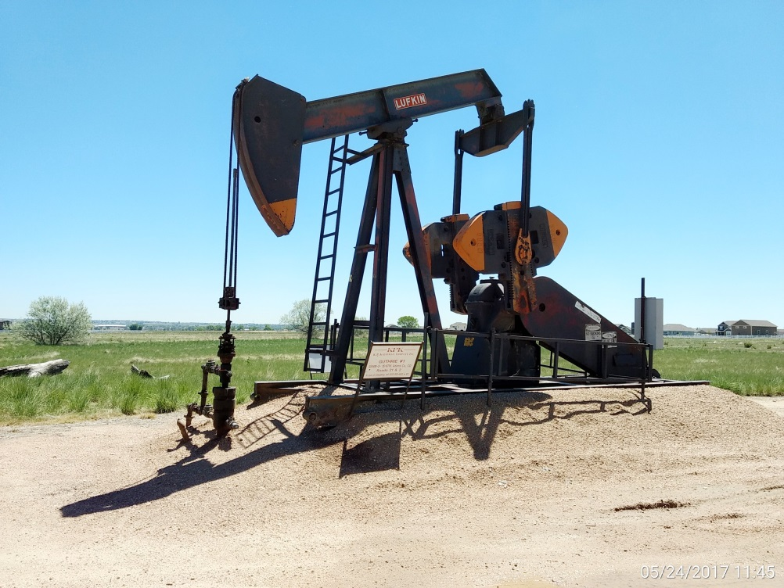
Inspection Photos
Location Name: Guthrie #2
API: 05-001-08358
Battery
Wellhead, pumping unit, & prime mover

