Slide 1
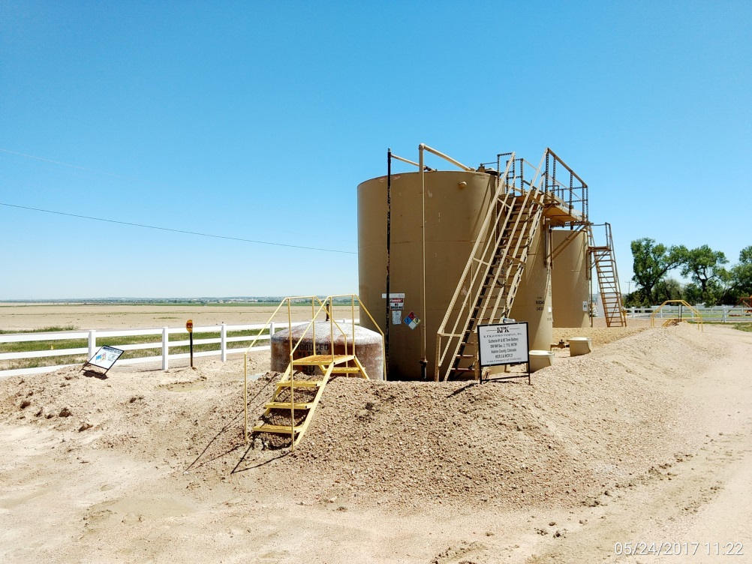
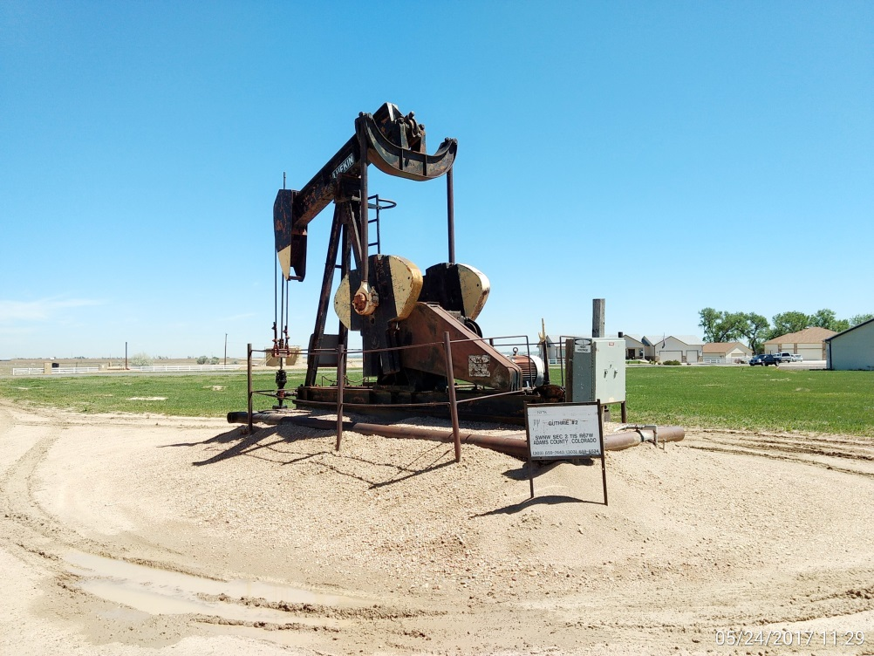
Inspection Photos
Location Name: Guthrie #1
API: 05-001-08349
Battery View
Wellhead, pumping unit, prime mover

Slide 2
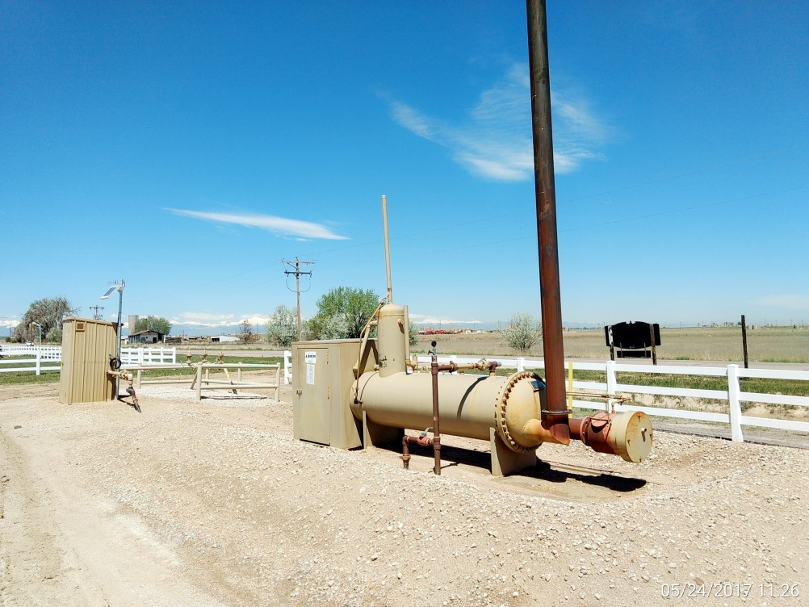
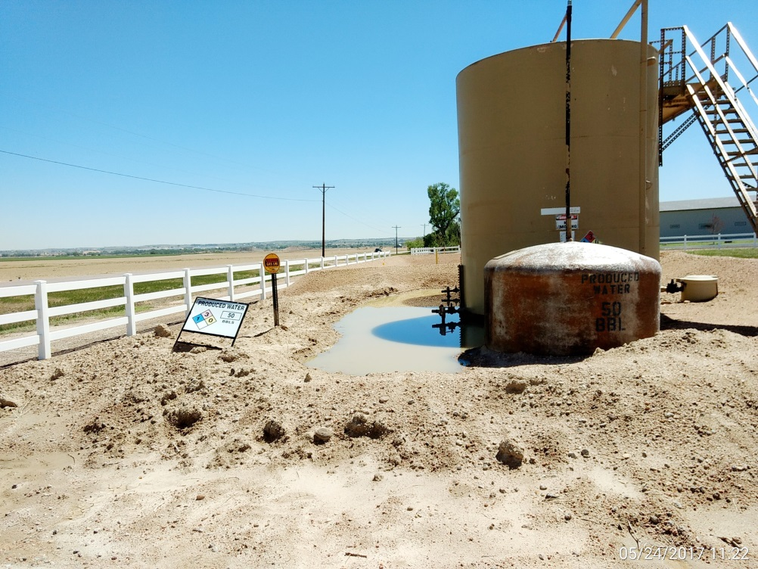
Inspection Photos
Location Name: Guthrie #1
API: 05-001-08349
Separator and meter run
Repair or install berms or other secondary containment devices per Rule 605.a.(4).

