Slide 1
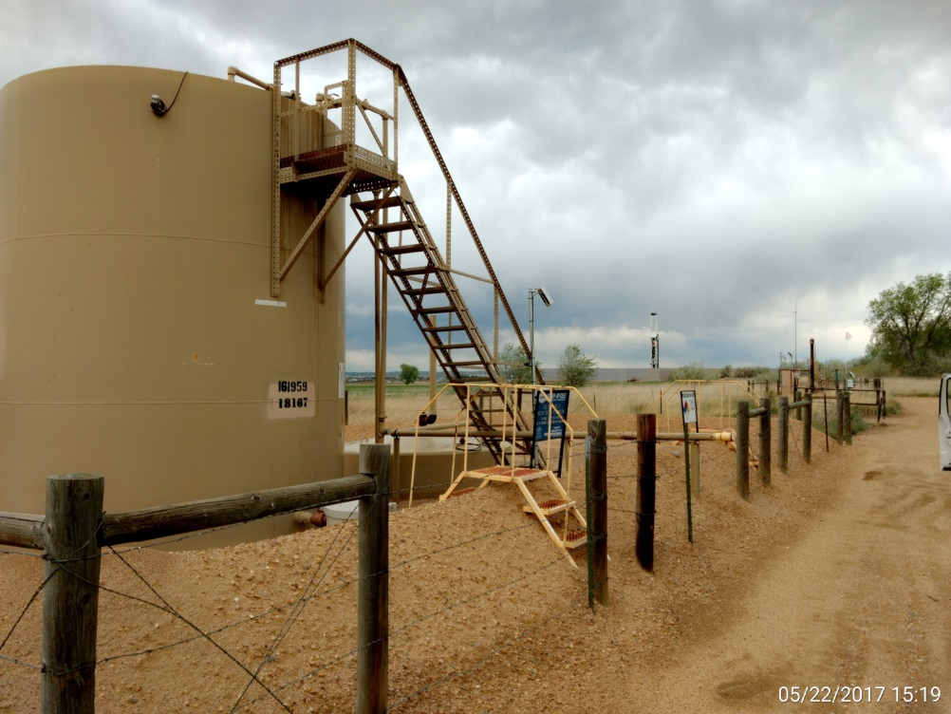
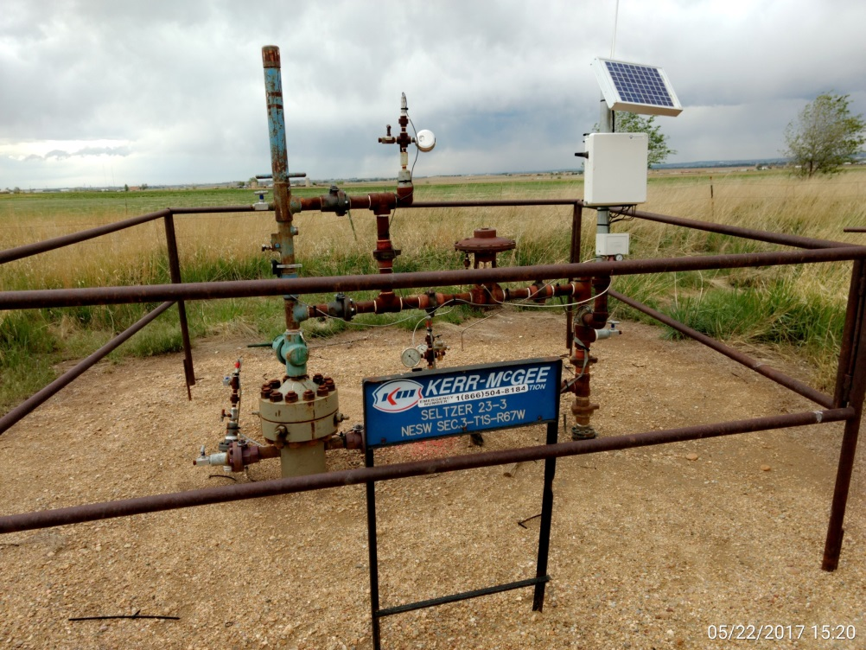
Inspection Photos
Location Name: Seltzer 23-3
API: 05-001-09119
Battery View
Wellhead View

Slide 2
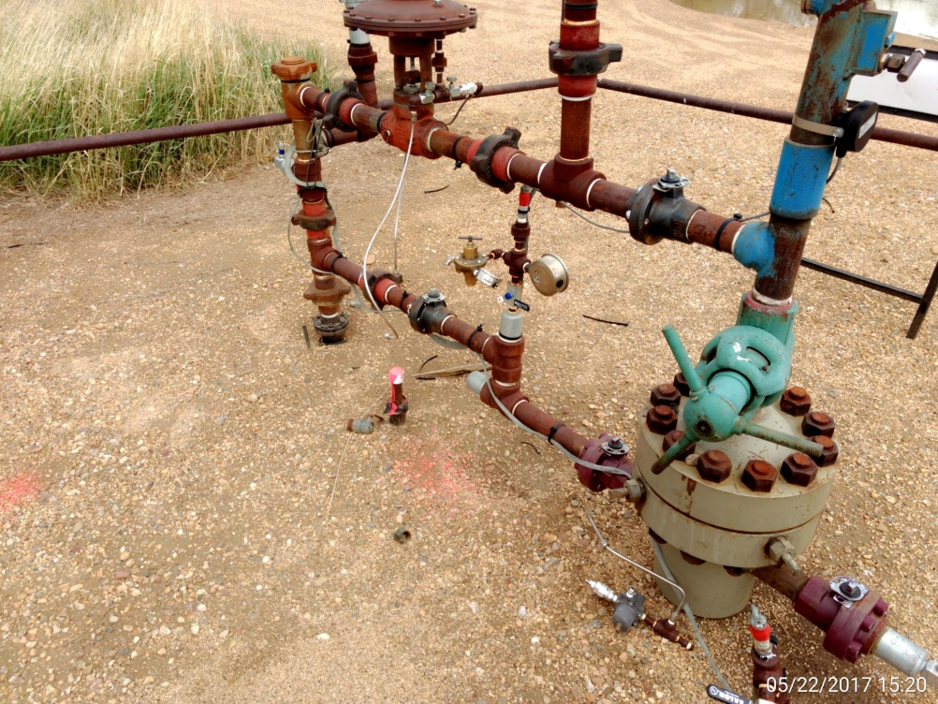
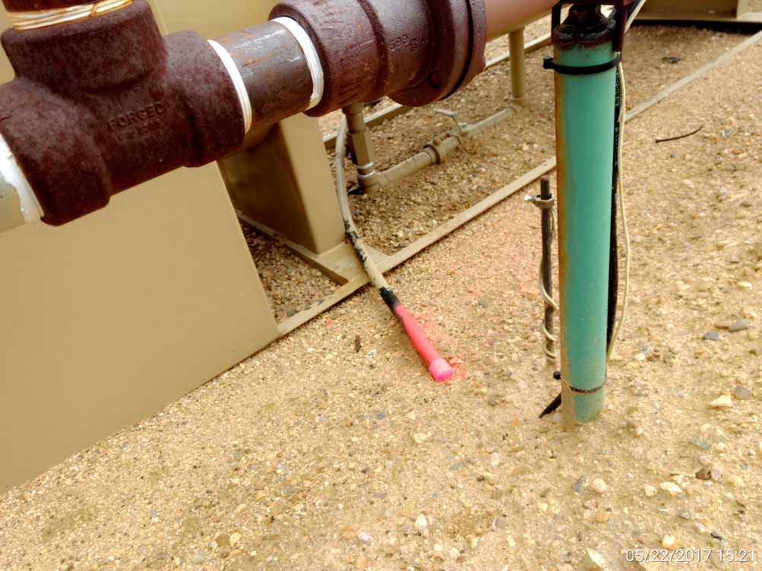
Inspection Photos
Location Name: Seltzer 23-3
API: 05-001-09119
Supply line @ wellhead, capped & marked
Supply line @ separator, capped & marked

